Slide 1
Institute of Chartered Accountants of India
Kottayam Branch
Filing of GSTR 9 & 9C for FY 2022-23
15.12.2023
Tony M P, FCA

Slide 2
Amendments in GSTR 1 & GSTR 3B
of October, 2023
(For the FY 2022-23)

Slide 3
Time limit - 30.11.2023 /Annual Return filed Date Whichever is earlier.
Section 16 (4) – Time limit for Availment of ITC for FY 22-23.
Section 34 (2) – Time limit for uploading of Credit Notes for FY 22-23.
Section 37 (3) – Time limit for Rectification of errors and omissions In Invoices for FY 22-23.
Section 39 (9) – Time limit for Rectification of any omission or incorrect particulars in GSTR 3B for FY 22-23.
Section 52 (6) – Time limit for Rectification of errors and omissions In TCS returns for FY 22-23.
Rule 37A – Time limit for Reversal of ITC, if supplier has not paid taxes for FY 22-23. ( Supplier filed GSTR 1 but has not filed GSTR 3B till 30.09.2023)

Slide 4
Electronic Credit Reversal and Re-claimed Statement” Balance declaration
“Electronic Credit Reversal and Re-claimed Statement” Balance declaration : The taxpayers have the opportunity to declare their opening balance as on 01.08.2023 for ITC reversal Until 30th November 2023.
3 (three) amendment opportunities to correct their opening balance.
However, after 30th November till 31st December 2023, only amendments will be permitted and the option for fresh reporting will not be available.
This amendment facility shall be discontinued after 31st December 2023.

Slide 5
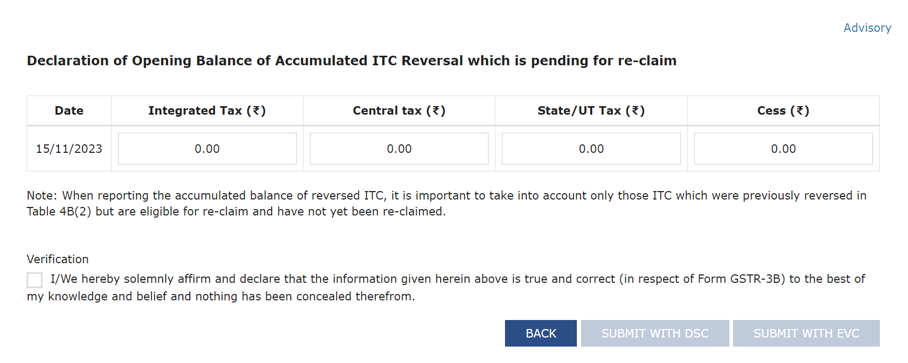
Electronic Credit Reversal and Re-claimed Statement” Balance declaration

Slide 6
Proper Reporting of eligible and ineligible ITC in GSTR 3B

Slide 7
Proper Reporting of ITC in GSTR 3B
Changes GSTR 3B format………..Table 4
Moving from GSTR 2A to GSTR 2B…….Auto population into GSTR 3B.
The concept of Permanent Reversal and Temporary Reversal….
ITC Credit Reversal Option in GST Portal. Giving opening balance on 01.08.2023.
CBIC Circulars and State Circulars on ITC availment and Reversal disclosures.
New Rules – Rule 88D & DRC 01C…for ITC Mismatch between GSTR 3B & GSTR 2B……. GST Portal Comes out with new functionality.
New Rules – Rule 88C & DRC 01B…for Output Tax Mismatch between GSTR 3B & GSTR 1………GST Portal Comes out with new functionality.
ITC Reversal under Rule 37A………..Supplier had filed GSTR 1,but GSTR 3B had not filed………….. New option in Portal.

Slide 8
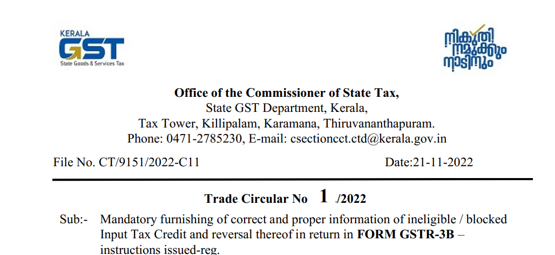
Proper reporting of Eligible and Ineligible ITC in GSTR 3B
Kerala State Trade Circular No: 1 dt 21.11.2022 – Mandatory furnishing of correct and proper information of ineligible / blocked Input Tax Credit and reversal thereof in return in FORM GSTR-3B

Slide 9
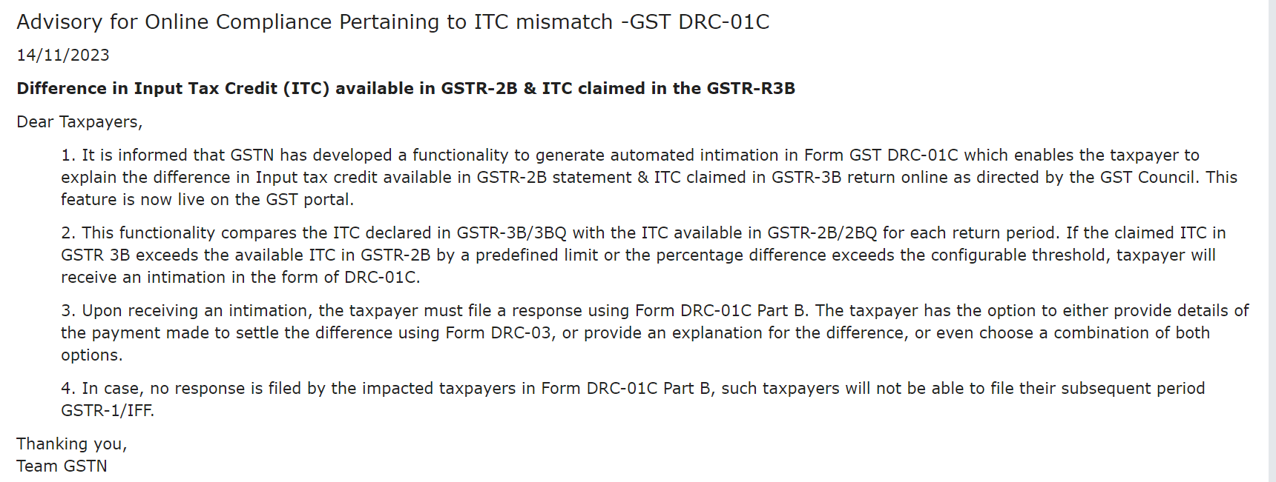
ITC mismatch -GST DRC-01C

Slide 10
ITC Reversal on Account of Rule 37(A)

Slide 11
Introducing Electronic Credit Reversal and Reclaimed statement

Slide 12
Filing of GSTR 9 for FY 2022-23

Slide 13
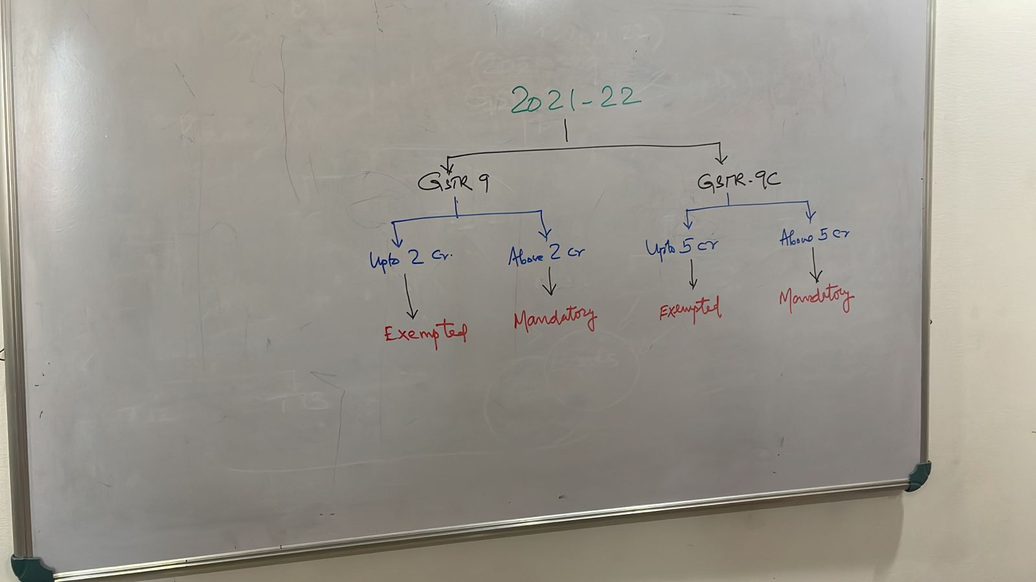

Slide 15
Data of FY 2022-23
Reported in 2022-23
Reported in 2023-24
3B
GSTR 1
3B
GSTR 1
Omissions/Corrections
GSTR 9 (Annual Return)
Tables 4 to 9
Table 10,11,12,13,14

Slide 16
22-23 : GSTR 3B
22-23 : GSTR1
2A
23-24: GSTR 3B
23-24 : GSTR1
4
5
6
7
8
9
10
11
12
13
14
Correction in Tax
DRC 03
22-23 BOOKS : Turnover / tax
22-23 BOOKS : ITC

Slide 17
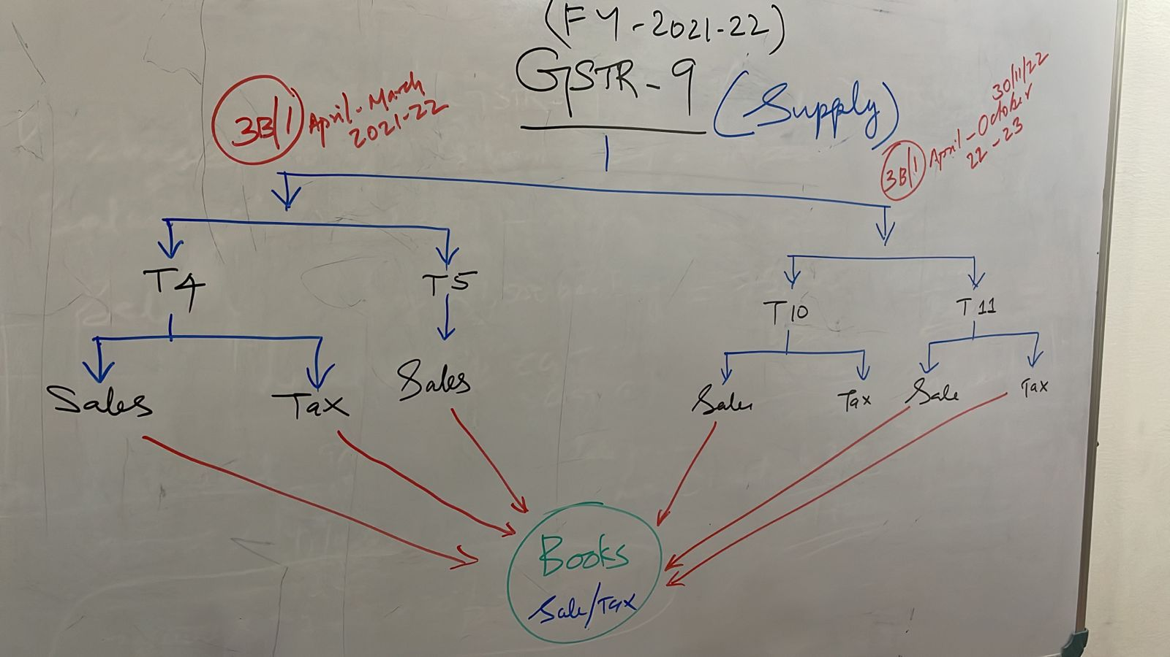

Slide 18
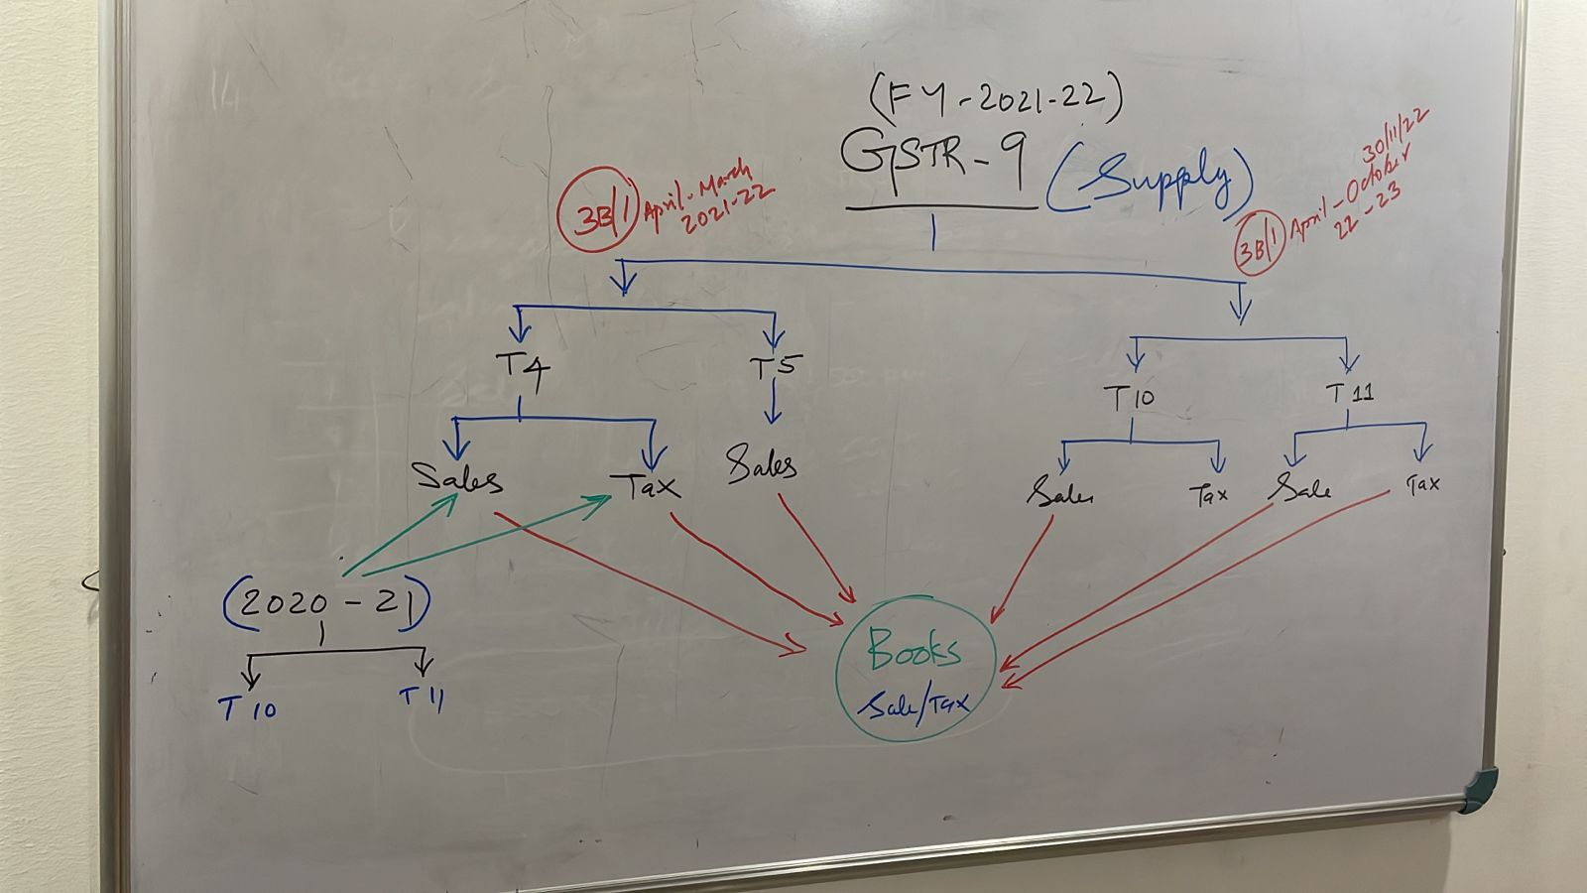
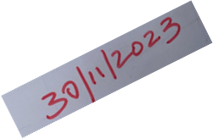
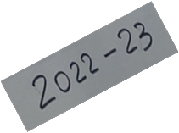
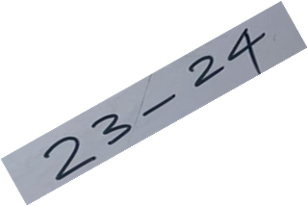

Slide 19
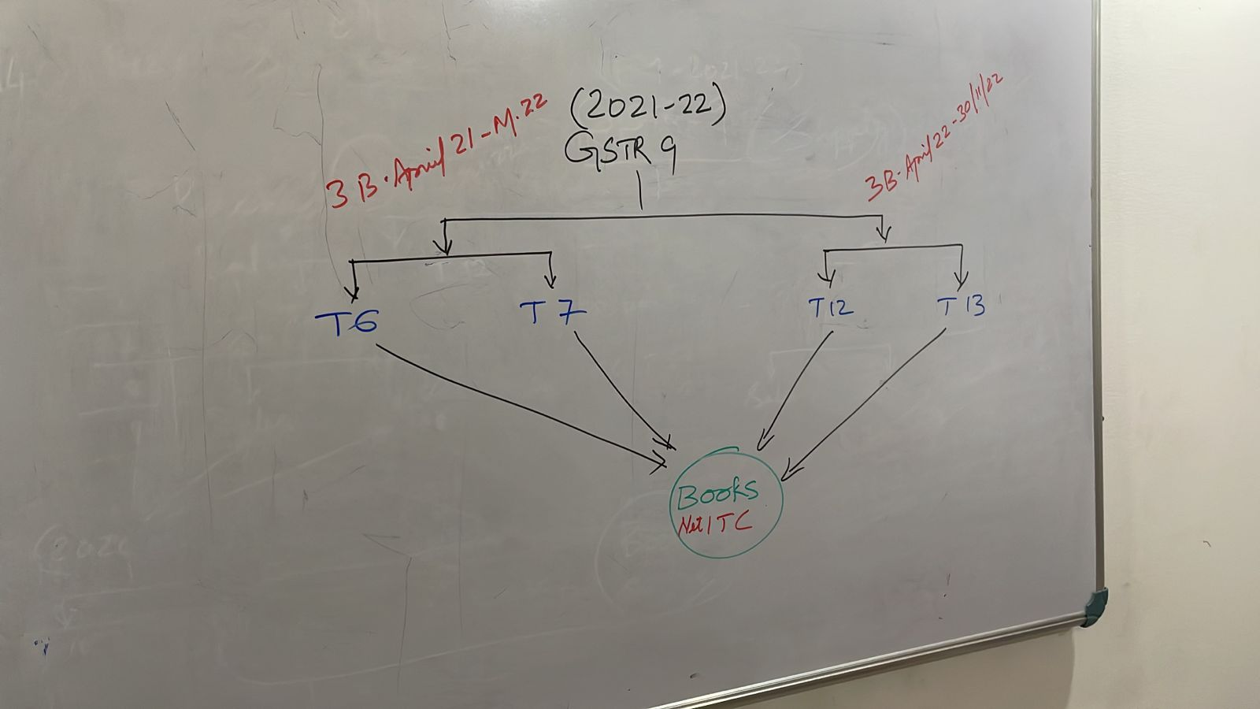

Slide 20
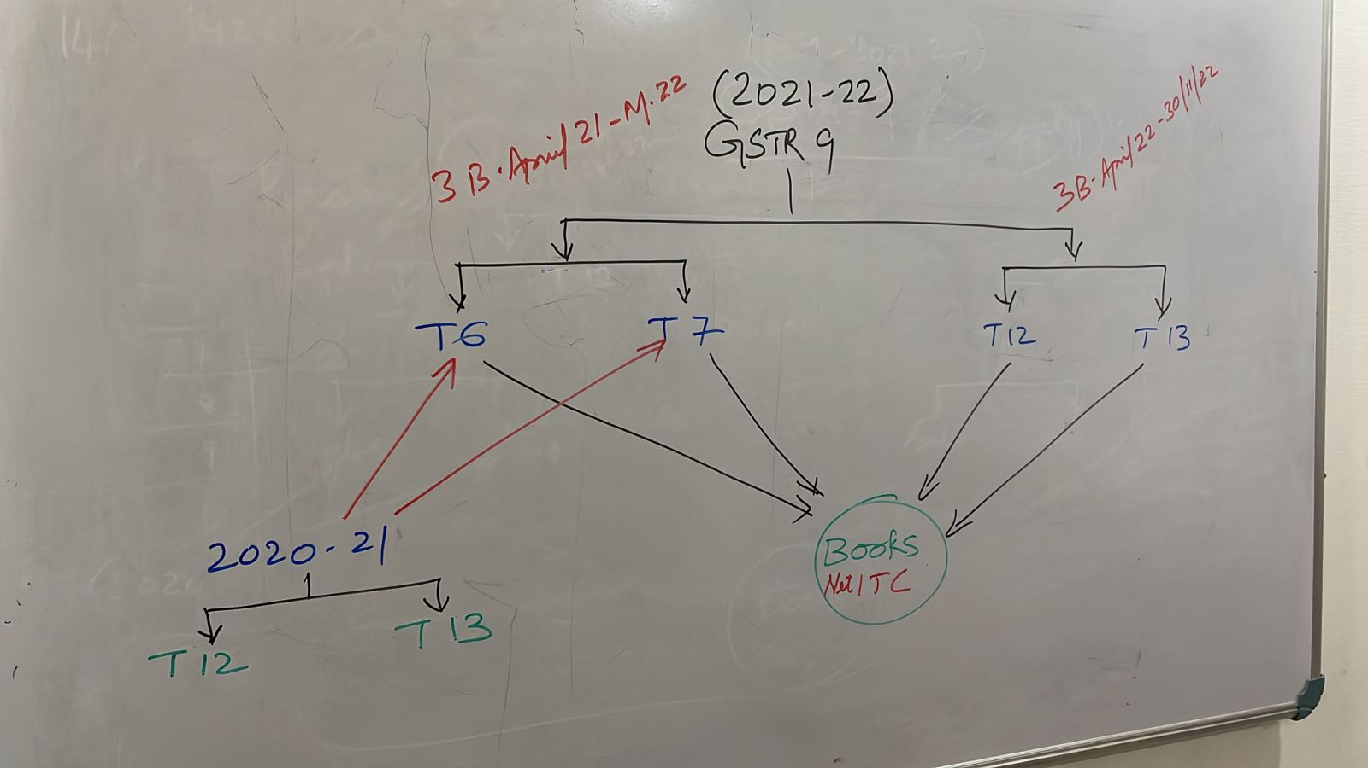
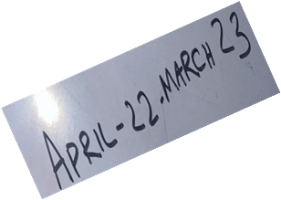
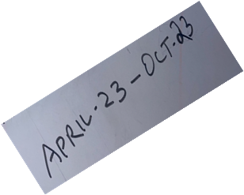

Slide 21
Relaxation in Annual Return Filing FY 2022-23

Slide 22
Relaxation in Annual Return Filing FY 2022-23
Entry No in GSTR 9 | Particulars | Relaxation
5D to 5E | Exempt, NIL Rate | Option to fill the total in Exempted
5H to 5K | CN, DN, Amendments + - | Option to fill 5A to 5F, Net off CN,DN,+,-.
6B to 6E | Input, Input Services, CG | CG shall be separate, Option to fill balance in Inputs
7A to 7H | Various Reversals | Separately or all amount in 7H.
12 to 13 | ITC Availment, Reversal of Prev. Year | Option not to fill this Tables.

Slide 23
Relaxation in Annual Return Filing
Entry No in GSTR 9 | Particulars | Relaxation
15A to 15D | Details of Refund | Optional
15E to 15G | Details of Demands | Optional
16A | Supply Received from composition Tax Payers | Optional
16B | Deemed Supply u/s 143 – Job Works | Optional
16C | Goods sent on Approval basis but not returned. | Optional

Slide 24
Relaxation in Annual Return Filing
Entry No in GSTR 9 | Particulars | Relaxation
17 | HSN Details of Outward Supplies | PY TO Upto 5Cr……4 digit (B2B- Mandatory, B2C –Optional.) PY TO Above 5 Cr…..6 Digits (Mandatory for both B2B and B2C.)
18 | HSN Details of Inward Supplies | Optional

Slide 25
Facilities in GST Portal

Slide 26
facilities in GST Portal
Download……… GSTR 3B Summary.
Download……… GSTR 1 Summary.
Download……… GSTR 9 System Computed Summary.
Verify……… Total Credit & Liability Statement.
Verify……… Liability (Other than Export & RCM).
Verify……… Liability …. Due to RCM.
Verify……… Liability ….. Due to Exports.
Verify……… ITC Credit claim and Due.

Slide 27
facilities in GST Portal

Slide 28
facilities in GST Portal

Slide 29
facilities in GST Portal

Slide 30
Annual Returns

Slide 32
How Annual Return is prepared?

Slide 33
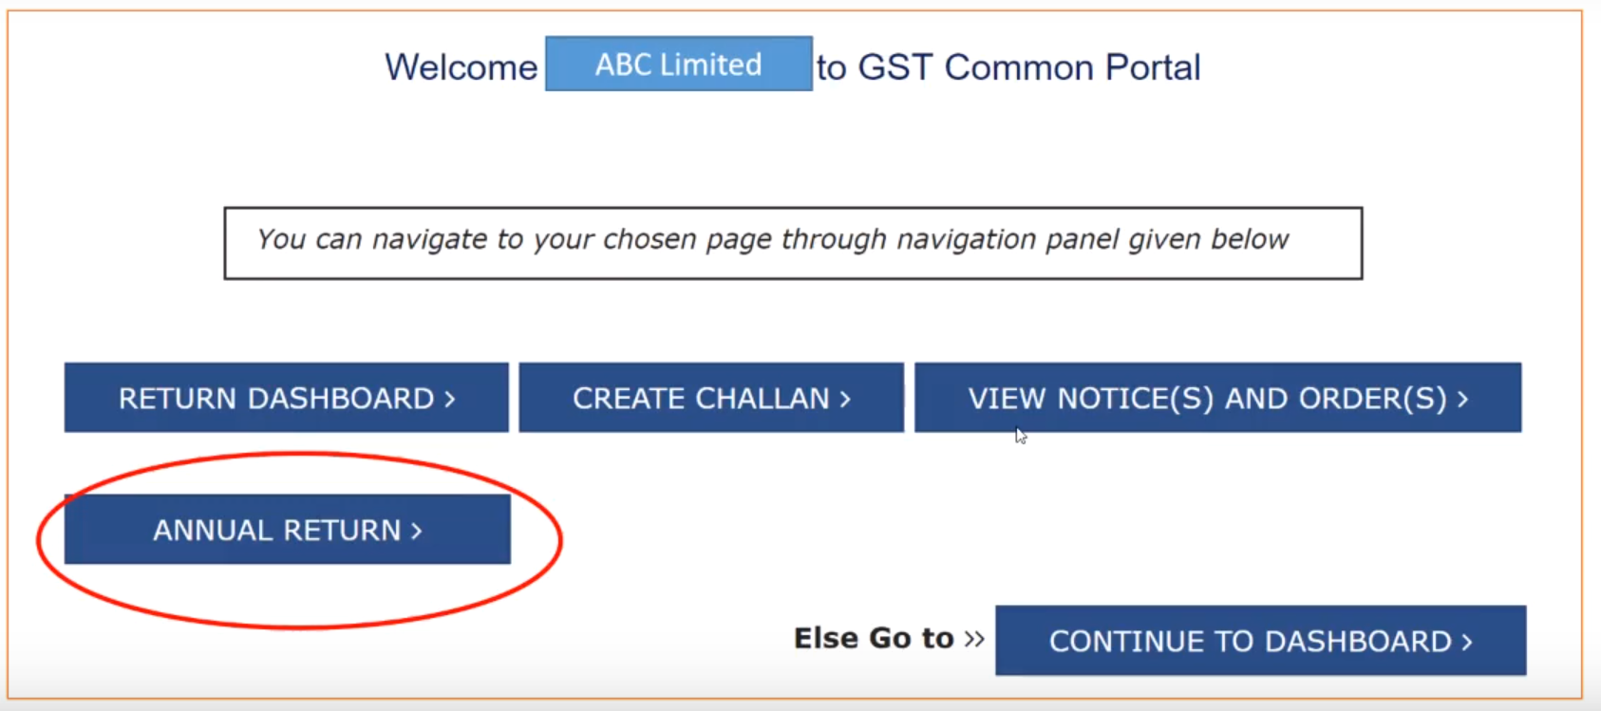

Slide 34
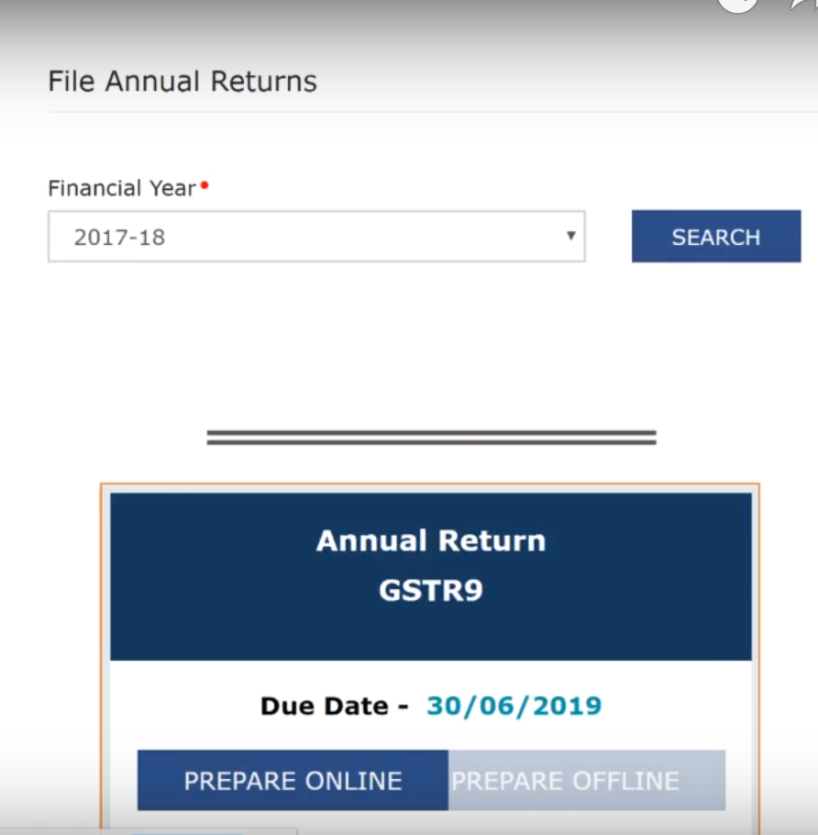

Slide 38
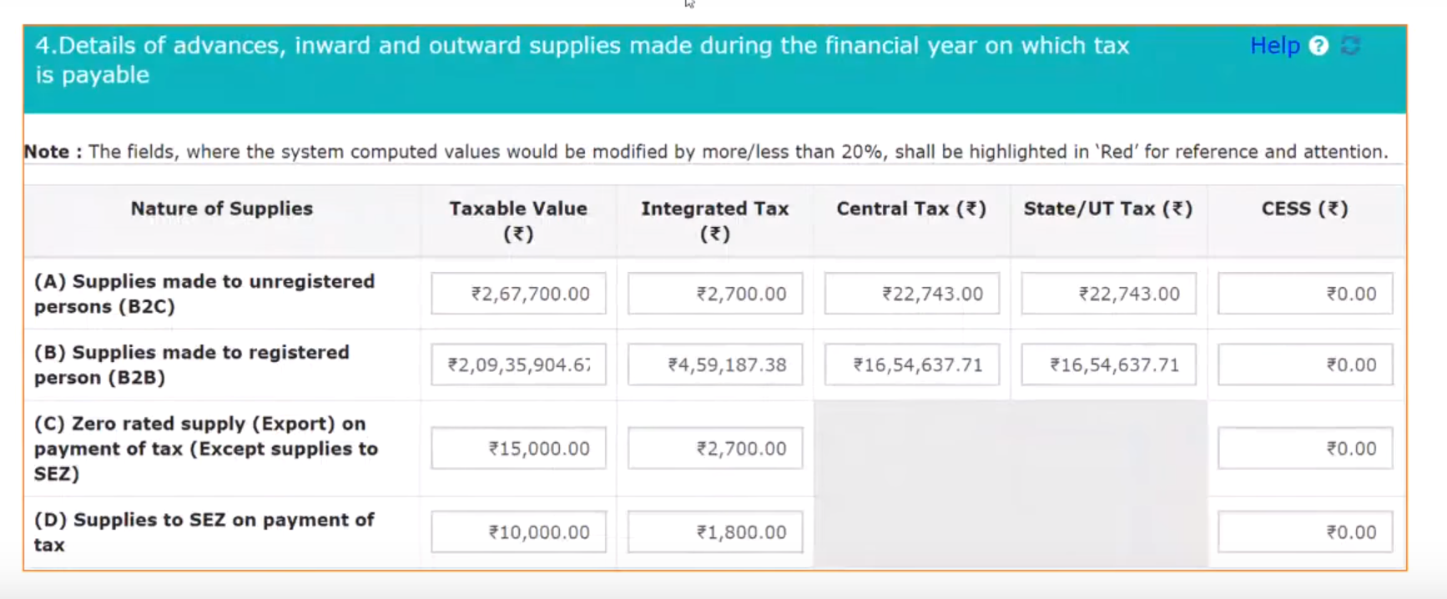

Slide 41
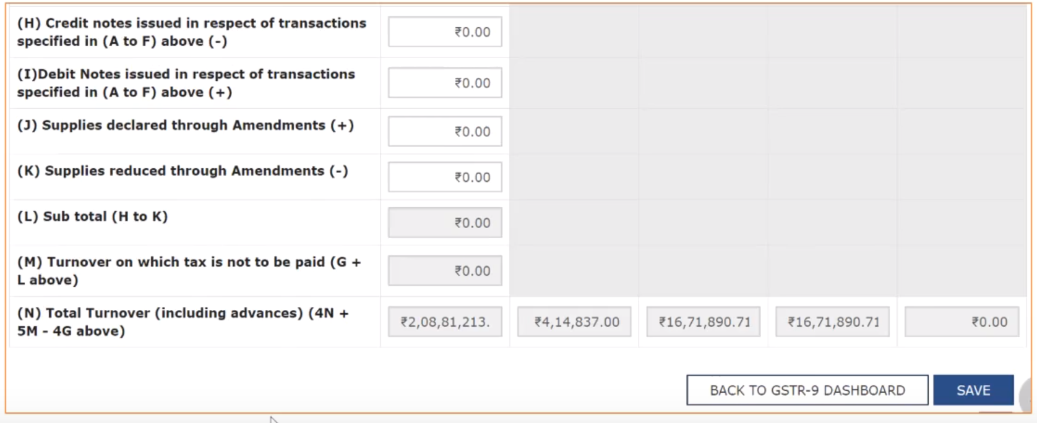

Slide 47
Reasons for variations in
ITC in 2A and ITC Table 8A

Slide 54
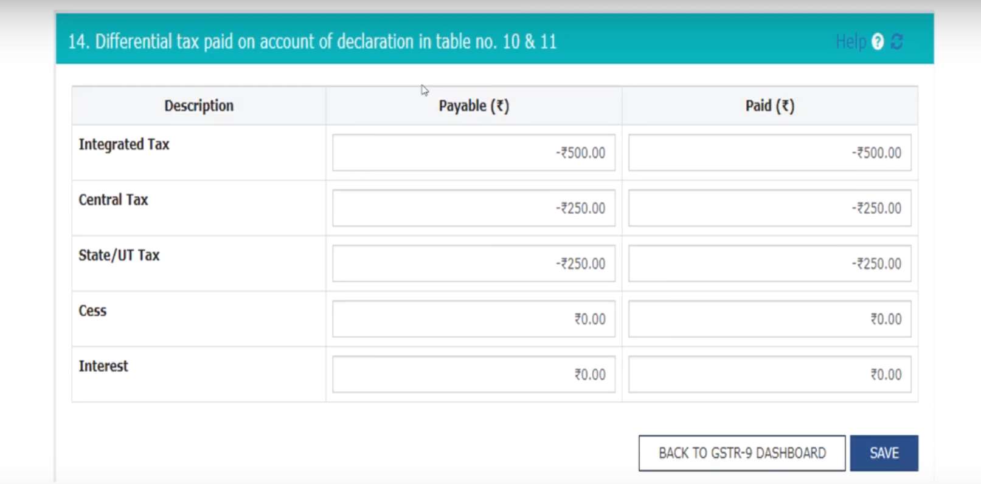

Slide 55
How turnover in books is tallied with GSTR 9
Turnover in books / Tax liability in Books / RCM in books = Table 4 – 4F- 4G + 5 + 10 – 11
ITC in books = Table 6 – 7 - 12 + 13

Slide 56
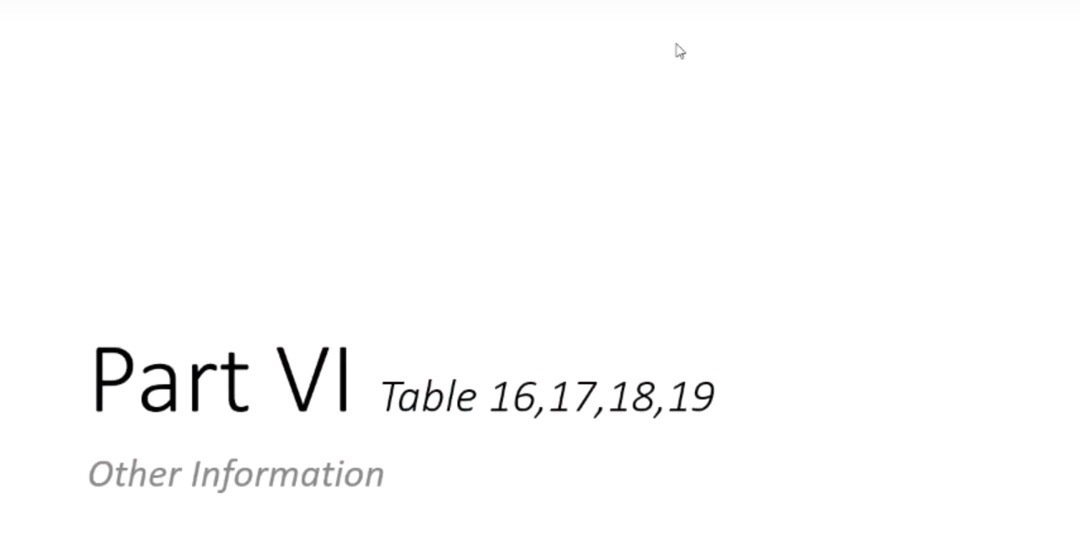

Slide 61
Additional Tax liability Reported in GSTR 9
Any Additional tax liability determined……. If reported in GSTR 9….pay in Cash……if not reported in GSTR 9…….pay using ITC.
Any liability omitted to be reported in GSTR 9…..can be reported in GSTR 9C…...
Any Additional tax liability determined……. If reported in GSTR 9C….pay in Cash……….any liability omitted to be reported in GSTR 9C…..can be paid using ITC .

Slide 62
ITC Reporting in Annual Return
(For the FY 2022-23)

Slide 63
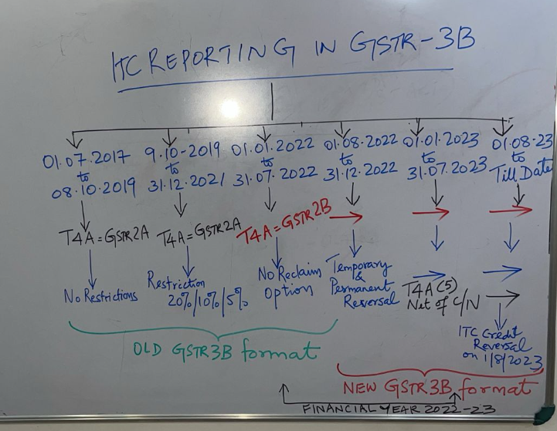

Slide 64
Changes in GSTR-3B
Upto 31.12.2021, Table 4(A)(5) of GSTR-3B is to be filled after considering GSTR-2A.
However, w.e.f. 01.01.2022, ITC claim will be allowed only if it appears in GSTR-2B. So, the taxpayers can no longer claim 5% provisional ITC w.e.f. 01.01.2022.. Section 16(2)(aa) of the CGST Act, 2017 also specifically states that the details of the invoice or debit note should be communicated to the recipient.

Slide 65
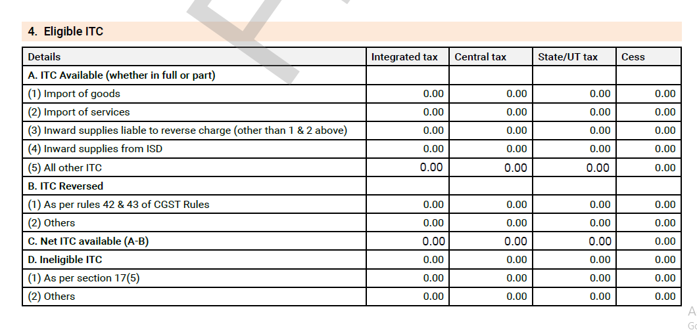
Table 4 of Old GSTR-3B

Slide 66
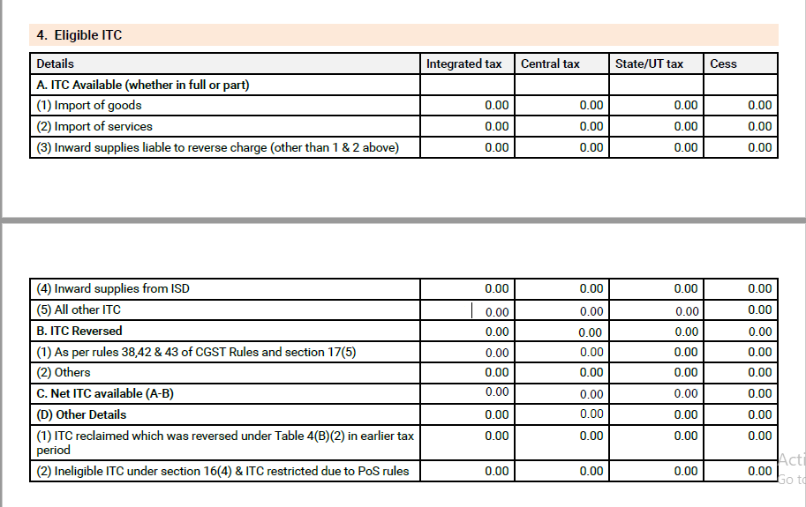
Table 4 of New GSTR-3B

Slide 67
ITC Comparison Sheet: FY 2022-23

Slide 68
Opening Balance Reporting for August 2023

Slide 69
ITC Reversal and Reclaim Ledger

Slide 70
Table 6 of GSTR-9

Slide 71
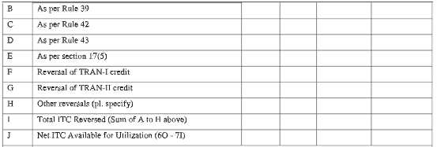
Table 7 of GSTR-9

Slide 72
Table 8 of GSTR-9

Slide 73
ITC Updation in Table 8A of GSTR-9

Slide 74
Instruction for Table 6H & 6J of GSTR-9

Slide 75
Instruction for Table 8D of GSTR-9

Slide 76
Instruction for Table 13 of GSTR-9

Slide 77
Table 12 of GSTR-9C

Slide 78
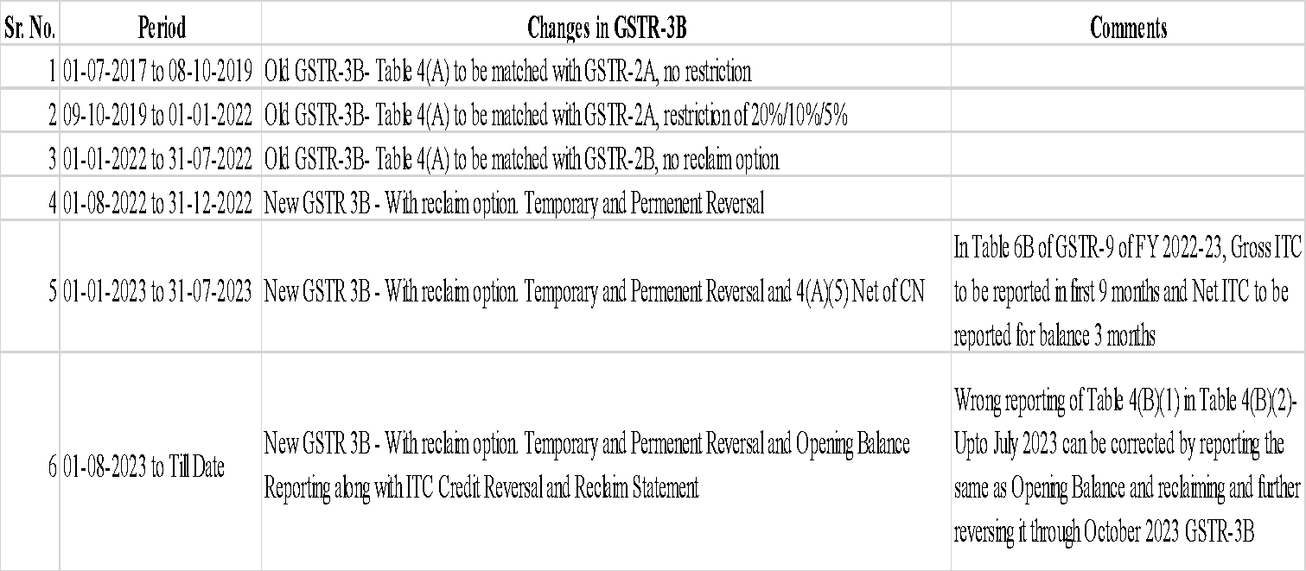
History of Changes in GSTR-3B

Slide 79
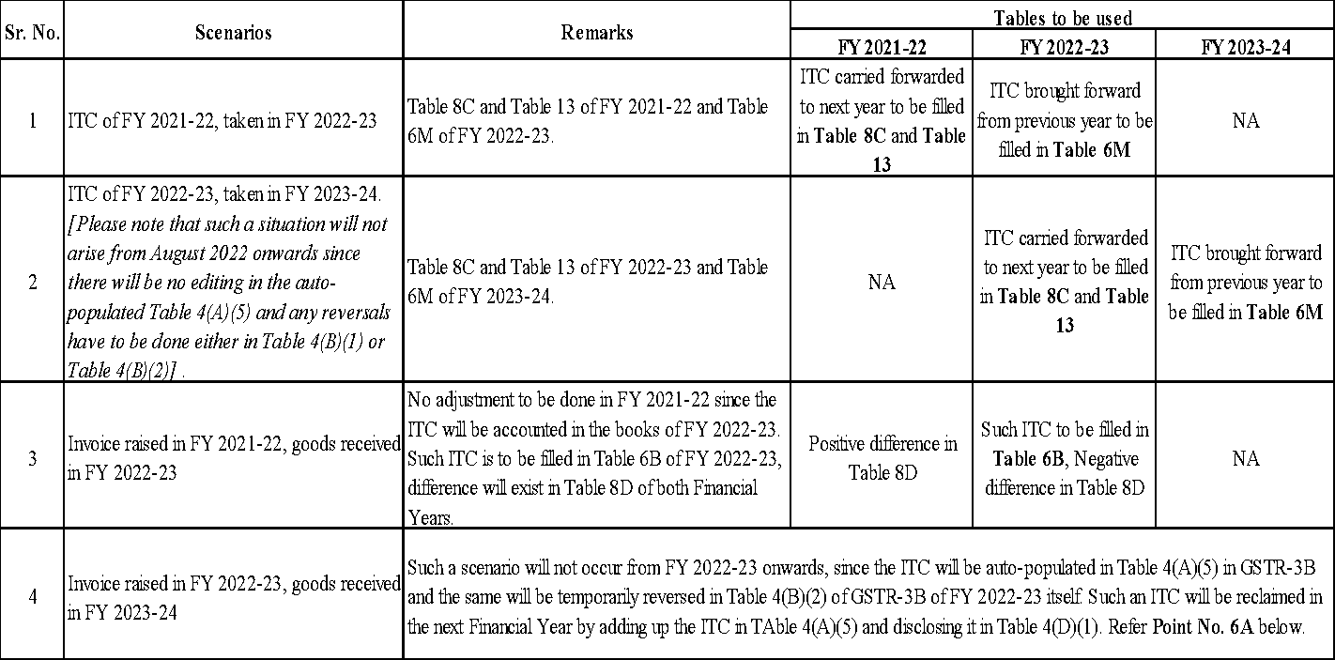
ITC Related Scenarios in GSTR-9

Slide 80
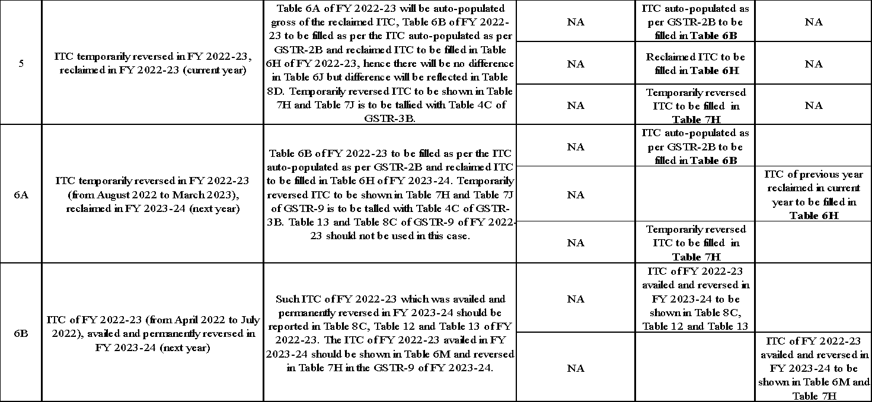

Slide 83
Filing of GSTR 9C for FY 2022-23

Slide 85
ITC updating done up to 31.07.2023 only…….!!!

Slide 86
GSTR 9C for FY 2022-23

Slide 87
Reconciliation Statement

Slide 88
Points to Remember
First file GSTR 3B, I , 9 ……before filing GSTR 9C.
If there are separate GSTIN for same PAN….. File separate GSTR 9C for each.
GSTR 9C reconciles Turnover, Tax and ITC …….between………………… GSTR 9 and Audited Financial Statement.
GSTR 9C…….is only a reconciliation statement…..and not a GST Audit.
Relaxations in Table 5 withdrawn……..except T5B…… All other items in Table 5 are mandatory for FY 22-23.
Table 14 of GSTR 9C ……ITC on Expenses wise……is optional for FY 22-23.
Any Additional tax liability determined……. If reported in GSTR 9C….pay in Cash……….any liability omitted to be reported in GSTR 9C…..can be paid using ITC .

Slide 89
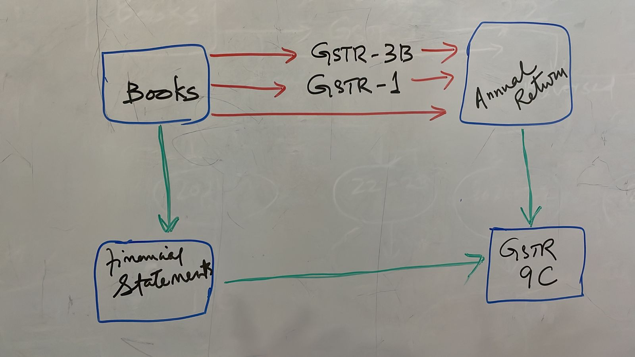

Slide 90
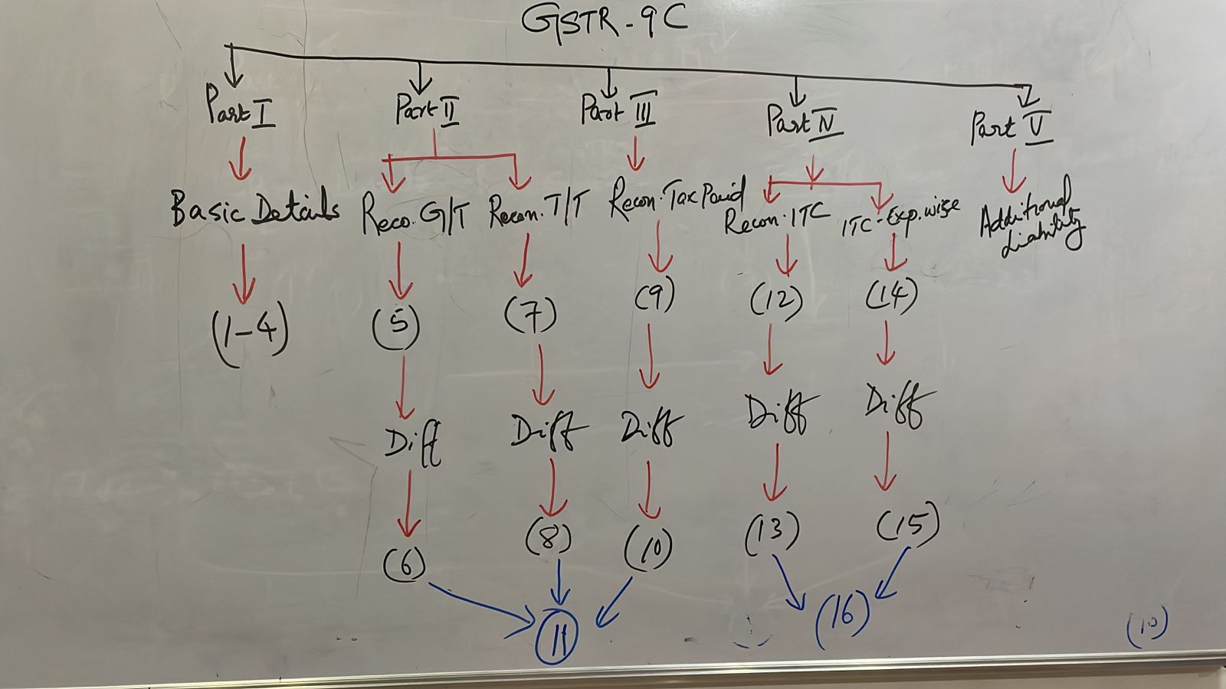

Slide 91
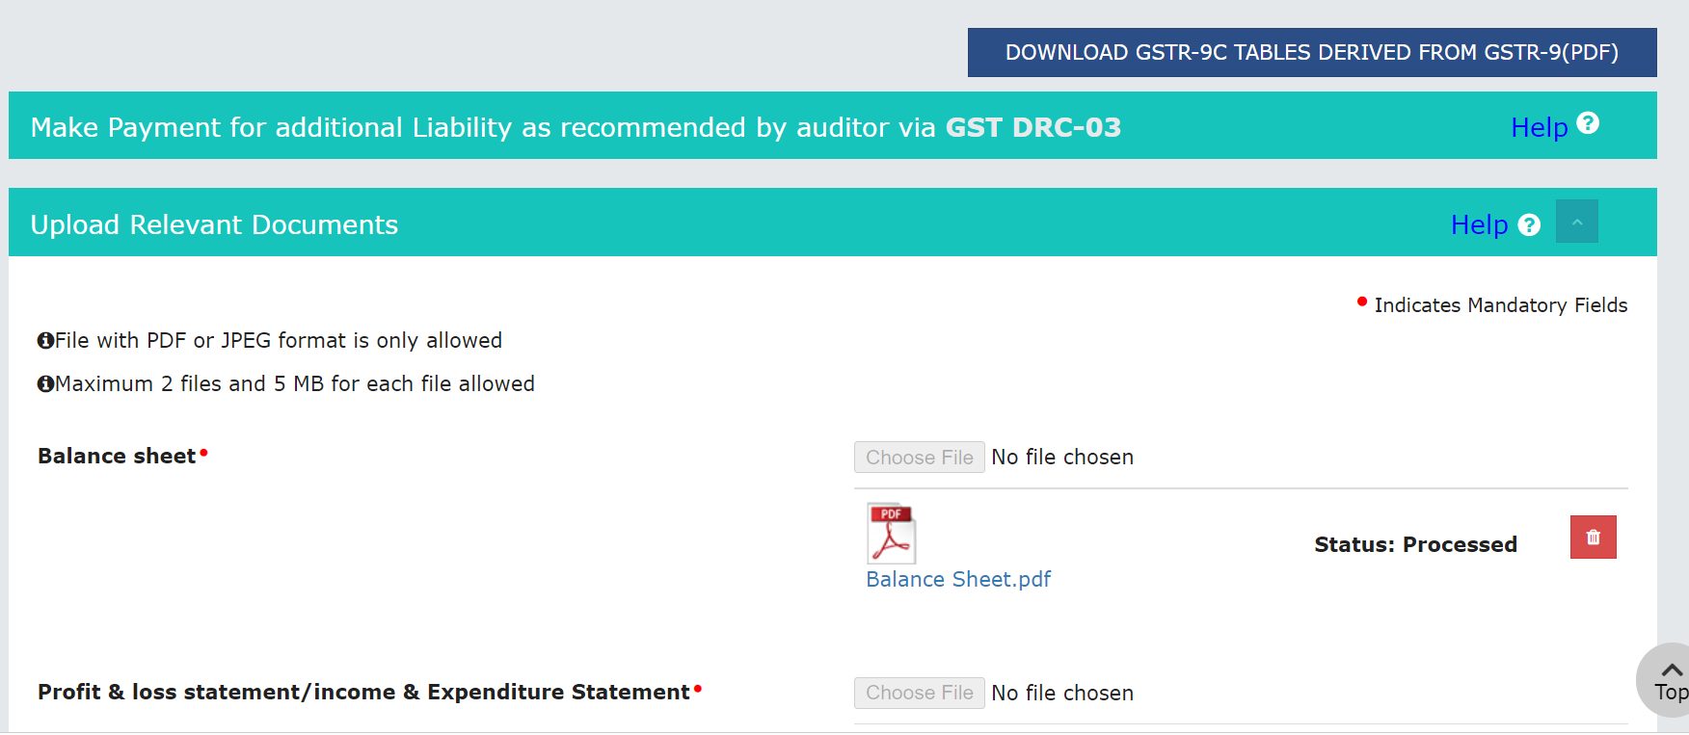

Slide 92
Tables of GSTR 9 Down loaded from Portal

Slide 93
Tables of GSTR 9 Down loaded from Portal

Slide 94
Tables of GSTR 9 Down loaded from Portal

Slide 95
Tables of GSTR 9 Down loaded from Portal

Slide 96
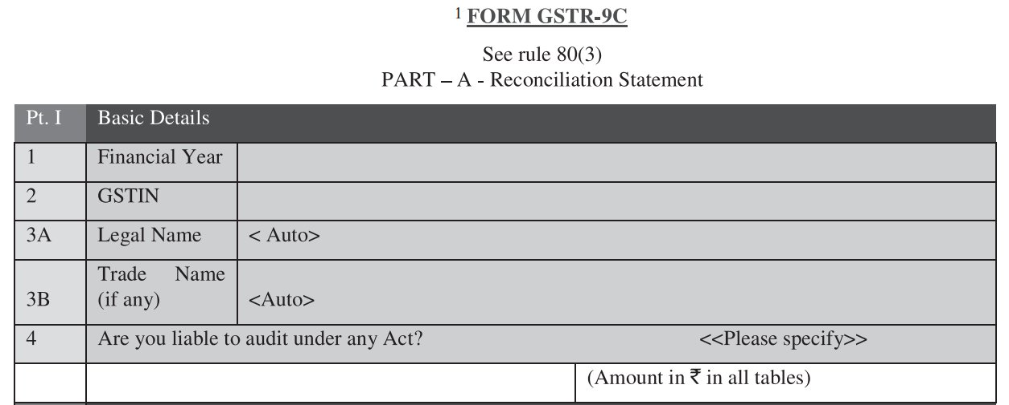

Slide 97
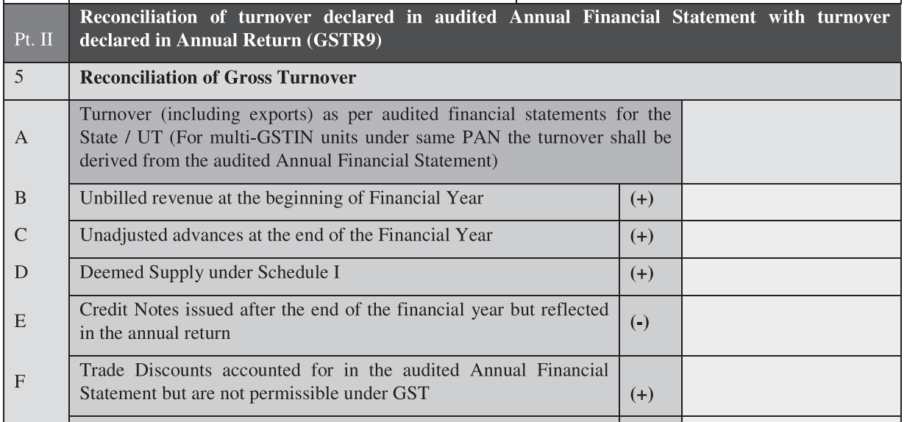

Slide 98
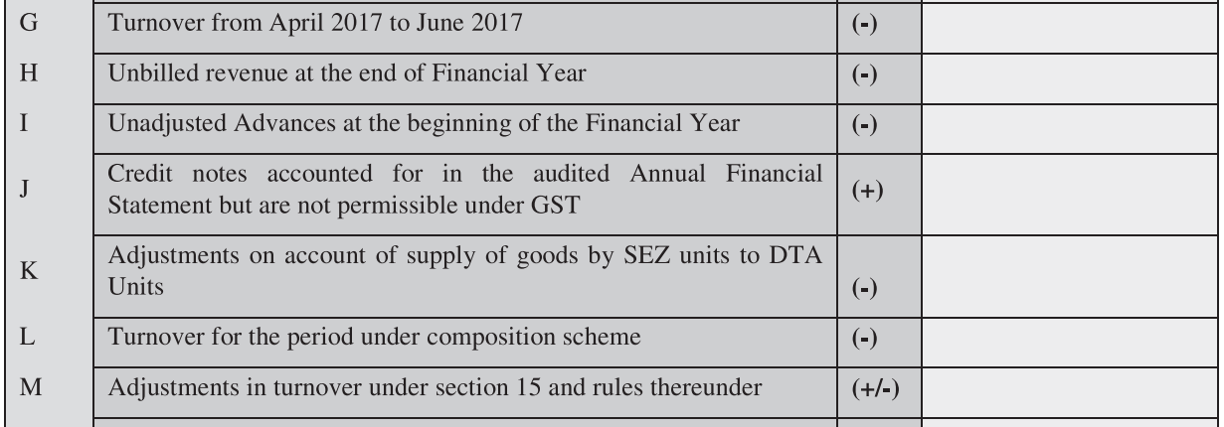

Slide 103
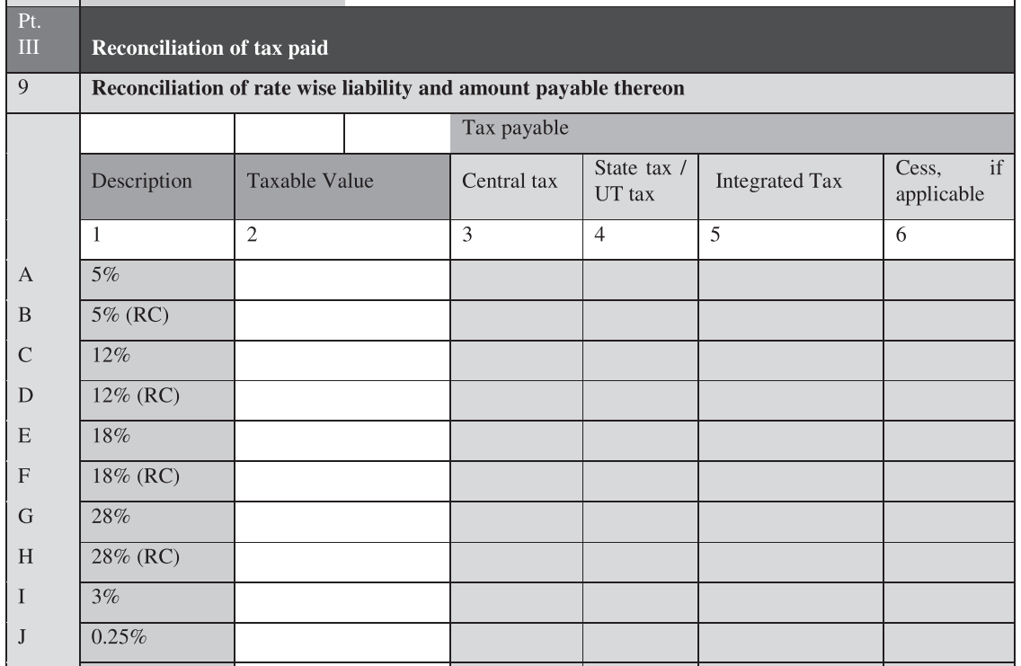

Slide 104
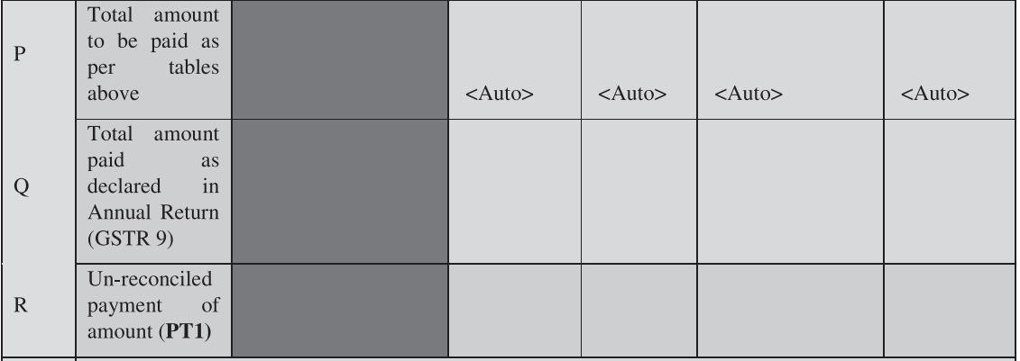

Slide 106
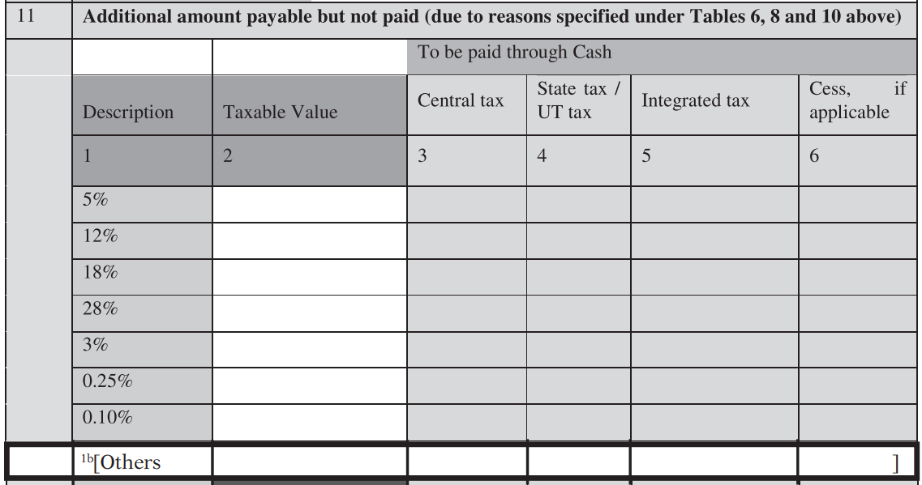

Slide 107
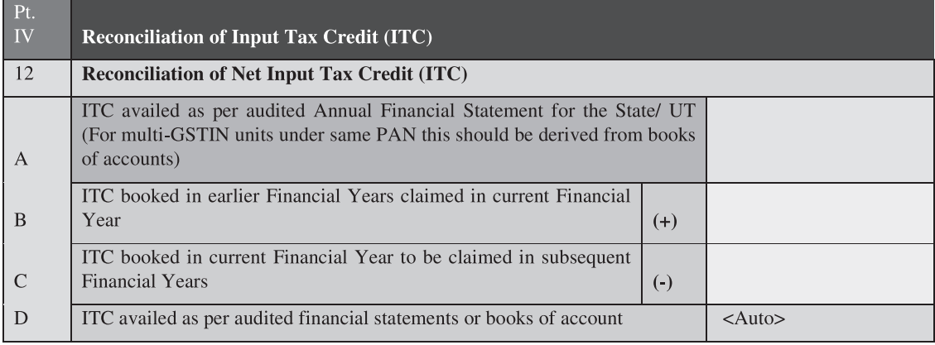

Slide 109
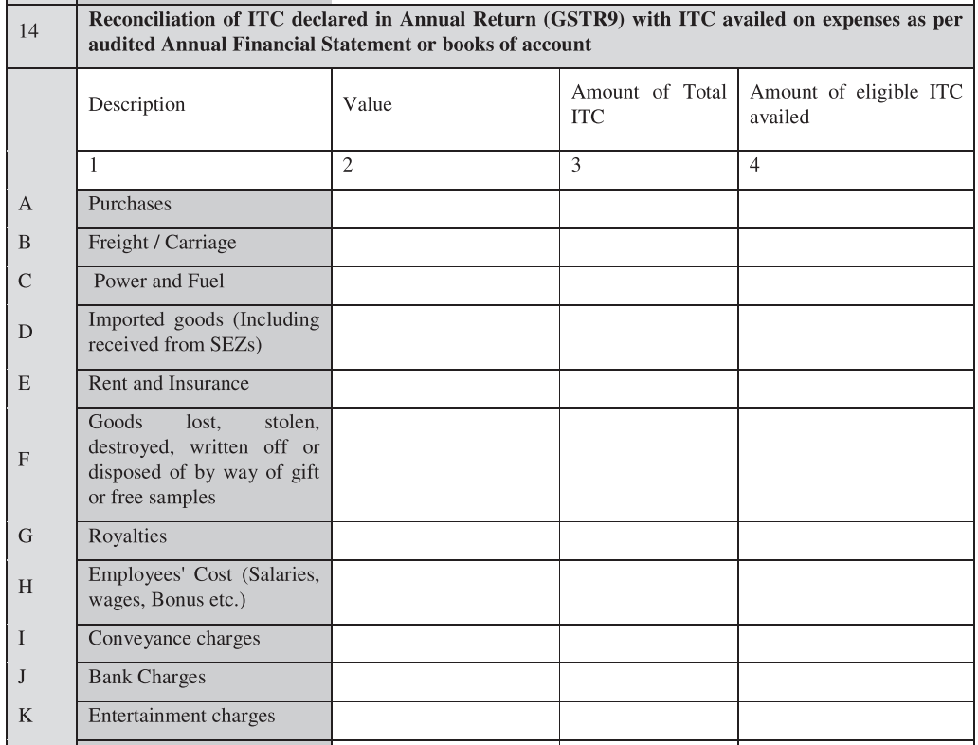

Slide 110
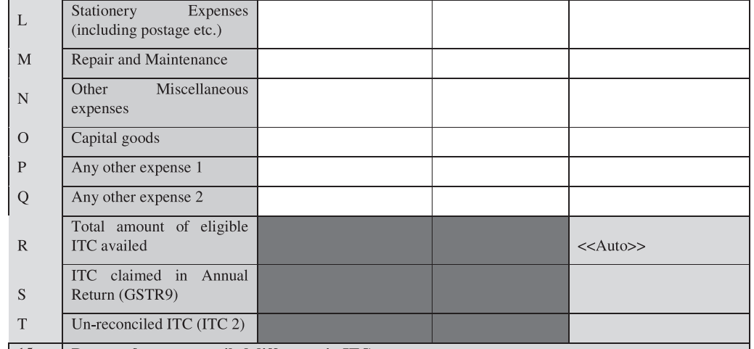

Slide 113
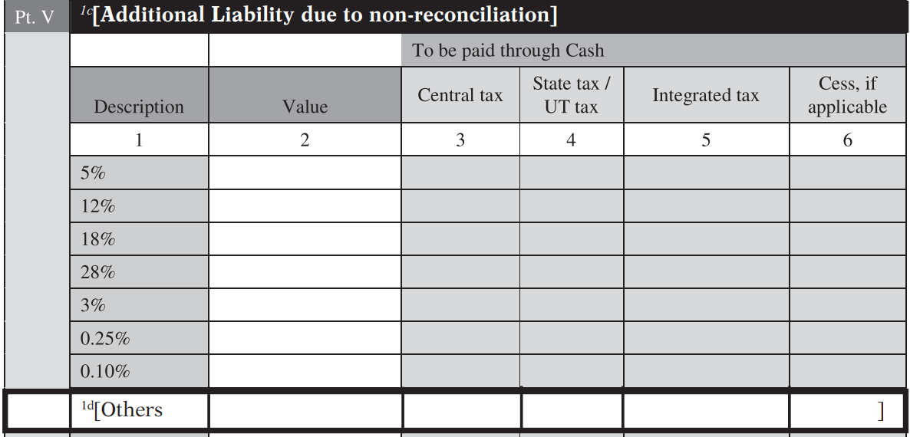

Slide 114
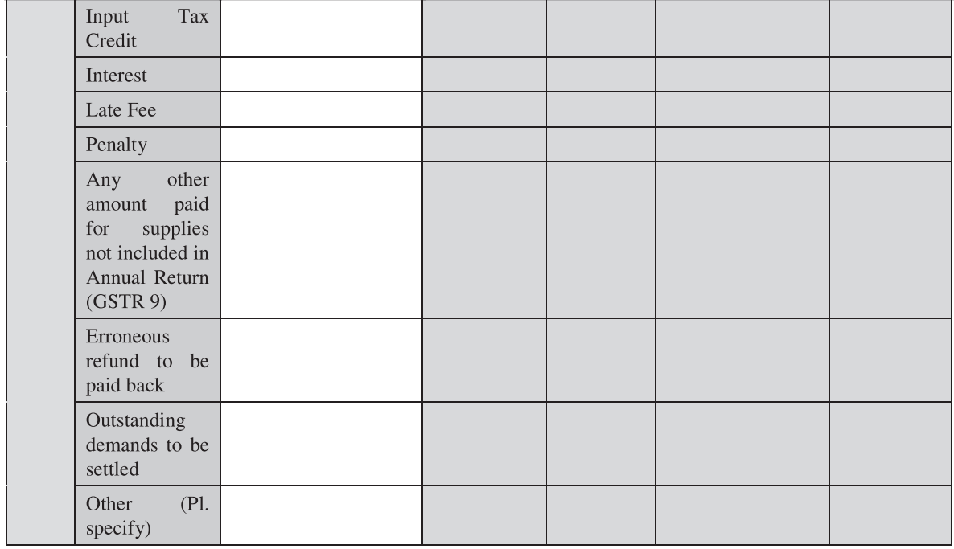

Slide 116
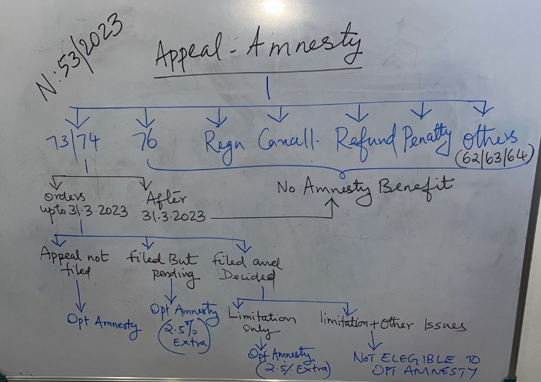

Slide 117
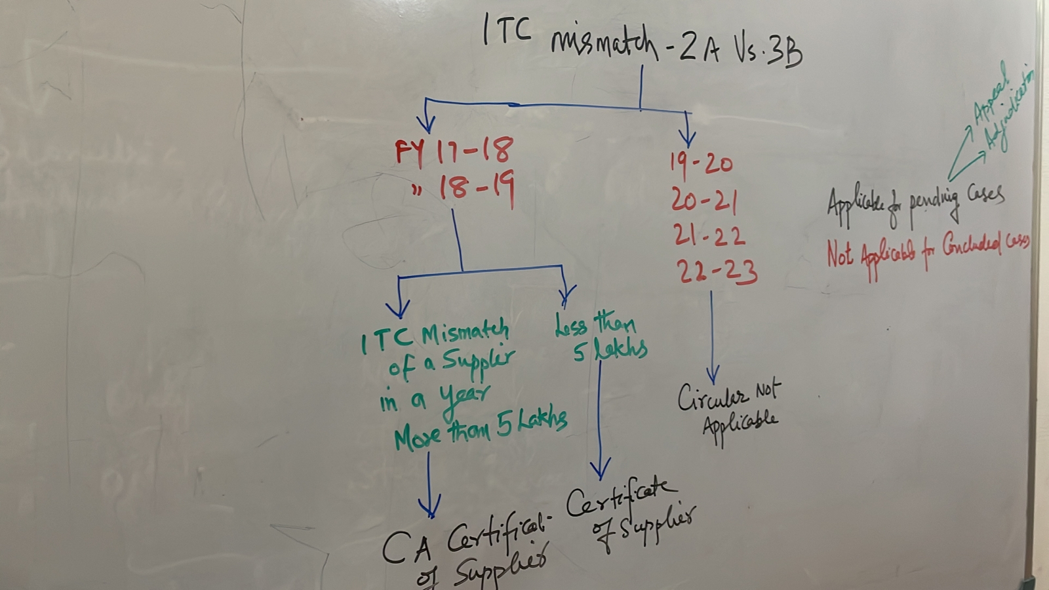

Slide 118
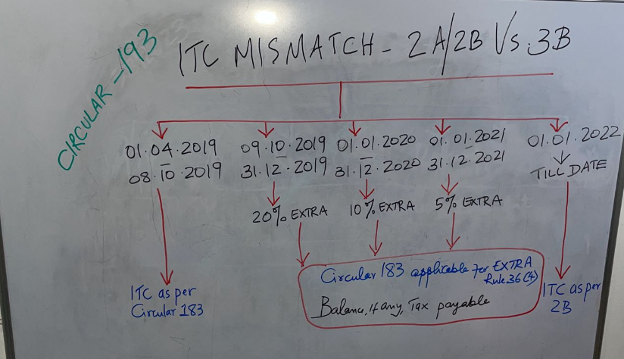

Slide 119
Thank You

Slide 120
Questions?

