Slide 1
OPPORTUNITIES FOR CAs IN DIGITAL ERA

Slide 2
What can Technology Do?
Easier process
Automated Tasks
Safer Transactions
Keep up with the competition
Advanced-Data Analysis
Reducing mistakes
Technology for Improving Audit Quality
Increased Customer Satisfaction
Frame a poem on Samruddhi by Digital Transformation. How it is an opportunity for chartered accountants

Slide 4
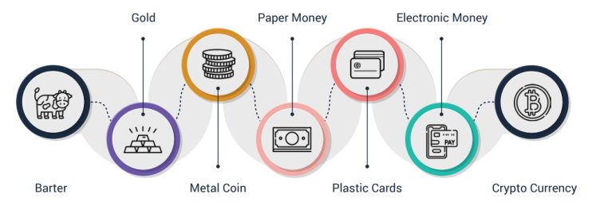
EVOLUTION OF TRADE

Slide 5
CHANGING BUSINESS SCENARIO

Slide 6
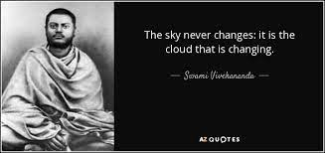
WHY TRANSITION?
The integration of technology and the growing complexity of financial transactions have created various opportunities for CAs.
Paradigm shift
Technology, small globe
Huge Expectations
Time to Grow
Anytime anywhere
NO ONE CAN STOPS YOUR GLOBAL APPEARANCE

Slide 7
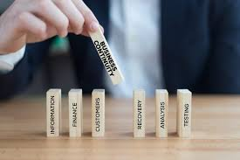
BUSINESS CONTINUITY & DISASTER RECOVERY MANAGEMENT

Slide 9
DUAL PERSPECTIVE

Slide 10
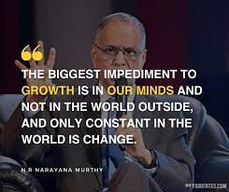

Slide 11
KEY CHALLENGES
Cost of Technology Adoption
Resistance to Change
Proper Training / updating
Regular Upskilling
Automation and Job Displacement
Data Security and Privacy
Ethical Concerns
Rapid Technological Changes
Regulatory and Compliance Complexity
Digital Divide
Client Expectations
Lack of Standardization

Slide 12
CA’s OFFICE

Slide 13
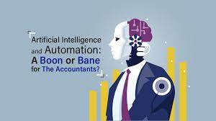
“A positive mind finds opportunity in everything. A negative mind finds fault in everything.”

Slide 14
Regulatory and Ethical Oversight
Interpersonal Skills
Complex Decision-Making
Contextual Understanding
Creativity and Innovation
Strategic Advisory
Varied Specializations
Human-Centered Roles
Regulatory Complexities

Slide 15
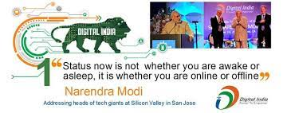

Slide 16
WHAT IS DIGITAL TRANSFORMANTION?
Digital transformation can be defined as the process of utilizing modern technology to create new—or modify existing—business processes, culture, and customer experiences.
This reimagining of business in the digital age equips organizations with the tools necessary to keep up with competitors and meet changing market requirements.

Slide 17
AREAS OF DIGITAL TRANSFORMANTION
PROCESS TRANSFORMATION
It will modernize an organization’s processes, integrate new technology, save money, and better incorporate core systems.
BUSINESS MODEL TRANSFORMATION
Netflix, Uber, Apple, I-Tunes
DOMAIN TRANSFORMATION
Online retailer, Amazon, which expanded into a new market domain with the launch of Amazon Web Services (AWS).
CULTURAL/ ORGANIZATIONAL TRANSFORMATION
Align its digital transformation efforts with its internal values and behaviors
Change Management and Employee Adoption

Slide 19
Audit Automation
Automation of PLANNING
Automation of SAMPLING
Connecting observation to report – travel to report- red flags
Impairment – consequential checklist
Audit Trail
Memos – reaching to Report
Automatic working paper
Time stamp
ERP for audit
Embrace the change

Slide 20
USEFUL DIGITAL TOOLS FOR CAs

Slide 21
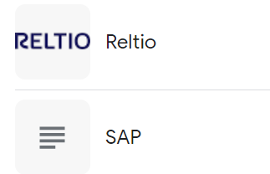
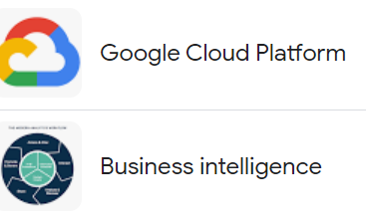
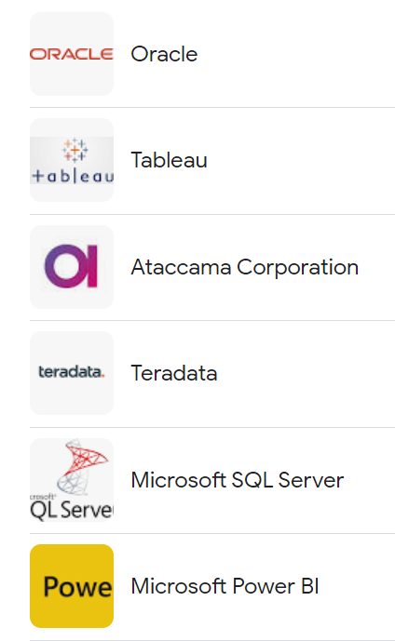
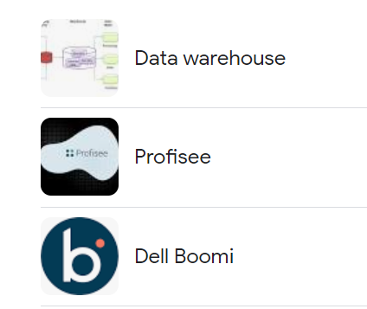
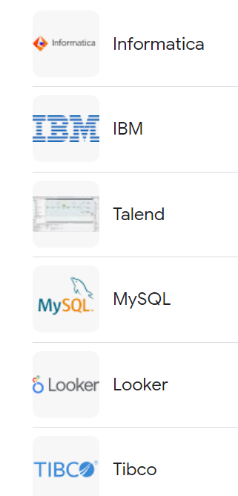
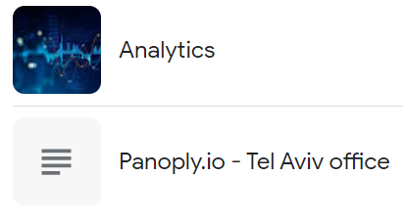
DATA MANAGEMENT TOOLS

Slide 22
Accounting Software
QuickBooks: A widely-used accounting software for small businesses, offering features like invoicing, expense tracking, and financial reporting.
Xero: Cloud-based accounting software with tools for bank reconciliation, inventory management, and financial analysis.
FreshBooks: Designed for service-based businesses, it offers time tracking, client management, and online payment options

Slide 23
Data Analytics and Reporting
Microsoft Excel: A powerful tool for data analysis, financial modeling, and creating custom reports.
Tableau: A data visualization tool that helps CAs present financial data in interactive and meaningful ways.
Power BI: Microsoft's business analytics service for creating reports and dashboards with real-time data.

Slide 24
Document Management
Dropbox or Google Drive: Cloud storage solutions for securely storing and sharing financial documents with clients.
DocuWare: A document management system that enables efficient storage, retrieval, and collaboration on documents.

Slide 25
Communication and Collaboration
Slack: A team communication platform for seamless collaboration and sharing of information with clients and colleagues.
Microsoft Teams: A hub for teamwork that integrates chat, video conferencing, file sharing, and app integration.

Slide 26
Project Management
Trello: A visual project management tool that helps CAs organize tasks, track progress, and manage deadlines.
Asana: A task and project management tool that allows for team collaboration and task tracking.

Slide 27
Digital Signature and Document Signing
DocuSign: A popular tool for digitally signing documents and contracts securely.
Adobe Sign: Adobe's digital signature solution for streamlining document signing processes.

Slide 28
Tax and Compliance
Thomson Reuters ONESOURCE: A tax compliance and reporting platform for managing various tax-related processes.
Avalara: A tool for automated sales tax calculations, returns filing, and compliance management.

Slide 29
Online Learning and Professional Development
Coursera, LinkedIn Learning: Platforms offering courses to help CAs stay updated on industry trends, regulations, and skills.
AICPA and ICAI Websites: Institutes often provide webinars, resources, and updates for professional development.

Slide 30
Financial Analysis and Forecasting
Prophix: A software for financial planning, budgeting, and forecasting.
Anaplan: A platform for integrated business planning, allowing CAs to create financial models and scenarios.

Slide 31
Virtual Meetings and Webinars
Zoom, Microsoft Teams, or Webex: Platforms for conducting virtual meetings, webinars, and client consultations.

Slide 32
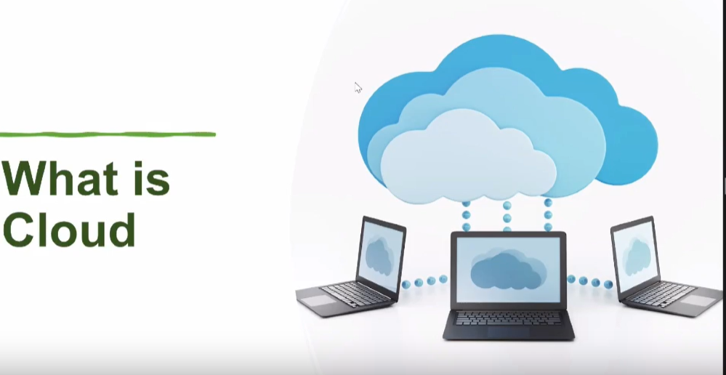

Slide 33
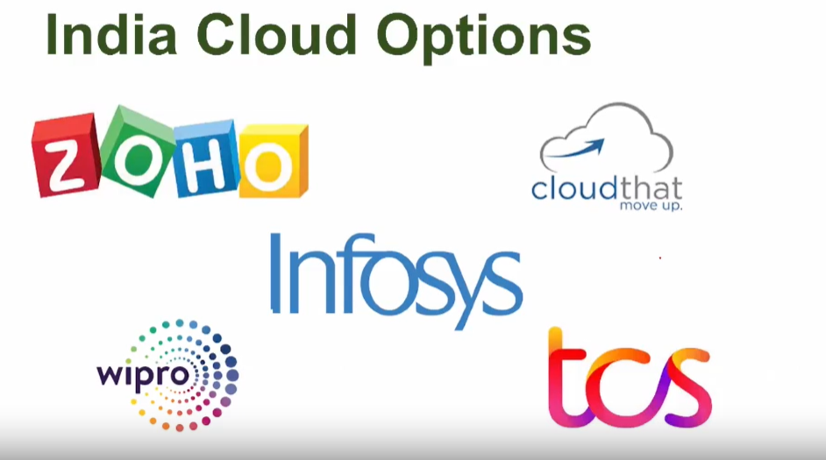

Slide 35
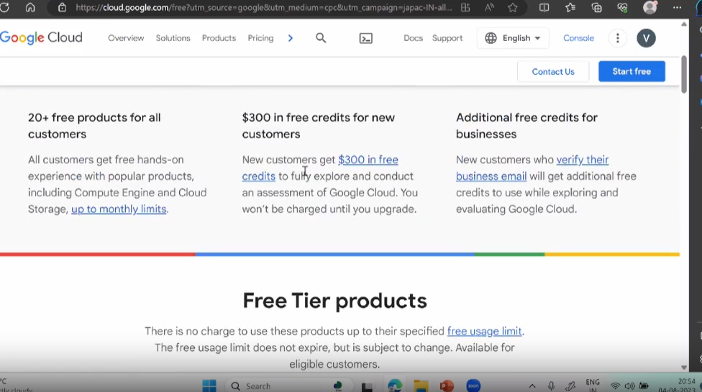

Slide 36
How CA can support Businesses?
Cost and Benefit analysis on migration to Cloud
Assessment of Different Models of Cloud and Variants
Consulting on migration from traditional facilities to cloud based infrastructure
Cloud Based Solution Implementation Support
Training to the User Staff on operating these facilities
IT Audit of these facilities

Slide 37
GLOBAL PROFESSIONAL OPPORTUNITIES

Slide 38
FAFD (FORENSIC AUDITOR)
Investigate financial discrepancies, fraud, and other financial irregularities within an organization.
Use their accounting, investigative, and analytical skills to uncover evidence of financial misconduct and provide insights that can be used in legal proceedings, regulatory actions, or internal decision-making.
Fraud Detection and Prevention
Investigation of Financial Irregularities
Gathering Evidence
Financial Analysis
Who Appoints?
Government Agencies
Courts
Companies and Organizations
Shareholders or Stakeholders
Insurance Companies
Bankruptcy or Restructuring Situations

Slide 39
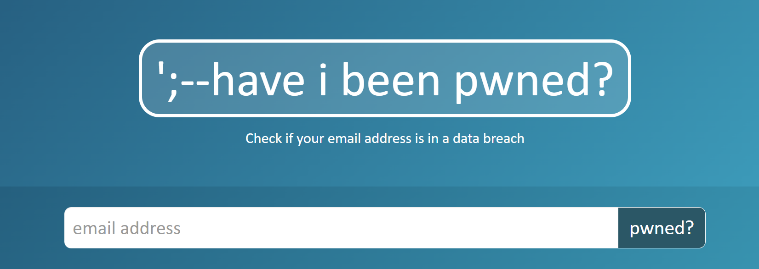
https://haveibeenpwned.com/

Slide 40
Crypto Currency
In relation to crypto currencies (for example bitcoins) there are no specific accounting guidance despite their increasing usage.
There are ongoing deliberations whether to account for these as intangibles or inventory.
There is need for specific guidance to avoid diversity in practice. Further, disclosures are critical to explain how these are classified and measured for accounting purposes.
Many developed countries have recognized Crypto currencies and are regulating same.
While India is still evaluating relevance and security concerns, many Indian companies with overseas subsidiaries may have crypto currencies in their books and reflected in the consolidated financial statements.

Slide 41
Valuation of Intangibles (digital assets)
Valuing digital assets (including technology, IP valuations, etc.) — can be as much art as science.
Ability to weigh the worth of digital IP, potential market size and disruption factors is critical to evaluate digital assets and market deals.
The valuation is important at the time of acquisition and subsequently for testing impairment as well as insurable value.
Data is a big asset for many including of ecommerce and aggregators in various sectors.
Putting a number on the worth of young start-ups is notoriously difficult; cash flows, profitability, and other familiar metrics often don’t fit.
Many of the standard techniques that are used to estimate cash flows, growth rates and discount rates either may not work or yield unrealistic numbers.

Slide 42
Audit Evidence and Social Media
Social media networks add and link customers, employees, investors and other stakeholders to businesses every second of every day.
The best way to mitigate this type of reputational risk is by monitoring social media chatter and ensuring the company is well placed to respond rapidly.
Forward-thinking audit committee chairs and advisors suggest that, given the gravity of the reputational risks involved, social media should be a full board issue, rather than one limited to an audit or risk committee.
From audit perspective the primary focus continues to be on assessing impact on IT systems and data that would impact the financial statements and the effectiveness of internal control over financial reporting (ICFR).

Slide 43
Leverage Digital Marketing
Build an Online Presence
Content Marketing
Social Media Engagement
Email Marketing
Networking
Online Advertising
(Utilize pay-per-click (PPC) advertising)
Search Engine Optimization (SEO)
Webinars and Online Workshops
Online Reviews and Testimonials
(Google My Business)
Personal Branding
Analytics and Data Insights
(to check your effectiveness)
Continual Learning

Slide 44
CODE OF ETHICS
v/s

Slide 45
ICAI warns its CAs, Students to abstain from Misconduct using Social Media to express grievances related to Profession/Academics
“Members and students are, therefore, advised in their own interest, to exercise caution while posting/sharing/forwarding any message, video, audio, photograph(s), comments and other material on print and social media which may bring disrepute to the profession or tarnish the image of the Institute generally in the eyes of the public,”

Slide 46
WHAT IS PERMISSIBLE?
It is not permissible for a member to use Messaging Applications to send messages to make people aware about his practice, and mention the services provided therein.
It was clarified that it is not permissible to use Whats App to send messages to make people aware about his new practice, and mention the services provided therein
A CA Firm may register itself on UDYAM REGISTRATION, a web portal of Ministry Micro, Small and Medium Enterprises.

Slide 47
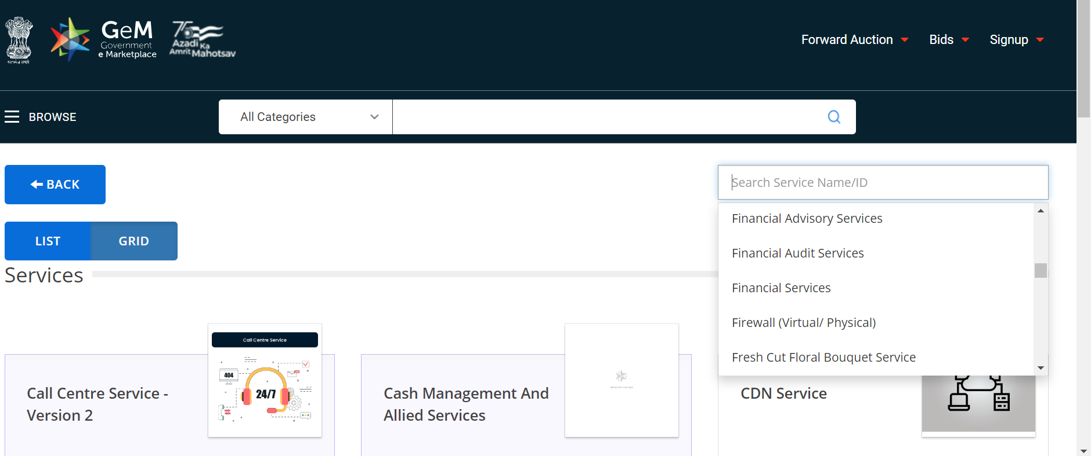

Slide 48
ADVERTISEMENT
Whether a member in practice can advertise their services on social networking websites?
Ans. Yes, a member in practice may advertise through a write up on social networking websites setting out his particulars or services, subject to the Council Guidelines for Advertisement, 2008 appearing in Volume-II of Code of Ethics.
Whether a write-up in an Advertisement may contain any information about an achievement or award given to a member?
Ans. Yes, a write-up may contain information about an achievement or award given to a member, provided it has been awarded by the Central or State Governments or Regulatory bodies.
Whether a member in practice or a Firm may give link of its website on a social networking site?
Ans. Yes, a member in practice or a Firm may provide link of its webpage on Social Networking site. However, the members should not solicit people to visit or request to like their respective page(s) on such social Networking site.

Slide 49
VIDEOS/ YOU TUBE CHANNEL
Whether a members in practice/firm of Chartered Accountants can upload videos on internet?
Ans. Members in practice may upload videos of educational nature on the internet, no reference should be made to the Chartered Accountants Firm wherein the member is a partner/ proprietor. Further, it should not contain any contact details or website address.
Whether member in practice/or firm of Chartered Accountants can have the YouTube channel?
Ans. Members can own a YouTube channel. However, CA firms are not allowed to open its channel.

Slide 50
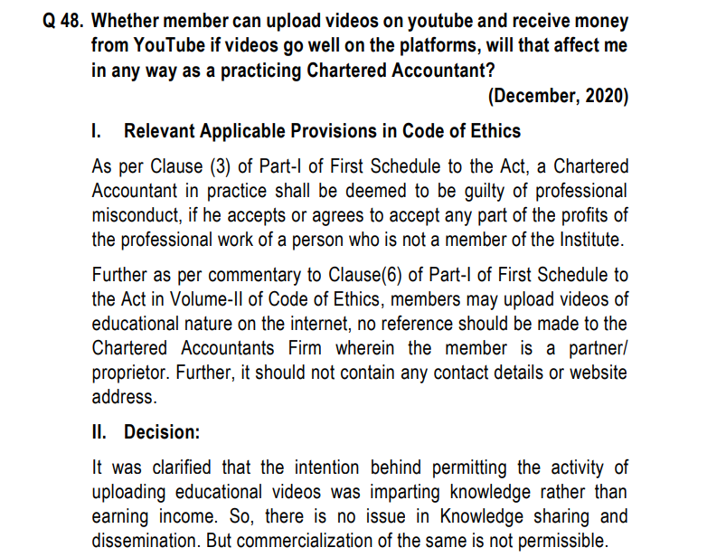

Slide 51
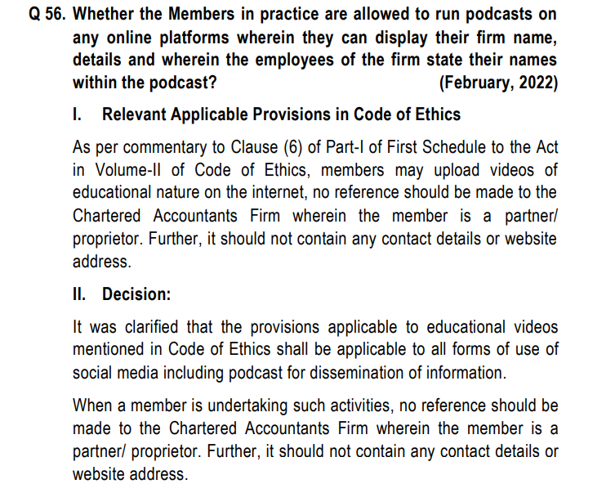

Slide 52
Write Up
Can a Chartered Accountant in practice/firm give advertisement in press?
Ans. No, however, the members in practice may advertise the services setting out the services provided by him or his firm, and particulars of his firm, through a `Write-Up’, subject to Advertisement Guidelines issued by the Council.
Whether a member in practice can advertise their services on social networking websites?
Ans. Yes, a member in practice may advertise through a write up on social networking websites setting out his particulars or services, subject to the Council Guidelines for Advertisement, 2008 appearing in Volume-II of Code of Ethics.
Whether a member in practice mention position held as Director in a Management Consultancy Company registered with the Institute in the write up?
Ans. Yes, member in practice can mention his Position held as Director or Managing Director in a Management Consultancy Company registered with the Institute in the write up.
Whether a Chartered Accountants firm can mention their Affiliation with a Network registered with the Institute in write up?
Ans. The write up of firm of Chartered Accountants may include their Affiliation with a Network registered with the Institute in write up.

Slide 53
Write Up
Whether a write-up in an Advertisement may contain any information about an achievement or award given to a member?
Ans. Yes, a write-up may contain information about an achievement or award given to a member, provided it has been awarded by the Central or State Governments or Regulatory bodies.
Whether a member can appear on television, films, internet and broadcast in the Radio or give lectures at forums?
Ans. Yes. A member may appear on television, films and internet and agree to broadcast in the Radio or give lectures at forums and may give his name and describe himself as chartered accountant. Special qualifications or specialized knowledge directly relevant to the subject matter of the programme may also be given.
Firm name may also be mentioned, however, any exaggerated claim or any kind of comparison is not permissible.
What he may say or write must not be promotional of him or his firm but must be an objective professional view of the topic under consideration.

Slide 54
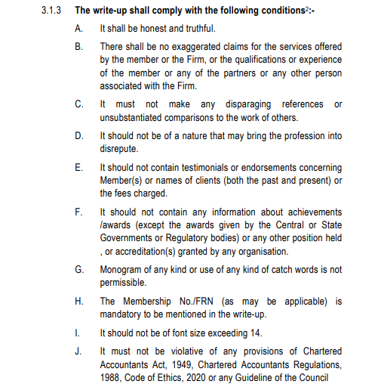

Slide 55
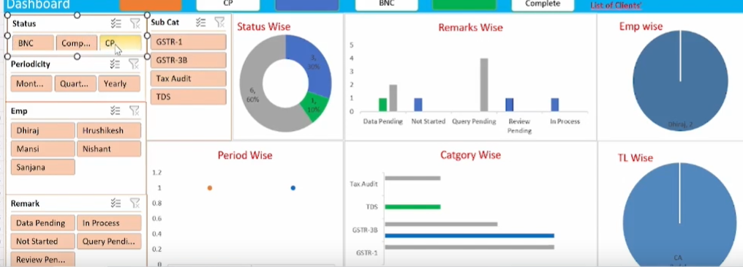
Data Analytics and Business Intelligence
CAs can leverage their financial knowledge to analyze large datasets and provide valuable insights to businesses.
They can use data analytics tools to identify trends, patterns, and anomalies in financial data, helping companies make informed decisions.

Slide 56
Financial Technology (FinTech)
The FinTech industry is rapidly growing, encompassing digital payments, block chain, crypto currency, robo-advisory services, and more.
CAs can work with FinTech companies to ensure regulatory compliance, risk management, and financial reporting.

Slide 57
Risk Management and Cyber security
With the increasing reliance on digital systems, organizations are exposed to various risks, including cyber threats.
CAs can help assess and manage these risks, ensuring that financial data and transactions are secure.

Slide 58
Artificial Intelligence (AI) and Automation
CAs can use AI to streamline financial processes, automate routine tasks, and enhance accuracy in areas like auditing, fraud detection, and financial forecasting.
AI
Automated Data Entry and Bookkeeping
Predictive Analytics and Forecasting
Tax Compliance and Planning
Fraud Detection and Risk Assessment
Auditing and Assurance
Financial Reporting and Visualization
Client Interaction and Chatbots
Credit Scoring and Loan Approval
Investment Analysis
Natural Language Processing (NLP)
Portfolio Management
Cash Flow Management

Slide 59
Blockchain and Cryptocurrency
As these technologies gain prominence, CAs can offer services related to auditing smart contracts, assessing the financial implications of blockchain implementations, and providing guidance on cryptocurrency taxation and regulation.

Slide 60
Digital Taxation
The digital economy has brought about new challenges in taxation.
CAs can help businesses navigate the complexities of cross-border transactions, digital goods and services taxation, and transfer pricing in a globalized digital landscape.

Slide 61
Advisory Services
CAs can provide strategic financial advice to businesses looking to optimize their operations in the digital age.
This might involve optimizing capital structures, evaluating investment opportunities, and devising growth strategies.

Slide 62
Sustainability and Environmental Reporting
With increasing emphasis on sustainability, CAs can assist companies in measuring and reporting their environmental impact.
This can involve creating frameworks for reporting, analyzing the financial implications of sustainability initiatives, and ensuring compliance with reporting standards.

Slide 63
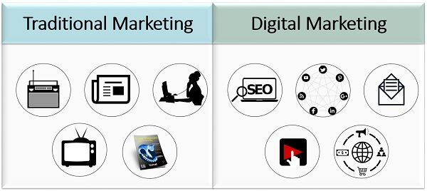
E-commerce and Digital Business
As businesses move online, CAs can provide guidance on e-commerce taxation, digital revenue recognition, and financial strategies for digital business models.

Slide 64
Plethora of services in DIGITAL ECONOMY
Digital Transformation Consultancy services
Startup ecosystem
Create a website
Fintech services
Set up your own blog or contribute blog posts on various CA platforms
Conferences and Public Speaking Opportunities in virtual mode
Become An Affiliate of Network of Chartered Accountants
Create Profiles on social media

Slide 65
Plethora of services in DIGITAL ECONOMY
Join Groups on Various Social Media Platforms
DSC Agency
Digital Marketing Coaching
Big data create new opportunities for businesses and consumers, and new challenges for security and privacy
Big data analytics
Assistance in social media
Data Protection laws
Audit of documents, maintained in electronic form
Awareness about privacy and data protection frameworks and strengthen their enforcement
Solutions to address digital security issues
Governance approach that supports co-ordination, articulating a strategic vision, assessing key digital trends and policies

Slide 66
Plethora of services in DIGITAL ECONOMY
Ensure technical enablers are in place, such as Internet exchange points, efficient allocation of spectrum and new generation Internet protocol addresses. Reduce administrative barriers to investment, such as burdensome licensing requirements and complex rights of way.
Empower everyone with a mix of skills to thrive and trust in a digital world.
Review education and training systems to better exploit the possibilities of digital learning
Promote investment in digital technologies and intangible assets (e.g., patents, software)
Data Centre Audit

Slide 67
SUCCESS MANTRA
Continuous Learning and Adaptation
Adopt Digital tools and knowledge to provide valuable insights and solutions to businesses

Slide 68
Continuous Learning and Skill Development
Stay Informed About Technological Trends
Digital Tools Adoption
Data Analytics Proficiency
Ethical Considerations
Digital Communication and Networking
Specialization in Emerging Areas
Client Education
Collaboration with IT Professionals
Adaptive Mindset
Leadership in Digital Transformation
Strategic Advisory Services
Thought Leadership
Partnerships and Collaborations
Client-Centric Approach
Data Security and Privacy

Slide 69
INITIATIVES TAKEN BY DAAB

Slide 70
CA DIVYA SOMANI
FCA, IP, CS, DISA, CCCA,
Certified MSME Consultant
DIP IFRS (ACCA, UK), B.COM
Mobile - 9772211292; cacsdivyasomani@gmail.com

