Slide 1
ICAI- RESIDENTIAL COURSE- SAMRUDDHI THROUGH DIGITAL TRANSFORMATION.
CA. PANKAJ DARA,
Bcom,FCA, DISA,
CERTIFICATE COURSE IN MSME
DIPLOMA IN CYBER LAW.
pbd1978@gmail.com
9823354105

Slide 4
Icai start-up .
@ Introduction to Start-up
@ Go- to Market Strategy.
@how to value start up/Startup valuation.
@Business Model- Case studies of Successful Start up.
@ Start Up Funding : Angel/vc/Seed Funding.

Slide 5
Economy of Kerala
Statistics
GDP | ₹11.6 lakh crore (US$145 billion) (2023-24 est.)
GDP rank | 9th
GDP growth | 12% (2021–22)
GDP per capita | ₹352,151 (US$4,410) (2023–24)

Slide 6
The primary sector of the state is mainly based upon Cash crops.
Kerala produces a significant amount of national output of the cash crops such as coconut, tea, coffee, pepper, natural rubber, cardamom, and cashew in India.

Slide 7
Kerala does not fall in the list of the first 10 rich states in India, but the state has consistently been ranked on top in multiple indicators of social development such as literacy, healthcare, education, and standard of living

Slide 8
The Kerala Startup Mission (KSUM) has been ranked as one of the world's top five business incubators in 2021-22. According to the 2021-22 World Benchmark Study on Startup Ecosystems, KSUM is among the top 5 public or private business incubators around the globe.

Slide 9
How many startups are there in Kerala?
With over 3100+ startups, Kerala's startup ecosystem provides an attractive and world-class business infrastructure for entrepreneurs.

Slide 10
What is the startup policy in Kerala?
Innovation Grant scheme of Kerala Startup Mission provides financial assistance of up-to 12 lakhs to startups, entrepreneurs and students to help them convert their innovative ideas into full fledged ventures. Productization grant is to convert the prototype into a product and is limited to a maximum Rs. 7 lakhs/idea

Slide 11
Which business is going to boom Kerala?
Which industry is the most profitable one in Kerala?
Agriculture, garments, and tourism are the most popular among many profitable industries. Therefore, developing a business in these fields can be profitable. Agriculture, garments, and tourism are the most popular among many profitable industries.

Slide 12
Industries in Kerala
Kerala is mainly dominated by handloom, handicraft, bamboo, coir, khadi & village, cashew, tourism, etc. Here is the list of major industries in Kerala-
Agriculture & Livestock
Kerala is mainly involved in the production of pepper, natural rubber, tea, cashew, spices, coffee, coconut. All its agriculture production is sent across the country. It produces various types of spices including vanilla, cardamom, nutmeg, cinnamon. Kerala has a huge workforce for all these tasks.
Tourism
Tourism is one of the major industries in Kerala. The state has various tourist places that attract tourists from all across the world. Some of the most visited areas are Kovalam, Fort Kochi, Munnar, Ponmudi, Nelliampathi, Kozhikode, Alappuzha, Thrissur. The major tourist attractions are coastal areas, mountains, temples, wildlife sanctuary, etc.

Slide 13
Oil Refining & Petrochemicals
The city is also having an oil refining and petrochemical industry in the city of Kochi. It has one of the leading state-owned refinery in India with a huge production capacity. Its oil refinery is referred to as Kochi Refinery which was formerly named Cochin Refineries Ltd. Kochi Refinery is engaged in the Refining and marketing of petroleum products.
Ship Building
Ship Building is one of the major industries in Kerala. The state has the largest shipbuilding facility in India. Cochin Shipyard was started in the year 1972 as fully owned by the Government of India company. The yard is involved in building and repairing the largest vessels in India. It is also building a Shipyard for the Indian Navy. Recently Cochin Shipyard won a major repair order from ONGC.
Energy
India’s largest floating solar power plant set up on the Banasura Sagar reservoir in Wayanad, Kerala. The state is contributing hugely to the promotion of solar energy.

Slide 14
Chemical Industry
Aluva is one of the leading industrial belts in Kerala. The industrial belt is the manufacturing of a wide range of chemical products including pesticides, rubber processing chemicals, zinc/ chromium compounds, rare-earth elements, and leather products.
Handloom
Handloom is one of the leading sectors in Kerala. The industry is mainly concentrated in Thiruvananthapuram and Kannur districts.
Handicrafts
Handicraft is one of the major industries in Kerala. It is also contributing to the generation of employment into that state. The handicrafts products include coconut shell carving, bamboo and reed weaving, bell metal casting, straw picture making, mat weaving, ivory carving, etc. Handicrafts Development Corporation and Artisans Development Corporation are the major promotional agencies of the industry.

Slide 15
Bamboo Industry
Bamboo is mainly used in the State for the manufacture of pulp for making paper, bamboo ply, and in the traditional bamboo industry. The Kerala State Bamboo Corporation has created a new product Flattened Bamboo Board which is going to hit the market along with bamboo ply.
Khadi and Village Industry
The state has Khadi and Village Industries Board. It does various activities through registered institutions, cooperative societies by the financial assistance from Khadi Commission, Nationalized Banks, and State Government.
Cashew Industry
It has Kerala State Cashew Development Corporation which is involved in the development of this Industry. KSCDC exports cashew kernels and cashew shell liquid. The Institutions promoting industrial activity in the Sate are the following.

Slide 16
Kerala Financial Corporation (KFC)
Centre for Management Development (CMD)
Small Industries Development Corporation of India (SIDBI)
Kerala State Industrial Development Corporation (KSIDC)
Infrastructure Kerala Limited (INKL)
Kerala Industrial Infrastructure Development Corporation (KINFRA)
Kerala Small Industries Development Corporation (SIDCO)
Directorate of Industries & Commerce (DIC)
Kerala Industrial and Technical Consultancy Organization (KITCO)
MSME Development Unit (formerly SISI)
Kerala Bureau of Industrial Promotion (K-bip)

Slide 17
Unicorn startup in Kerala
Marking a major milestone in State's start-up ecosystem, homegrown company Open Financial Technologies has entered the coveted unicorn club with a new funding round, raising $50 million from the Mumbai-headquartered IIFL Finance.
Unicorn startup in Kerala
Marking a major milestone in State's start-up ecosystem, homegrown company Open Financial Technologies has entered the coveted unicorn club with a new funding round, raising $50 million from the Mumbai-headquartered IIFL Finance.

Slide 18
START-UP

Slide 20
START -UP
WHATS IS STARTUP ??????
????

Slide 21
DEFINATION OF START UP AS PER GOVERNMENT OF INDIA.- Department for Promotion of Industry and Internal Trade(DPIIT)
A startup defined as an entity that is headquartered in India, which was opened less than 10 years ago, and has an annual turnover less than ₹100 crore (US$13 million).
Is a private limited company or registered as a partnership firm or a limited liability partnership.

Slide 22
Benefits of DPIIT Recognition
80 IAC Tax exemption.
Tax Exemption under Section 56 of the Income Tax Act (Angel Tax)
Self-certification and no for three years.
Concession in Trademark filings fees.
Preference in Government tenders.
Funding Support by government.

Slide 23
Start - up

Slide 24
What is the difference between startup and MSME?
Mostly Start-ups are started by engineers or others who are often more qualified as compared to those entrepreneurs who start MSMEs. Those who establish Start-ups are called Founders or Co-Founders whereas those who set up small or medium enterprises are called Promoters

Slide 25
Defination of msme
Particulars turnover investment
micro 5 cr 1 cr
Small 50 cr 10 cr
Meduim 250 cr 50 cr

Slide 26
Start up.
General terms defines as for start up means to start something.
Start in terms of business activities or social activities.
Start up means to start something online activities
Start up means to earn big money .

Slide 27
Start up.

Slide 28
Start up – countries

Slide 29
Journey of start up in india.

Slide 30
Start up - deals

Slide 31
Start up - unicorn

Slide 32
Start up – overseas oppurtinuties

Slide 33
Start up – venture capitalist

Slide 34
Start up - ecosystem

Slide 35
Start – up ceo

Slide 36
Start up – government defination

Slide 37
Start- up – best cities

Slide 38
Start – up

Slide 39
START UP – INNOVATION WEEK

Slide 40
START-UP REGISTRATION PROCESS

Slide 41
START- UP – INDIAN LAWS

Slide 42
START-UP- FAILURE

Slide 43
Which sector is best for startup in India?
Here's a closer look at these top 5 industry sectors/markets that Indian startups are focused on.
The FinTech Sector. Technology has pushed growth phenomenally in the Fintech sector. ...
The EdTech Sector. ...
The Health Sector. ...
The Logistics Sector. ...
The Enterprise Tech Sector. ...

Slide 44
VARIOUS GOVERNMENT SCHEMES AND TAX ELEIGLIBITY.

Slide 45
What are the prominent Indian government investment schemes for the startups of the country?
Some of the popular government investment schemes that are benefitting the startup ecosystem of India are:
SAMRIDH Scheme
Startup India Seed Fund
Startup India Initiative
ASPIRE
Pradhan Mantri Mudra Yojana (PMMY)
India Water Pitch-Pilot-Scale Startup Challenge
Chunauti
Ministry of Skill Development and Entrepreneurship
ATAL Innovation Mission
eBiz Portal
Dairy Processing and Infrastructure Development Fund (DIDF)
Support for International Patent Protection in Electronics & Information
Technology (SIP-EIT)
Multiplier Grants Scheme (MGS)

Slide 46
What are the prominent Indian government investment schemes for the startups of the country?
Credit Guarantee Fund Trust for Micro and Small Entreprises (CGTMSE)
Software Technology Park (STP) Scheme
The Venture Capital Assistance Scheme (VCA)
Loan For Rooftop Solar Pv Power Projects
NewGen Innovation and Entrepreneurship Development Centre (NewGen IEDC)
Single Point Registration Scheme
Modified Special Incentive Package Scheme (M-SIPS)
Stand Up India Scheme
High Risk - High Reward Research
IREDA-NCEF Refinance Scheme
Dairy Entrepreneurship Development Scheme
Drone Shakti
Zero Defect Zero Effect (ZED) Certification Scheme
Credit Linked Capital Subsidy for Technology Upgradation (CLCSS)
Design Clinic Scheme for Design Expertise

Slide 47
Start up – sector wise

Slide 48
CAN ANYONE GUESS KING OF IDEAS IN INDIA FOR ???

Slide 49
BUSSINESS WE DIVIDE INTO TWO PARTS
SOCIAL
A.PRODUCT
B. SERVICES
POLITICS
SPORTS

Slide 50
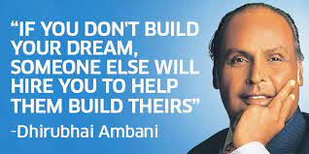

Slide 51
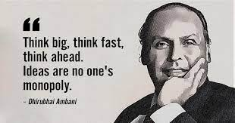

Slide 52
The 5 stages of a startup
5Maturity.
1.Solving the problem.
4.Scaling.
2. Development.
3.Entering the market.

Slide 53
3.DISTRICT
5.NATIONAL
1.VILLAGE
4.STATE
6.INTERNATIONAL
IDEA TO BE CONVERTED INTO STARTUP FOR WHICH TYPE OF MARKET
2.TALUKHA

Slide 54
GOVERNMENT POLICIES
HOBBIES
TRAVEL
SOCIETY
SELF
FAMILY
FRIENDS

Slide 55
Six Types of Startups .
2.Small Business Startups.
4.Buyable Startups.
6.Social Startups.
1.Lifestyle Startups.
5.Large Company Startups.
3.Scalable Startups.

Slide 57
 | Feasibility | Market Potential | Competitive Advantage | Resource Requirement | Overall Score
Idea 1 | 1-High Feasible 5- Not feasible | 1-high potential 5-low potential | 1- Highly 5- No Competitive edge | 1-low resource 5-high resource | Lower score means more favorable
Idea 2
Idea 3
Idea 4
Idea 5

Slide 58
Feasibility: Assess the technical feasibility of implementing the idea. Consider factors such as available technology, skills, and resources needed. Rate the feasibility on a scale of 1 to 5, with 1 being highly feasible and 5 being not feasible. Market Potential: Evaluate the market size and demand for the product or service associated with the idea. Consider factors such as target audience, market trends, and potential customer base. Rate the market potential on a scale of 1 to 5, with 1 being high potential and 5 being low potential. Competitive Advantage: Analyze the uniqueness and competitive advantage of the idea. Consider factors such as differentiation from existing solutions, intellectual property, or innovative features. Rate the competitive advantage on a scale of 1 to 5, with 1 being highly advantageous and 5 being no competitive advantage.

Slide 59
Resource Requirement: Estimate the resources (financial, human, technological) required to develop and launch the idea. Consider factors such as capital investment, time commitment, and team size. Rate the resource requirement on a scale of 1 to 5, with 1 being low resource requirement and 5 being high resource requirement. Overall Score: Calculate the overall score for each idea by summing up the ratings in the previous columns. A lower overall score indicates a more favorable idea for further exploration. After evaluating and rating each idea in the matrix, you can prioritize the ideas based on their overall scores. The ideas with the lowest scores represent the most promising opportunities for your startup. Note: This is just a template to get you started. Feel free to modify or add additional columns and criteria that are relevant to your specific startup and

Slide 60
WE HAVE TO MOVE FROM IDEA GENERATION TO IMPLEMENTATION
OR
IDEA IMPLEMENTATION TO IDEA GENERATION.
FORWARD INTERGRATION OF IDEA TO IMPLEMENTATION
BACKWARD INTEGRATION FROM IMPLEMENTATION TO IDEA

Slide 61
ONE DISTRICT ONE PRODUCT

Slide 62
The one district one product programmed is the core concept of the government of Japan, launched in 1979. The objective of the ODOP is to optimize production, productivity, and income, preservation and development of local crafts, promotion of art, improvement in product quality, and skill development.
Notes:
The one district one product programmed is the core concept of the government of Japan, launched in 1979. The objective of the ODOP is to optimize production, productivity, and income, preservation and development of local crafts, promotion of art, improvement in product quality, and skill development.

Slide 63
One District One Product (ODOP) is an initiative by the Government of Uttar Pradesh to encourage state's domestic production of various handicrafts, readymade clothes, leather products etc. The aim of state government is to encourage indigenous and specialized products district wise.

Slide 64
Central Government has initiated One District One Product (ODOP) in all States/UTs of the country, as a transformational step towards realizing the true potential of a district, fueling economic growth, generating employment and rural entrepreneurship, taking us to the goal of Aatmanirbhar Bharat

Slide 65
IS UNICORN STATUS TRUE BENCHMARK FOR SUCCESSFUL IDEAS OF STARTUP

Slide 67
IDEAS MOTIVE
OR
PROFIT MOTIVE
SOCIAL MOTIVE

Slide 68
GREAT IDEA BUT IMPROPER EXECUTION
FAILURE STARTUP STORIES
IMPROPER IDEA BUT GREAT EXECUTION
SUCCESSFUL STORIES

Slide 69
IDEA
TARGET
CLASS
MASS
POPULATION
STARTUP
ELITE
LOCAL OR GLOBAL

Slide 72
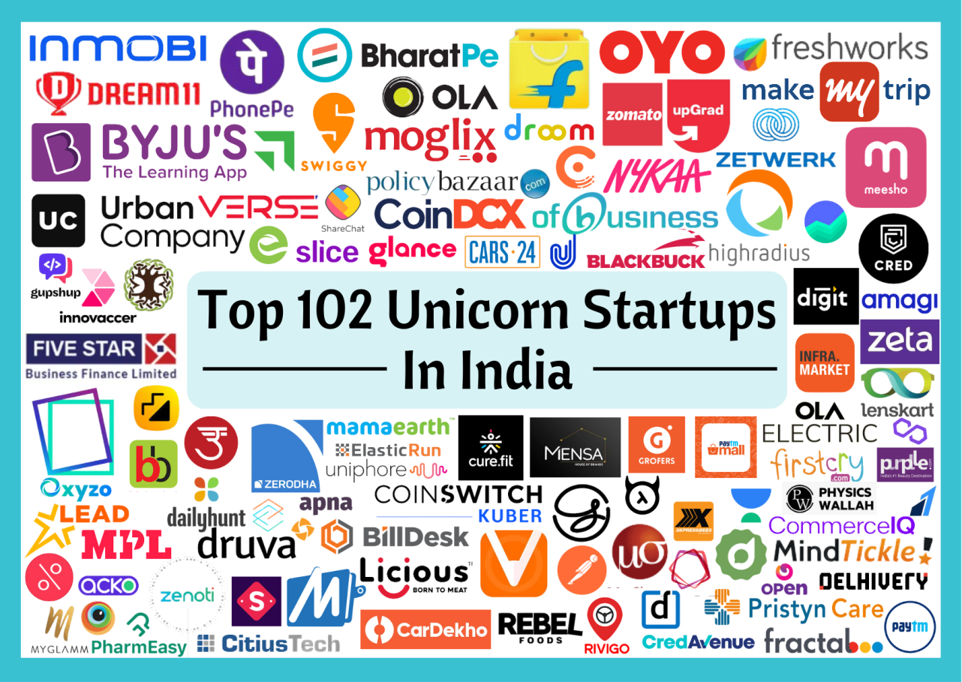

Slide 73
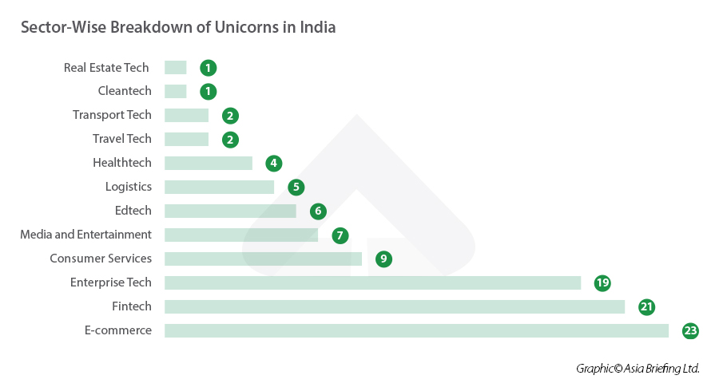

Slide 74
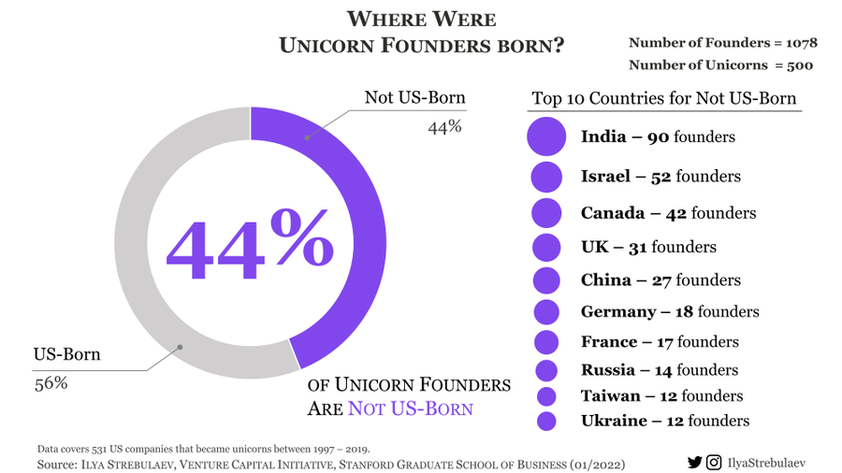

Slide 75
WHAT IS THERE IN UNICORN
AND
WHAT NOT THERE IN UNICORN

Slide 77
Best Sectors for Long-term Investment in India 2023
1.Information Technology (IT)
2.FMCG (Fast-moving consumer goods)
3.Housing finance companies
4.Automobile Companies.-Having Alternative fuels
5.Infrastructure
6.Bonus: Pharmaceuticals

Slide 78
According to NITI AAYOG’S FIRST MULTIDIMENSIONAL POVERTY INDEX(MPI) 10 Poorest State of India
1.Odisha,
2.Bihar,
3.Madhya Pradesh,
4.Chhattisgarh,
5.Jharkhand,
6.Arunachal Pradesh,
7.Assam,
8.Meghalaya,
9.Uttar Pradesh and
10.Rajasthan.
The seven most developed status are Goa, Kerala, Tamil Nadu, Punjab, Maharashtra, Uttarakhand and Haryana.

Slide 79
The Vision for 'Amrit Kaal' articulated in the Union Budget for FY 2023-24 is centered around:
1.Opportunities for Citizens with focus on youth
2.Growth & Job creation
3.Strong & Stable Macro-Economic Environment

Slide 80
The seven priorities, termed Saptarishi, adopted in the Union Budget for FY 2023-24 to guide the country towards 'Amrit Kaal', thus providing a blueprint for an empowered and inclusive economy, are:
1.Inclusive Development
2.Reaching the last mile
3.Infrastructure & Investment
4.Unleashing the potential
5.Green Growth
6.Youth Power
7.Financial Sector

Slide 81
SUMMING BRIEF FOR SUCCES OF STARTUP
1.90/10 RULE
In fact, the 90/10 Rule tells us that during small business startups, 90% of your time should be spent on direct marketing activities and only 10% on building technical skills. The type of small business startup activities to spend 90% of your time on include: Prospecting. Lead generation

Slide 82
2. What is the rule of 50 profitability?
EBITA- If Company Giving greater than 50 % it will survive in long run
3.What is the rule of 45 company?
The Conversion Rate Of 45 % is to be there if not able to convert lead into revenue generation then some issues

Slide 83
10 Most In-Demand Startup Trends Of 2023
1.Environment-Friendly Technology Startups.
2.Super Apps.
3.Digital health startup trends in 2023.
4.Cloud Computing and Infrastructure startups.
5.AgriTech startups.
6.Metaverse Startups.
7.Cybersecurity Solutions Startups.
8.Quick Service Restaurants (QSR).
9.EV Startup.
10.Defence.

Slide 84
USE OF AI IN START UP
Notes:
USE OF AI IN START UP

Slide 87
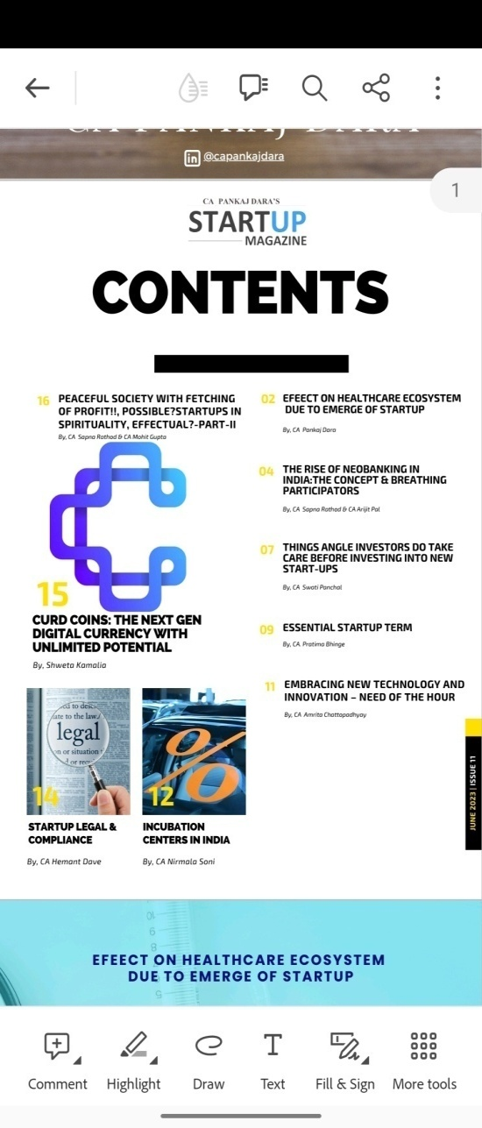
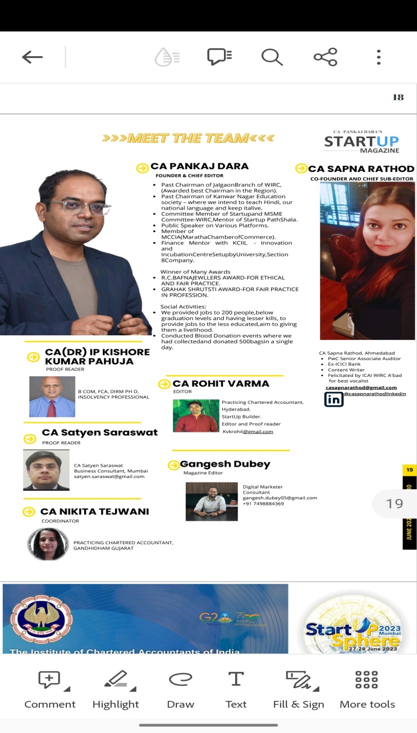

Slide 88
START-UP-ENERGY SECTOR

Slide 89
Import for fuels
India's imports of petroleum, crude and its products were estimated at a value of over 12 trillion Indian rupees in financial year 2022
India is the third-largest oil consumer in the world with 85% of which is imported, after China and the US.

Slide 90
Agriculture start up

Slide 91
Various production from agriculture

Slide 92
production
China. Production – China has only 10% of arable land worldwide and produces a quarter of the global grain output. China leads the agriculture production of fruit, vegetables, cereals, cotton, eggs and poultry.
Arable land (%)
WORLD -11.6 %
india – 50 %
USA- 17 %
CHINA- 12.9

Slide 93
Defence start up

Slide 94
Budget for defence
5.25 trillon budget
60 % import.
11 % of global import.
Suport local defence innovative to reduce import reliance.

Slide 95
Space start up

Slide 96
Artifical intelligence

Slide 97
Artificial intelligence

Slide 98
Pharma sector

Slide 99
Robotics, AI and Agriculture.- combination of two or more sectors.

Slide 100
Agriculture Robots

Slide 101
Water start up

Slide 102
Water start up challenge

Slide 103
Cloud computing start up

Slide 104
Mixing of area of many sectors together in start up.

Slide 105
Combination of sector

Slide 106
Pharmaceutical
One of the best ways to start a business is to start a pharmaceutical company. A pharmaceutical business may be involved in one or more of the following activities: research, manufacturing, trading, distribution, and marketing. Every country regulates the pharmaceutical industry

Slide 107
Area of penetration in start up
Cloud Computing. ...
Biotechnology. ...
Data Analytics. ...
Artificial Intelligence. ...
Internet of Things (IoT) ...
Cybersecurity. ...
Sustainable Products Market.

Slide 108
Fintech companies
What is a fintech company?
In broad terms, Fintech describes any company that uses the internet, cloud services, mobile devices, or software technology to either connect with financial services or to use them.
Fintech is a combination of the words “finance” and “technology.” Although it's a blanket term that can mean many different things, broadly speaking, it describes the evolution of an industry where new technology use-cases are developed and deployed to streamline more traditional-looking finance functions.

Slide 109
Fintech Start up
Paytm.
Lendingkart.
MoneyTap.
Instamojo.
Razorpay.
Shiksha Finance.
Pine Labs. ...
ZestMoney.

Slide 110
What is difference between NBFC and bank?
A bank is a legally recognized financial institution with the mission of offering consumers financial services. NBFCs are businesses that offer individuals banking-like services without having a bank licence. Banks take deposits and lend money. NBFC does not take deposits or make loans.

Slide 111
Nbfc .

Slide 112
START – UP - IDEA

Slide 113
Area of penetration in start up
Automobiles and Components
Banks
Capital Goods
Commercial and Professional Services
Consumer Durables and Apparel
Consumer Services
Diversified Financials
Energy

Slide 114
Area of penetration in start up
Food, Beverage, and Tobacco
Food and Staples Retailing
Health Care Equipment and Services
Household and Personal Products
Insurance
Materials
Media and Entertainment
Pharmaceuticals, Biotechnology, and Life Sciences

Slide 115
Area of penetration in start up
Real Estate
Retailing
Semiconductors and Semiconductor Equipment
Software and Services
Technology Hardware and Equipment
Telecommunication Services
Transportation
Utilities

Slide 116
START UP PROFESIONAL OPPURTINETIES
Scalable startups.
Small business startups.
Lifestyle startups.
Buyable startups.
Big business startups.
Social startups.

Slide 117
Scalable startups.
A scalable startup is one that begins with a lucrative and innovative idea and adopts a profitable business model that can grow quickly into a hugely profitable company. This includes entering a large market and creating a niche for the company's products.
Twitter, Google, Facebook, Skype – are all perfect examples of scalable startups. Scalable startups, more often than not, are always in the tech niche

Slide 118
Building a scalable start-up
Have a strong plan. Planning for scalability early on in your business journey is a wise move. ...
Automate processes. Efficient processes are crucial to scalability. ...
Focus on marketing. ...
Encourage customer loyalty. ...
Hire the right people. ...
Outsource to experts. ...
Getting investment. ...
Build a network.

Slide 119
What business is easily scalable?
Digital products, courses, and blogs are great examples of scalable businesses.

Slide 120
Small Bussiness scale start up
Look for Founder-Market Fit.
Solve a Personal Problem (Bottom-Up Approach)
Consider Your Passions.
Come Up With Ideas Around Something New (Top-Down Approach)
Employ Strategic Foresight.

Slide 121
Small Bussiness scale start up
Think of a Variation of a Recently Successful Company.
Search For an Industry That is Broken
Crowdsource an Idea
The 10x Rule
Find Ways to Use Otherwise Idle Assets

Slide 122
Small business startups
Most profitable small businesses
Food trucks. ...
Car wash services. ...
Auto repair. ...
Personal trainers. ...
Newborn and post-pregnancy services.

Slide 123
Lifestyle startups.
Lifestyle startups are local small businesses that provide founders with a sustainable income. Some have physical locations while others are online. Lifestyle startups generally provide services or products that target a relatively small customer base and are thus hard to scale

Slide 124
What is an example of a lifestyle business?
Lifestyle businesses operate flexibly, sometimes reducing their working hours below 40 hours per week, often turning to outsourcing and automation and emphasizing lifestyle over work. Examples of a lifestyle business include selling online templates, providing virtual consulting, or a clothing dropshipping business.

Slide 125
How do I start a lifestyle business?
Define your life and business goals.
Take inventory of your skills, interests, and expertise.
Find your business niche.
Validate your idea.
Choose your tool stack.

Slide 126
How do I start a lifestyle business?
Add additional income streams.
Automate and outsource.
Make time for learning.
9. Make time for learning
10. Find your community
Are you ready to build the lifestyle business of your dreams?

Slide 127
What are the types of lifestyle?
Active Lifestyle. If you are outgoing or extroverted, this is your lifestyle. ...
2- Healthy Lifestyle. ...
3- Solo Lifestyle. ...
4- Rural Lifestyle. ...
5- Urban Lifestyle. ...
6- Nomadic Lifestyle. ...
7- Bohemian Lifestyle. ...
8- Digital Lifestyle.

Slide 128
List of 25 Lifestyle Business Ideas
Blogging. If you have good writing skills and an idea of the readers' preferences, blogging is an ideal lifestyle business idea for you. ...
Freelance Writing. ...
Virtual Assistant. ...
Web Designing. ...
Graphic Designing. ...
Social Media Marketing. ...
Affiliate Marketing. ...
Online Teaching.

Slide 129
List of 25 Lifestyle Business Ideas
Create Online Courses
Launch a LifestyleBased YouTube Channel
E-Book Writing
Cryptocurrency Trading
App Development
Travel Consultant

Slide 130
List of 25 Lifestyle Business Ideas
Interior Decoration Consultant
Legal Consultancy
Fashion Designing
Event Management
SEO Consultant
Podcasting

Slide 131
List of 25 Lifestyle Business Ideas
Create an Online Shop Selling Lifestyle Products
Wedding Photography
Accounting Services
Babysitting

Slide 132
Suceesful lifestyle start up
Nykaa
Bewakofoo
boat

Slide 133
Buyable startups.
The goal of a "buyable" startup is to create a product (usually a mobile or web app) and then be sold to a larger company. Buyable startup entrepreneurs are usually happy to sell their company for $5 million to $50 million.

Slide 134
What is an example of a startup company?
Examples of such startups include Google, Uber, Facebook, and Twitter. These startups hire the best workers and search for investors to boost the development of their ideas and scale. Small business startups. These businesses are created by regular people and are self-funded.

Slide 135
Big business startups.
Companies that start small with a product that's revolutionary, but go on to be globally recognized are considered large company startups. These companies reach the end of their life cycle fairly quickly.

Slide 136
Social startups.
A social startup is a newly established, market-oriented venture committed to solve cultural, environmental and/or social issues. Rather than being driven by profit, a social startup is committed instead to make the world a better place.

Slide 137
Types of social enterprise
Credit union. Definition: Finance co-operative that helps people save and borrow money. ...
Community-based organisation. ...
Non-Governmental Organisations with commercial arms. ...
Social firm. ...
Cooperative. ...
Fairtrade. ...
Microfinance.

Slide 138
Amazing Social Entrepreneurs In India who are Changing The Face Of Urban India
URVASHI SAHNI. Talking about the best of social entrepreneurs in India, Urvashi Sahni definitely tops the list. ...
HARISH HANDE. ...
JEROO BILLMORIA. ...
ANSHU GUPTA. ...
SANTOSH PARULEKAR. ...
SUMITA GHOSE. ...
AJAITA SHAH. ...
TRILOCHAN SHASTRY.

Slide 139
URVASHI SAHNI
Talking about the best of social entrepreneurs in India, Urvashi Sahni definitely tops the list. She is the founder and CEO of SHEF (Study Hall Education Foundation), an organization dedicated to offering education to the most disadvantaged girls in India. Urvashi Sahni has worked with over 900 schools and changed the life of 150,000 girls (directly) and 270,000 girls (indirectly) with her program. She was rightly felicitated with the ‘Social Entrepreneur Of The Year‘ award in 2017 for her selfless act of dedication and passion.

Slide 140
HARISH HANDE
Harish Hande is another pioneering social entrepreneur of India and a remarkable committed one. He is the CEO & Founder of Selco, a company rendering sustainable energy source to rural regions of the country. This project was the first rural solar financing program in India. Till date, Selco has contributed over 120,000 installations and has more than 25 operating retail and service centres in Karnataka alone.

Slide 141
JEROO BILLMORIA
Jeroo Billmoria is one of the renowned social entrepreneurs of India who is supervising several International NGOs for the betterment of society. She initiated the ‘Childline’ that aims to provide help in form of healthcare and police assistance, especially to street children. Right from her childhood, she had a vision of giving back to the underprivileged in the society. She also believed in self-empowerment of women in India. Jeroo Billmoria was felicitated with the Skoll Award for Social Entrepreneurship and is a Schwab and Ashoka Fellow as well.

Slide 142
ANSHU GUPTA
Born in a middle-class family in Uttar Pradesh, took media as a profession and while as an intern he witnessed the need of proper clothing for the poor in rural India. Anshu then founded Goonj, a social enterprise that collects used clothing from the urban crowd, sort them, fix and later distribute among the poor and needy. The relief work was done by Goonj during the times of natural calamities in Gujarat, Tamil Nadu and Kerala have been highly acknowledged.

Slide 143
SANTOSH PARULEKAR
Santosh Parulekar worked to create job opportunities for the unemployed youth in rural India. He started ‘Pipal Tree’, a company that aims to impart formal training to the youth and provides them with reputable jobs in companies across the country. Operating since 2007, Pipal Tree has trained over 1,500 workers and intends to open training centres pan India in the coming years.

Slide 144
SUMITA GHOSE
Sushmita Ghosh is the founder of Ashoka Changemakers, an open-ended platform for social innovation that was one-of-its-kind in the world. Sushmita aims to revive the craftsmanship and talent that is unharnessed in rural India and aims to provide them with their deserving recognition. She started with ‘Rangasutra’, a retail chain from FabIndia and it turned out to be a huge success.

Slide 145
YUJVENDRA MAHAJAN
Helping all The Divyang In the country to stand on there on feat and make them income stable also social stable with there talent being aken on upper hand .

Slide 146
CA – START UP
AKRITI CHOPRA
From a chartered accountant to leading India’s top food tech startup, Akriti Chopra’s journey has been quite an interesting ride. A dedicated Zoman for over a decade, Akriti has held several positions in the top management and is currently the Chief People Officer and Co-founder of the food aggregator.

Slide 147
Chartered Accountant entrepreneurs in India to know about for start up
#1. Radhe Shyam Agarwal is a CA who co-founded Emami.
#2. Nirmal Jain, the founder of India Infoline Group.
#3. CA Sonia Singal launched a recruitment portal for Chartered Accountants.
#4: Rajesh Magow, co-founder of MakeMyTrip, is also a CA.

Slide 148
FAILURE TO SUCESS
Hi! My name is Devesh Rakhecha a Chartered Accountant and entrepreneur from Jodhpur, Rajasthan (India).
For several years I worked in various finance roles while running several startups (failed) on the side!
In 2018, I co-founded YearBook Canvas, a self-publishing memory and data company that offers yearbooks and memoirs in both digital and physical formats.
In early 2019, we raised our first seed fund (INR 2 crores) from prominent investors at a valuation of almost I million USD.
This motivated me to help other entrepreneurs do the same and I also co-founded - Marwari Catalysts!
Here is my story of How I started two successful startups, raised seed money and bounced back after dealing with 3 failed startups!

Slide 149
What is the role of CA in startup?
helps a firm to increase its profits and assists the firm in registration and filing taxes while the founder focuses on the important aspects of the business.

Slide 150
AGRICULTURE START UP
India is home to more than 1,000 agritech startups and several venture capital funds, debt funds and angel investors have been backing startups in this segment for a long time.
Indian agritech startups are implementing emerging technologies like AI, data analytics, and IoT and helping Indian farmers increase productivity and reap better yields

Slide 151
What is the role of CA in startup?
helps a firm to increase its profits and assists the firm in registration and filing taxes while the founder focuses on the important aspects of the business.

Slide 152
VARIOUS INCUBATION CENTRE IN INDIA
*BASED ON ACTIVITIES.
AGRICULTURE
ARTIFICAL INTELLIGENCY.
EDUCATION
BANKING
TECHNOLOGY
WASTE MANGEMENT.
BIO CLUSTER

Slide 153
START UP
VARIOUS GOVERNMENT SCHEMES AND TAX ELEIGLIBITY.

Slide 154
What are the prominent Indian government investment schemes for the startups of the country?
Some of the popular government investment schemes that are benefitting the startup ecosystem of India are:
SAMRIDH Scheme
Startup India Seed Fund
Startup India Initiative
ASPIRE
Pradhan Mantri Mudra Yojana (PMMY)
India Water Pitch-Pilot-Scale Startup Challenge
Chunauti
Ministry of Skill Development and Entrepreneurship
ATAL Innovation Mission
eBiz Portal
Dairy Processing and Infrastructure Development Fund (DIDF)
Support for International Patent Protection in Electronics & Information
Technology (SIP-EIT)
Multiplier Grants Scheme (MGS)

Slide 155
What are the prominent Indian government investment schemes for the startups of the country?
Credit Guarantee Fund Trust for Micro and Small Entreprises (CGTMSE)
Software Technology Park (STP) Scheme
The Venture Capital Assistance Scheme (VCA)
Loan For Rooftop Solar Pv Power Projects
NewGen Innovation and Entrepreneurship Development Centre (NewGen IEDC)
Single Point Registration Scheme
Modified Special Incentive Package Scheme (M-SIPS)
Stand Up India Scheme
High Risk - High Reward Research
IREDA-NCEF Refinance Scheme
Dairy Entrepreneurship Development Scheme
Drone Shakti
Zero Defect Zero Effect (ZED) Certification Scheme
Credit Linked Capital Subsidy for Technology Upgradation (CLCSS)
Design Clinic Scheme for Design Expertise

Slide 156
What are the types of business incubation Centres?
9 Types of Business Incubators
Venture Capital Incubators.
Startup Studio.
Seed accelerators.
Corporate Incubators.
Kitchen incubators.
Virtual Business Incubators.
Academic Incubators.
Social Incubators.

Slide 157
Angel investors
An angel investor is a wealthy person who invests his or her own money in a company—usually a start-up—that is in the early stages of development. Angel investors expect to take ownership positions in the companies they support because their capital is unsecured—they have no claim on the company's assets.

Slide 158
Advantages of business angel financing
BAs are free to make investment decisions quickly.
no need for collateral - ie personal assets.
access to your investor's sector knowledge and contacts.
better discipline due to outside scrutiny.
access to BA mentoring or management skills.
no repayments or interest.

Slide 159
How to Attract Angel Investors
Make your business easy to understand. Do one thing, and do it extremely well. ...
Become close to profitable before trying to raise money. ...
Show you have the energy and dedication to build a meaningful company.

Slide 160
Ways To Find Angel Investors
AngelList. AngelList is a popular website where startups can go to hire as well as look for investors to partner with for funding. ...
Angel Capital Association. ...
Gust. ...
Angel Forum. ...
Angel Investment Network. ...
Social Media. ...
Networking Events. ...
Friends & Family.

Slide 161
What are the disadvantages of angel investors
The primary disadvantage of using angel investors is the loss of complete control as a part-owner. Your angel investor will have a say in how the business is run and will also receive a portion of the profits when the business is sold

Slide 162
Are Shark Tank angel investors?
Certainly the investors of Shark Tank are not your typical angel investors, but they do some of the things that most angel investors do (e.g. evaluate new ventures, estimate the value of new ventures, and commit their own capital to some of the ventures they view).

Slide 163
Angel funding.
Angel investors are wealthy private investors focused on financing small business ventures in exchange for equity. Unlike a venture capital firm that uses an investment fund, angels use their own net worth.

Slide 164
Pros and Cons of Using an Angel Investor to Fund a Startup
Pro: An Angel Investor is willing to take a Risk. ...
Con: An Angel Investor Might Set the Bar Higher. ...
Pro: Money is not a Loan. ...
Con: There will be Strings Attached. ...
Pro: Odds of Success Rise. ...
Con: You Aren't in Full Control.

Slide 165
Venture capital.-vc.
A venture capitalist (VC) is a private equity investor that provides capital to companies with high growth potential in exchange for an equity stake. This could be funding startup ventures or supporting small companies that wish to expand but do not have access to equities markets.

Slide 166
Who is an example of a venture capitalist?
Google Inc, for example, is a major venture capitalist. Its division, Google Ventures, focuses on venture capital. Google Ventures also has a large European arm, which the company set up with an initial investment of $100 million.

Slide 167
Is Shark Tank venture capitalist?
The Sharks are venture capitalists, meaning that they provide capital (money) to companies with the potential for growth in exchange for equity stake.

Slide 168
Angel investors v/s seed funding.
Angel investors do not provide the first round of investment whereas Seed funding is mostly done in the first round of investment. Seed funding requires 'due diligence' by the startups whereas angels investors do not demand any such compliance.

Slide 169
HOW TO APPRAOCH VC

Slide 170
What are the three types of venture capitalist
The three most common types of venture capital firms are angel investors, seed investors, and growth investors. Angel investors are typically wealthy individuals who invest their own money in startups.

Slide 171
Is Jeff Bezos a venture capitalist?
Bezos primarily invests through his Washington-based investment firm Bezos Expeditions. The venture capital firm made several prudent investments in early and late-stage ventures since its inception in 2005. Apart from this, he also owns Nashville Holdings LLC, through which he bought The Washington Post in 2013.

Slide 172
What is the difference between angel investors and venture capitalists?
Angel investors are affluent individuals who invest their own money into startup ventures, whereas venture capital (VC) investors are employed by a risk capital company (where they invest other people's money).

Slide 173
Pros and Cons of Venture Capitalists
Advantages of Venture Capital
Open To Risk
Hands-on Support
No Repayments Networking Opportunities

Slide 174
Disadvantages of Venture Capital
Giving Away Shares
Pushed Too Far, Too Fast
Distraction
Hard To Get The Right Deal

Slide 175
What is seeding funding?
Seed funding is the first official equity funding stage. It typically represents the first official money that a business venture or enterprise raises. Some companies never extend beyond seed funding into Series A rounds or beyond. You can think of the "seed" funding as part of an analogy for planting a tree.

Slide 176
SEED MONEY

Slide 177
How to get pre-seed funding
Step 1: Build your pitch deck. You still need a pitch deck to begin raising capital even at this early stage. ...
Step 2: Make an investor list. Not every investor will provide funding for pre-seed startups. ...
Step 3: Present to investors. ...
Step 4: Negotiate for success.

Slide 178
Who provides seed funding?
DPIIT has created Startup India Seed Fund Scheme (SISFS) with an outlay of INR 945 Crore to provide financial assistance to startups for Proof of Concept, prototype development, product trials, market entry, and commercialization.It will support an estimated 3,600 entrepreneurs through 300 incubators in the next 4 years

Slide 179
Does seed funding have to be paid back?
After seed capitalists have been introduced to entrepreneurs, seed money providers will agree on the amount of seed money they'll invest. This seed money is then repaid within a specific time frame with interest attached.

Slide 180
Differences between Seed funding and Venture capital
While seed funding focuses on start-ups and small businesses that are just starting, venture capital focuses on established businesses with a proven revenue model.

Slide 181
Venture Capital Versus Seed Capital
Seed capital, as the term implies, is the absolute initial funding stage for a startup to get off the ground. Venture capital typically happens at the more subsequent stages of a business, when the business is more or less established and looking at scaling up.

Slide 182
Is early-stage VC the same as seed?
Seed funding typically starts with family, friends, and other angel investors who like to work with startup companies. For early-stage financing, venture capitalists focus on up-and-coming businesses with products they think will sell.

Slide 183
What is the difference between VC and hedge fund?
Venture capital (VC) provides equity financing to young, private companies with attractive growth prospects. Hedge funds, on the other hand, mostly invest in publicly traded securities like stocks, bonds, and other financial instruments such as derivatives.

Slide 184
Table of Contents
What Is Seed funding?
What is the Difference Between Seed vs. Series A Funding?
When is it the Right Time to Raise Seed Funding?
How to Raise Seed Funding for Startups
How to Build Your Pitch Deck
How to Choose Investors for Seed Funding

Slide 185
WHO INVEST WHEN

Slide 186
TEAM WORKS

Slide 187
WIN WIN SITUTIONS.

Slide 188
How do you value a startup in India?
The various methods through which the value of a startup is determined include the
(1) Berkus Approach,
(2) Cost-To-Duplicate Approach,
(3) Future Valuation Method,
(4) the Market Multiple Approach,
(5) the Risk Factor Summation Method, and
(6) Discounted Cash Flow (DCF) Method.

Slide 189
START UP VALUATION

Slide 190
1. Berkus method
The Berkus method, or development stage valuation approach, is a valuable tool that pre-revenue startups can quickly use to assign value and compare their company's qualities with others to see available opportunities. This method bases its measurements on the startup's idea and assesses the values of five key success factors:

Slide 191
FIVE KEY FACTORS
Basic value
Technology
Execution
Strategic relationships in the core market
Production and sales

Slide 192
2. Book value method
book value method associates a startup company's net worth with its valuation. A startup's book value, or asset-based valuation, equals its total assets minus liabilities. After offsetting impairment and depreciation, you can add the total value of physical assets to balance sheet values, which include cash and accounts receivables, and subtract debts and expenses to get the asset-based valuation.

Slide 193
BOOK VALUE METHOD
To get book value per share, since book value represents shareholding worth, take the company's total equity less preferred stock and divide it by the number of shares outstanding. You can also use book value as a valuation technique and compare it to the market value to determine whether a share is undervalued or overvalued.

Slide 194
3. Comparable transactions method
The comparable transactions method involves determining the number of similar startups acquired in recent years and using this information as a precedent to value the business. Looking at these comparable transactions can help you determine an appropriate value range. This method may work best if you compare two startups that create similar products or offer similar services.

Slide 195
4. Cost-to-duplicate approach
The cost-to-duplicate approach method looks at the costs and expenses of a startup and the development of its products and calculates how much it would cost to replicate the same business. To use this method to determine the value of a startup, you add up the fair market value of a company's tangible assets. For example, you may include the costs for a software company's prototype development and research.

Slide 196
4. Cost-to-duplicate approach
Investors who use this method aren't typically willing to invest more than market value or at a higher valuation. This method doesn't consider the company's future potential sales and growth or intangible assets, such as brand value, goodwill and intellectual property. Consider combining it with other qualitative methods for optimal results in startup valuation.

Slide 197
5. Discounted cash flow method
This method relies on market analysis to predict the company's future growth and how that may affect its overall profits. It's an intrinsic value approach where you project a company's cash flow into the future and discount it back at the weighted average cost of capital. This method calculates what the startup could make using an estimate of the investment return rate, so you can forecast value based on different scenarios to know the company's potential.

Slide 198
6. First Chicago method
The First Chicago method creates a prediction for the business with different outcomes using elements of a discounted cash flow method and multiples-based valuation. The valuation includes determining the business' potential in a best, normal and worst-case scenario. You first calculate the valuation using either the multiples-based valuation or the discounted cash flow method.

Slide 199
6. First Chicago method
To get a weighted average valuation that combines the three scenarios, you combine them and estimate the likelihood of each scenario occurring, then multiply the probabilities by each scenario's value and get the sum. This method may show an investor the possibilities for a company's growth.

Slide 200
7. Future valuation multiple method
This valuation method uses a return on investment estimate that investors might expect in the future. These projections may include growth projections, cost and expenses projections or sales projections. For example, you could value the startup based on growth over the next five, 10 or 20 years and provide an estimate that investors could expect to earn over time.

Slide 201
8. Risk factor method
The risk factor summation method allows you to see the probability of success for a startup. It uses 12 factors that can affect the return on investment, which include management, technology, manufacturing, political and competition risks. Under this method, you calculate an initial estimated value using other methods, such as the Berkus or the scorecard valuation method.

Slide 202
8. Risk factor method
To determine the final value of the startup, you then take the initial estimated value and subtract or add different risk values. Summing the risk factors depends on how many risks are present in a particular category and their effect.

Slide 203
9. Scorecard valuation method
The scorecard valuation method is an innovative way to look at a startup's value, where you compare it with other startups in the same field or region and weigh different aspects of its worth. Categories you may use include the strength of the management team or marketing efforts. Each category receives a comparison percentage that can be below, at or above 100%. For example, if a company has recently hired the management team and it's still gaining experience, it may receive a 100% for being on par.

Slide 204
10. Valuation by multiples method
The valuation by multiples method uses a startup company's earnings to help create value. A multiple is a ratio you get when you divide an asset's estimated or market value by a specific item on the financial statement. Using the multiples method, you consider similar acquisitions using the same financial metrics and determine a base multiple for comparison.

Slide 205
10. Valuation by multiples method
Using the current earnings before any taxes, interest, depreciation and amortization (EBITDA), investors can determine the value based on the current status of the business. An investor may estimate that the company is worth five times the total EBITDA. You can also use the price-to-earnings ratio or other multipliers.

Slide 206
How are valuations calculated for startups?
While many established corporations are valued based on earnings, the value of startups often has to be determined based on revenue multiples. The market multiple approach arguably delivers value estimates that come closest to what investors are willing to pay.

Slide 207
Failed start up

Slide 208
Thanks
A start has to be there for start up

