Slide 1

OVERVIEW OF
Intellectual Property Rights
& COPYRIGHT
Parvathy Prasannan
Puthran & Associates
Chennai-Bangalore-Trivandrum-Kochi

Slide 2

TALK FLOW
ABOUT US
WHAT IS IPR
TYPES OF IPR
COPYRIGHT & RELATED RIGHTS
ASPECTS OF PROTECTION

Slide 3


ABOUT US

Slide 4
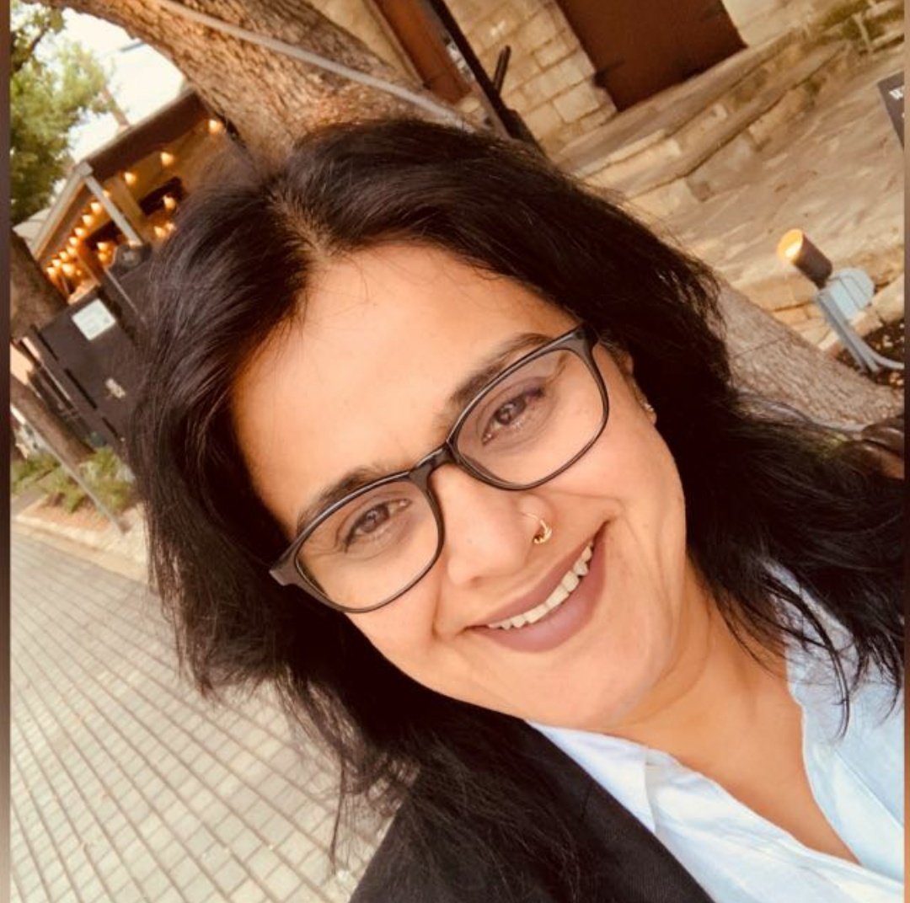



OUR TEAM
4 OFFICES
20 LAWYERS
7 PATENT AGENTS
12 PARALEGAL
25 + ENGINEERS
ELIZABETH PUTHRAN
Founder Partner
BRAHMA PUTHRAN Managing Partner
PARVATHY PRASANNAN
Partner
AMINA SHAHUL
Partner

Slide 5

INSPIRE . ENABLE . PROTECT
INNOVATION

Slide 6
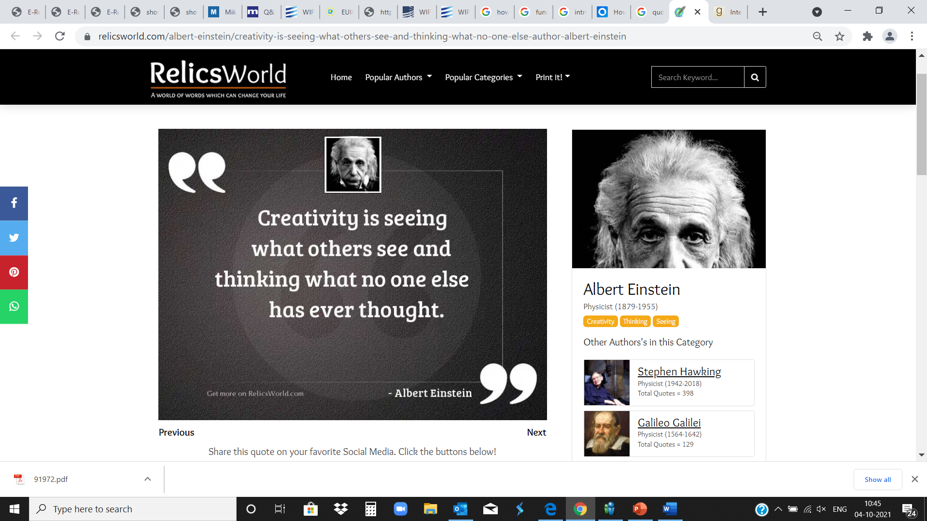
WHAT IS IPR ?
    Intangible asset
    Creation of mind
    A business asset
Must be developed, maintained, protected and used to realize value.

Slide 7

AREAS OF IPR
Trademarks
Patents
Copyrights
Designs
Trade Secrets
Geographical Indications

Slide 8

IP OFFICES IN INDIA
Trademarks – Chennai, Mumbai, Delhi, Kolkatta, Ahmedabad
Patents – Chennai, Mumbai, Delhi, Kolkata
Copyrights - Delhi
Designs - Kolkatta
Geographical Indication - Chennai

Slide 9





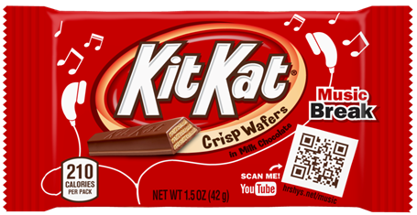

Slide 10

Function of a Trademark
Indicates source
Assures quality
Business goodwill
Brand awareness
Notes:
Trademarks protect consumers at the same time as they protect businesses.
Trademarks function as source identifiers, since they identify one seller’s goods and services and distinguish them from goods and services offered by others. For example, consumers understand that all products bearing the MICROSOFT trademark come from the same source.
Trademarks also signify that goods and services bearing the same trademark are of equal quality. Chocolate bearing the GODIVA trademark is all of the same quality; chocolate bearing the LINDT trademark is of a different (not necessarily lesser, just different) quality; chocolate bearing the M&M’s mark is of yet another different (but not necessarily lesser) quality. Goods and services bearing the same mark are expected to be of equal quality; therefore, consumers know what to expect when they purchase a product or service on or in connection with which a particular trademark is used. Consumers identify a particular trademark with a particular quality, and consequently trademarks are essential to creating goodwill and brand awareness among consumers.

Slide 11

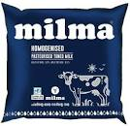


Trademarks and Service Marks
Service mark
examples
Notes:
In many countries, the term “trademark” refers to a mark that is used for goods (e.g., a car) and/or services (e.g., car repair services). Other countries use the term “trademark” to refer to any word, name, symbol, etc., that distinguishes a specific source of a PRODUCT from others in the marketplace and the term “service mark” to refer to any word, name, symbol, etc., that distinguishes the source of a specific SERVICE from others in the marketplace.
A service mark is, therefore, similar to a trademark, but it is used in connection with services (typically in advertising) to identify and distinguish the services of one source from those of others.

Slide 12

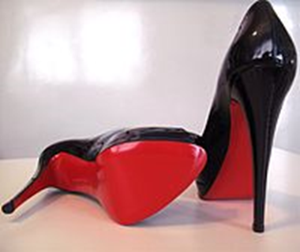

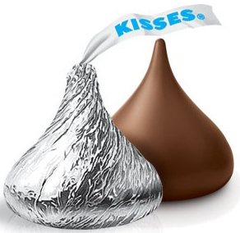


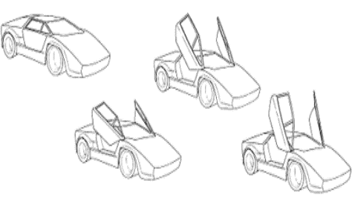
NON-TRADITIONAL TRADE MARKS

Slide 13
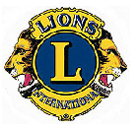
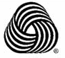


Collective mark
Certification mark
Notes:
A collective membership mark, also called a collective mark, is used to indicate membership in a group or an association when only members of the group or organization can use the collective mark. A collective mark distinguishes goods and services in accordance with particular characteristics and/or qualities defined by the group or association. An example of a collective mark is the LIONS CLUB mark, which indicates membership in that association.
A certification mark is used to certify the quality, regional origin or other origin of a product or service. A certification mark certifies that a product or service meets a certain standard of quality or is of a regional origin. An example of a certification mark is the "Woolmark," used to identify goods that are 100% wool.
The owner of a certification mark does not use the mark on its own goods or services, but rather allows others who meet a certain set of standards to use the mark on their goods or services.

Slide 14
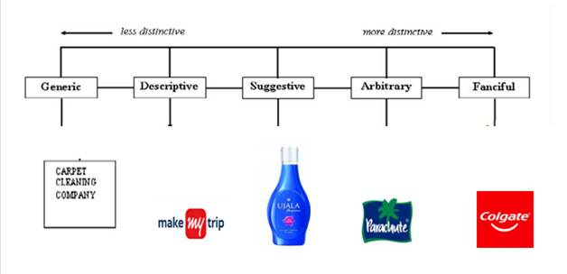
Selecting a Mark
The more distinctive the mark, the greater its level of legal protectability. Generic marks are not capable of trademark protection. Descriptive marks are capable of protection only with a showing of secondary meaning.

Slide 15
REGISTRATION OF TRADEMARKS
Trademark Search
Filing the Application
Allotment of Number
Examination
Advertisement/Publication
Opposition
Registration

Slide 16


MARKING
Trademark pending registration
Denotes a registered trademark
Validity of a Registered Mark: 10 years
Renewable indefinitely

Slide 17

Proper Use — Avoid Genericide
Once a trademark, not always a trademark
escalator
cellophane
Heroin
dry ice
aspirin
Notes:
Proper use of a trademark is essential for its continued protection. Companies must properly use their trademarks to aid the consumers who depend upon the marks and to prevent the marks from becoming generic. If a trademark is used properly, it will remain the exclusive property of its owner. If, however, the consuming public begins to treat a trademark as the name of the product, it will no longer “identify” and “distinguish” the goods or services of one company. Frequently, it is the company’s own advertising and labeling that transform the trademark into a generic term – and this is avoidable if the necessary education and training have been provided within the company. This transformation of the mark into a generic term is referred to as “genericide.” Examples of former trademarks that started as strong, fanciful or arbitrary marks but that lost their trademark significance include aspirin, cellophane, celluloid, escalator, linoleum and dry ice. Note that in some countries, such as the United States, marks that become generic lose their registered trademark status. Caution should, therefore, be exercised, as some of these terms may still function as a trademark in other jurisdictions. (For example, ASPIRIN, although no longer a registered trademark in the United States, is still registered in Canada and in Brazil, where it even holds the status of a “well-known” mark.)
To prevent genericide, policing of your trademarks is essential – both outside your company and within it.
One of the ways to police your rights is to ensure that trademarks are used correctly.

Slide 18

Remedies
Civil Suit
  Infringement
  Passing off
  Injunction
  Compensation for loss
Notes:
Misuse of trade mark- Remedies
Civil suit- for injunction to stop the infringer from using the mark and claim damages in case of infringement and passing off
If a trademark has not been registered, some jurisdictions offer protection for the business reputation or goodwill which attaches to unregistered trademarks through the tort of passing off. Passing off may provide a remedy in a scenario where a business has been trading under an unregistered trademark for many years, and a rival business starts using the same or a similar mark.
If a trademark has been registered, then it is much easier for the trademark owner to demonstrate its trademark rights and to enforce these rights through an infringement action.
Relief:
TYPES OF RELEIF
The type of relief to which a plaintiff is entitled are –
(1) An injunction restraining further use of the infringing mark.
(2) Damages or an account of profits.
(3) An order for delivery-up of infringing labels and marks for destruction or erasure.
Criminal Complaint- Law of trade marks in India lists certain acts as criminal offences, making them punishable under the Act. They include:
Falsifying a TM- falsely making a trade mark w.o the consent of the owner
Falsely apply TM of another
Making or possession of instruments for falsifying trade mark
Making false descriptions in trade- (as to quality, quality, number, weight, place of production, manufacturer, mode of manufacture etc)
Falsely representing a trade mark as registered
Falsification of entries on the registry
In addition to statutory and common law provisions for protecting registered trademarks through civil action, a trademark owner may consider recording its
marks with the appropriate customs authority.
Intellectual Property Rights (Imported Goods) Enforcement Rules, 2007, provides that the rights holder can record their registered trademarks with the Customs authorities. These guidelines authorize the Custom officials to seize goods infringing the trademarks of the rights holder at the border without obtaining any orders from the court[4]. Under these rules, the Custom authorities have initiated a recordation system using which the rights holder may give a notice in writing to the Commissioner of Customs or any other Customs officer authorized by the Commissioner at the port of import of infringing goods requesting the suspension of clearance of goods suspected to be infringing the trademarks of the rights holder. Subsequent to the filing of such notice, the Commissioner is bound to notify the rights holder within the prescribed time regarding the acceptance or rejection of this notice. In case of acceptance of the notice, the normal period of validity of such registration is one year during which assistance will be rendered by the Customs authorities to the rights holder to prohibit the importation of infringing goods at the border. After the grant of this registration the importation of goods that infringe the rights holder trademarks are deemed to be prohibited. The Customs officers have the authority to suspend the clearance of such prohibited goods either at the information received by the rights holder or by initiating suo moto action, provided they have prima facie evidence or reasonable grounds to believe that the imported goods are goods infringing the trademarks of the rights holder. After the clearance of the suspected goods is suspended the Customs authorities have to inform the rights holder of the same and should the rights holder not execute the requisite bond and join the proceedings against the importer within the prescribed period the Customs authorities will release the suspended goods.

Slide 19
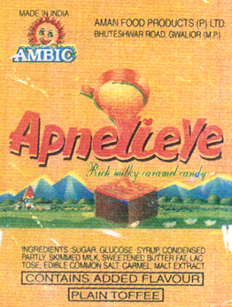
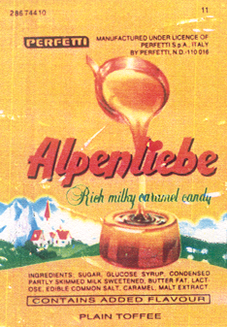
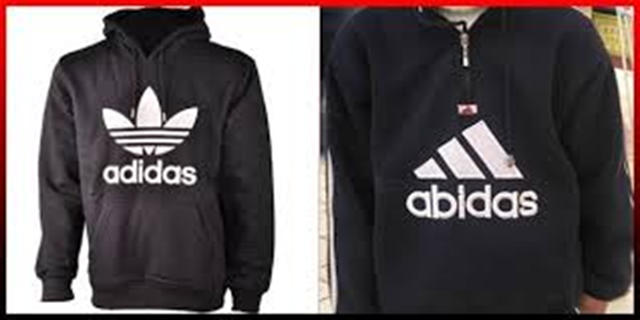

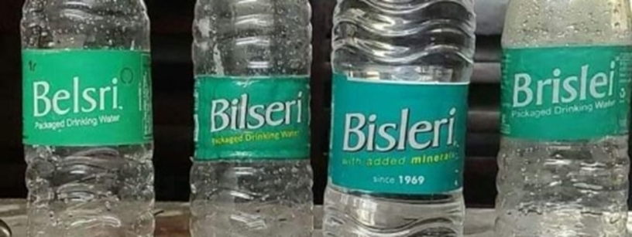
PASSING OFF/ INFRINGEMENT

Slide 20



Slide 21

PATENTS—WHAT IT IS?
IPR relating to inventions
Grant of exclusive right for limited period
Excludes others from making, using, selling, importing the patented product or process
Rights are statutory, territorial
PURPOSE: to encourage innovation, industrial growth

Slide 22
PATENTABILITY CRITERIA
NOVELTY
INVENTIVE STEP ( NON-OBVIOUS)
UTILITY/ WORKABILITY

Slide 23
INVENTIONS NOT PATENTABLE IN INDIA
Sec 3
Against public order or morality or cause damage to the health of any living being
Discovery of a scientific principle or abstract theory or living thing
New form of a known substance
Mixture of two substances
Method of Treatment of curing a disease

Slide 24
INVENTIONS NOT PATENTABLE IN INDIA
Sec 3
Plants and Animals
Software, business methods, algorithms
Any method of performing a mental act or method of playing a game
Presentation of Information
Traditional Knowledge
Sec 4
Invention relating to Atomic Energy

Slide 25

GENERAL INFORMATION FOR INVENTORS
Maintain Records of research
Do not publish your invention before filing
No objection to secret working of an invention/ reasonable trial
First to file has priority, file a patent application as early as possible

Slide 26

patent searches
Check patentability
Identify closest prior art
Helps filing a stronger application
Check infringements
Competitor’s portfolio etc.

Slide 27
PROCEDURE FOR REGISTRATION
Prior Art Search
Filing – Provisional & Complete Specification - 12 M
Publication – 18 M
Examination – 48 M
Successful prosecution-acceptance
Opposition
Sealing and grant of a patent
Opposition- Post grant
Renewal/ Annuity

Slide 28


20 years from the date of filing of patent application
Date of patent is the date on which the application for patent is filed.

Slide 29
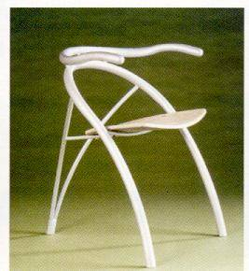
DESIGN
External shape, configuration, eye appealing aesthetic features of an article.
Integral part of the article.

Slide 30
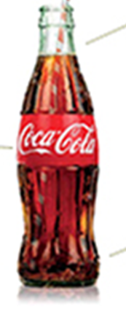


EXAMPLES
A new model of car
Novel designs on tiles, textiles, furnishing, wall papers

Slide 31
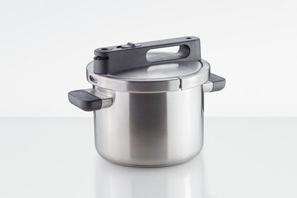
CRITERIA FOR DESIGN REGISTRATION
Must be new or original (novel)
Must relate to features, shape, configuration, pattern or ornamentation.
Must be applied by an industrial process.
Finished article judged solely by eye.

Slide 32
PROCEDURE FOR REGISTRATION
Filing the Application
Examination.
Registration.
Regd
Denotes a registered design
Validity of a Design
Valid for 10 years and further renewable for 5 years

Slide 33

remedies
PIRACY OF DESIGN
Damages
Injunction

Slide 34

TRADE SECRET
Any information used in business and kept secret from others
Terminate when the secrecy is lost
No law for the protection
A third party can only be contractually bound
Remedies:
    Injunction preventing disclosure
    Return of confidential information
    Compensation for losses suffered due to the disclosure of trade secrets

Slide 35
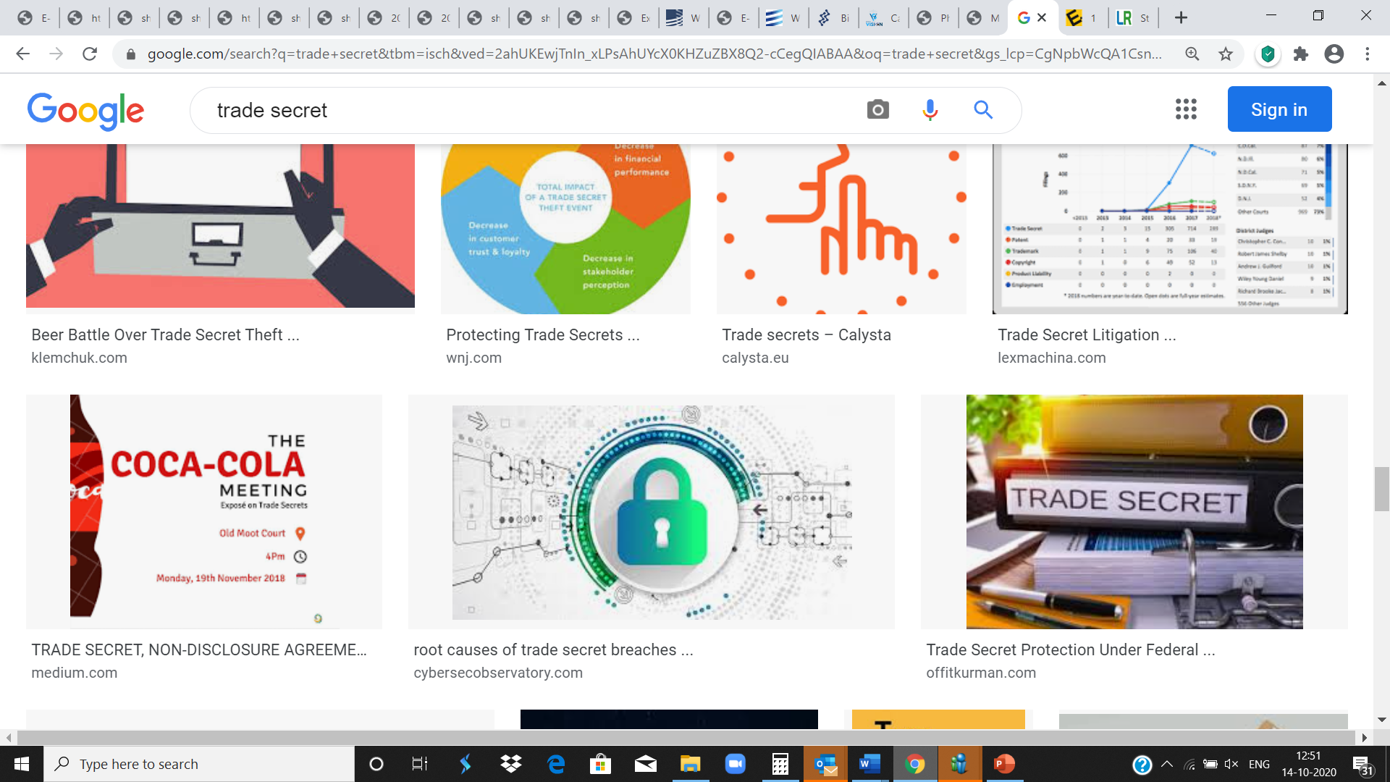
HOW TO MAINTAIN CONFIDENTIALITY
Label information as “confidential”
Restrict access to databases, servers, computer programs
Ensure that access to servers is password protected
Educate employees
Sign non-disclosure agreements

Slide 36
CONFIDENTIALITY & NON-DISCLOSURE AGREEMENTS
Need to disclose information to third parties
exploring business possibilities or
in the course of employment
Protect such disclosure through appropriate Non-Disclosure Agreements
Prevent third party recipient from using and disclosing confidential information

Slide 37

TYPES OF NON DISCLOSURE AGREEMENTS
Prevent third parties from unauthorized disclosure or use of the company’s intellectual property and
Prevent employees from unauthorized disclosure or use of the company’s intellectual property
A well-written non-disclosure agreement (NDA) is a necessity for all businesses

Slide 38
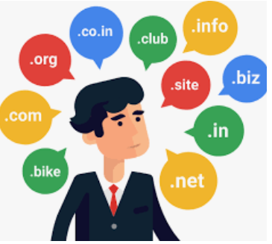
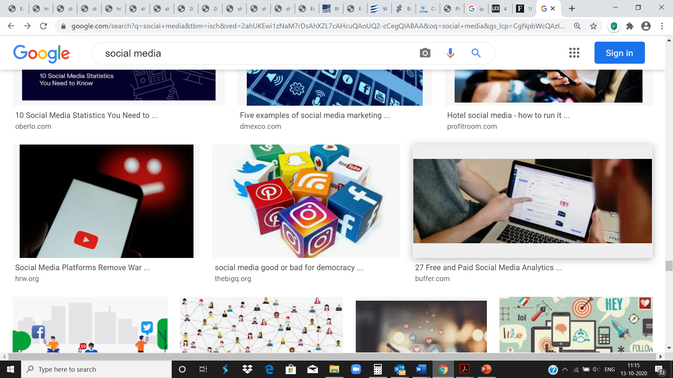
COMPANY NAME, INTERNET DOMAIN NAME & SOCIAL MEDIA ACCOUNTS
Ensure protection for
Company name
Domain name
Block popular categories of the top-level domains (TLDs)
Positive social media presence of the brands of the company
Social media marketing
Caution: Use of your social media accounts to distribute content sourced from other sites may result in infringement.

Slide 39
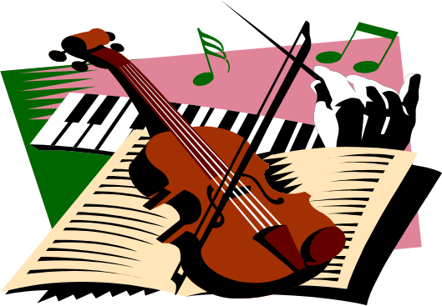
COPYRIGHT
Exclusive rights to an author or composer or creator of a work
Exists in:
Literary, dramatic, musical works.
Artistic Works
Computer Programs
Cinematographic works
Sound Recordings

Slide 40

AUTHOR’S RIGHTS
COPYRIGHT | MORAL RIGHT
During the term of copyright: To reproduce To issue copies To perform To communicate to the public To make any translation of the work To many adaptation of the work | Even after the expiry of the term of copyright Right to be identified as author of work To object to distortion, mutilation and modification of work which is prejudicial to honor or repute

Slide 41

PROTECTS- Expression OF IDEA NOT IDEA
Copyright Act
THOU SHALL NOT STEAL
No copyright in an Idea
Work should be original, protection for author’s creative expression
Others can come to the same result through an independent process.

Slide 42
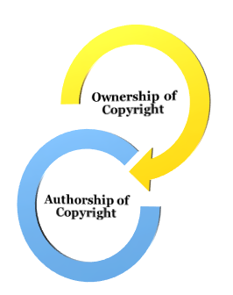
Ownership of copyright
Sui generis right
First owner is the Author or Creator of the work

Slide 43
PROCEDURE FOR REGISTRATION
Not compulsory but only optional.
Filing the Application.
Examination.
Registration.
C
Denotes a copyright

Slide 44
VALIDITY OF A COPYRIGHT
Original Literary, Dramatic, Music and Artistic Work – 60 years from the death of the author
Cinematograph films, sound recording, photographs, and anonymous publication – 60 years from the date of publication

Slide 45
INFRINGEMENT OF COPYRIGHT
Any of the following acts without the consent of the copyright owner:
Reproduce the work
Issuing copies of the work to the public
Performing, showing or playing a copyright work in public
Communicating the work to the public
Adaptation or translation of a work

Slide 46
COPYRIGHT SOCIETES
Licensed society with collective administration, formed by owners of copyright.
Can issue or award licenses for work in which copyright subsists
  The Indian Performing Right Society Limited (IPRS)
  Phonographic Performance Limited (PPL)
  Indian Reprographic Rights Organization (IRRO)
  Indian Singers’ Rights Association (ISRA)

Slide 47
LICENSES
For playing or performing music in public following licenses/ certificates may be needed:
IPRS – to play a song in which they have obtained rights from authors/ composers of the work.
PPL - to play a sound recording in which they have obtained right from the recording company.
ISRA- to play a musical work or sound recordings in which they have obtained rights from singers;
Licenses from owners or their agents where they have not assigned rights to a copyright society.

Slide 48

Remedies
Civil Remedies
Injunction
Damages
Account of profits
Delivery /destruction
Criminal Remedies
Imprisonment and fine

Slide 49
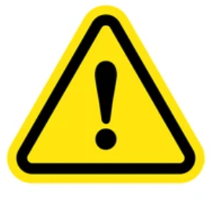
Does law permit any use of copyright work without permission of the owner?
Subject to certain conditions, some uses of copyrighted matters are permitted without the consent of the Copyright owner
FAIR USE

Slide 50
FAIR USE
Private or personal use, research.
Criticism or review of the content
Reporting of current events through newspaper
Reproduction for judicial proceedings or a report of judicial proceedings
Educational Purposes

Slide 51
FAIR USE
Playing a recording :
In an enclosed room or hall meant for the common use of residents in
any residential premises (not being a hotel or similar commercial establishment)
as part of the amenities provided exclusively or mainly for the residents;
or as part of the activities of a club not established or conducted for profit;

Slide 52
FAIR USE
The performance of a literary, dramatic or musical work by
an amateur club or society, if the performance is given to a non-paying audience, or for the benefit of a religious institution.
The performance of a literary, dramatic or musical work or the communication to the public of such work or of a sound recording
in the course of a bonafide religious ceremony or an official ceremony held by the Government or a local authority.

Slide 53
Points to note
Place Copyright notice (ex: COPYRIGHT © APRIL 2023 ALL RIGHTS RESERVED – PUTHRAN & ASSOCIATES) to indicate ownership of a work
Copyright will apply whether there is a copyright notice or not.
Work published on the Internet may be publicly accessible, but may not be in public domain, hence not free to use.
A work will fall into public domain after copyright expires, this is many years after the author’s death.
If you are using someone else’s work, check all licenses and permissions.
If not used under license, make sure that the use is ‘fair’

Slide 54
Points to note
Is acknowledgment sufficient before using a copyrighted work?
Mere acknowledgment by citing the author’s name is not always sufficient, license/ permission required
Always safe to use works in public domain

Slide 55
IPR as a tool FOR DEVELOPMENT
Intellectual Property – is a business asset
Invest in intellectual property
Makes business more attractive to investors
Builds credibility and creates a solid foundation
Proactive steps to protect ideas and intellectual property and stay clear of infringement of third-party rights

Slide 56


Thank You
Chennai – Bangalore – Trivandrum - Kochi
Email: parvathy@puthrans.com
Tel: 0471 2430877
Images and Trademarks used in this presentation are for educational purposes. Copyright in the images/ logos used belong to their respective owners

