Slide 1
Kottayam Branch of SIRC of ICAI
Latest Changes in GST
19th March 2022

Slide 2
Latest Changes in GST

Slide 3
Union Budget 2022
Kerala Budget 2022
Other Recent changes

Slide 4
Union Budget 2022

Slide 5
GST Changes in Budget 2022
GST Changes in Budget 2022 are effective from :-
Retrospective Date (01.07.2017)
Notified date
Certain sections are removed…..Section 42,43,43A…..
Certain Sections are substituted…..Section 38, 41….
Certain Sections are Amended…..Section 16,34,37,39……
ITC provisions are made more stringent…..Section 16, 38,41,49…..

Slide 6
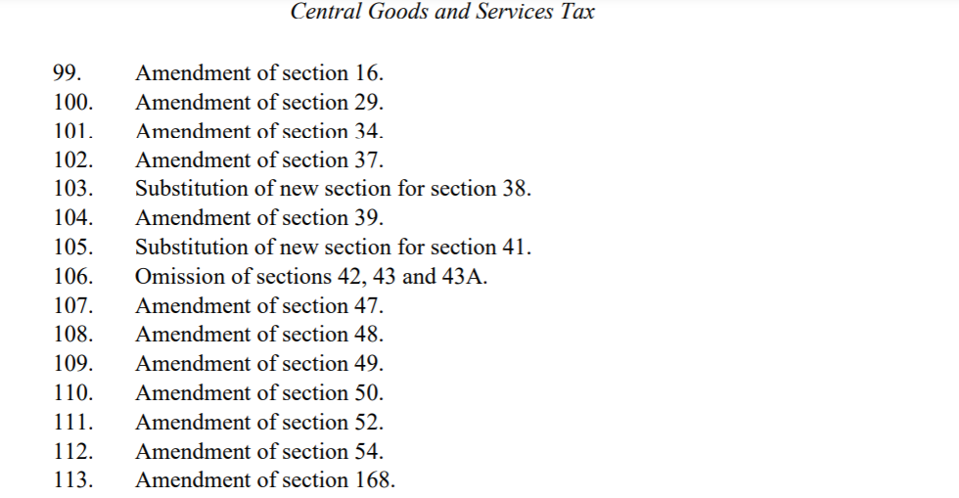

Slide 7
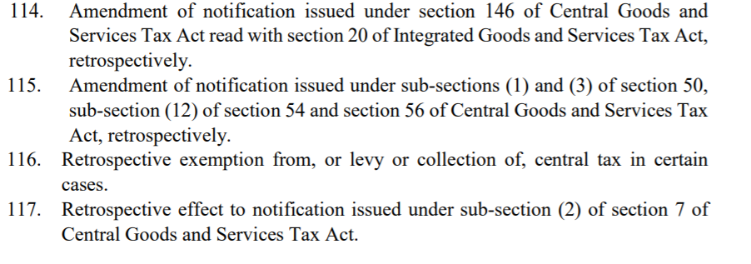

Slide 8
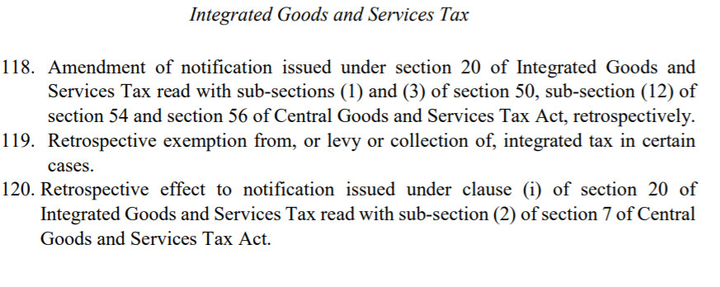

Slide 9
GST Changes in Budget 2022
Taxpayers adapted to GST and deserve applause: FM
GST is a landmark reform: FM.
Gross GST collection for January 2022 is Rs 1.4 lakh crores approx, highest since the inception of GST: Says FM.

Slide 10
GST Changes in Budget 2022
INPUT TAX CREDIT
Section 16
Section 38
Section 41
Section 49
Government is bringing more and more ‘conditions’ and ‘Restrictions’ not only in ‘availment’ of ITC ……..but also ……………in ‘Utilisation’
Governments are empowered to bring more such conditions and restrictions…!!!

Slide 11
GST Changes in Budget 2022
ITC……….. 16(2)………..new clause added…….(ba).The details of Input Tax Credit in respect of the said supply communicated to such registered person under section 38 has not been restricted..
Section 38……….new section introduced………the eligibility of ITC heavily depends on the Accuracy, timeliness, eligibility, Time limit of his registration, etc…etc…… (very dangerous provision indeed…)…..Two way Communication avoided…..
Section 41….Availment of ITC on Self Assessment basis… section substituted ……….. Take eligible ITC on Self Assessment. If supplier has not paid the tax, reverse the ITC with interest and Re-avail ITC if he supplier paid it, later.

Slide 12
GST Changes in Budget 2022
Section 38……….. New conditions & Restrictions introduced….
38(1)………. Auto Generated Statement made available…..
38(2)………..Auto Generated Statement shall have Details of ITC that may be availed by Recipient……and ITC which cannot be so availed…..if supply is from the following suppliers-
Newly Regd suppliers..
Who Failed to pay tax..
If his Output tax in GSTR1 exceeds the output tax in GSTR 3B.
Who availed ITC more that ITC reflected in his GSTR 2B.
Who defaulted in utilising ITC as per Section 49(12).
Prescribed suppliers

Slide 13
GST Changes in Budget 2022
Section 49(12)…..new subsection added………..Now, Govt can set artificial restrictions on maximum proportion of Output Tax which may be utilised from……..Electronic credit Ledger.
Section 16(4)…… time limit for availment of ITC …. due date of September of next year….changed to ….. 30th Nov of Next Year.
Section 29…Composition dealer….….“returns for three consecutive tax periods”, …..changed to…… “the return for a financial year beyond three months from the due date of furnishing the said return’

Slide 14
GST Changes in Budget 2022
Section 29…Regular dealer….….“a period of six months”, changed to ……..“such continuous tax period as may be prescribed” ’
Section 34……. Credit Note…. “September”, changed to ………“the thirtieth day of November”
Section 37…..GSTR 1 …. “shall furnish, electronically,”, changed to “subject to such conditions and restrictions and”
Section 37….GSTR 1….. “shall be communicated to the recipient of the said supplies within such time and in such manner as may be prescribed”,…… changed to …..“shall, subject to such conditions and restrictions, within such time and in such manner as may be prescribed, be communicated to the recipient of the said supplies”

Slide 15
GST Changes in Budget 2022
Section 37(3)…..GSTR 1 …. ““furnishing of the return under section 39 for the month of September”, ….changed to …. “the thirtieth day of November”.
Section 37…….new sub section 4 introduced as follows:
“(4) A registered person shall not be allowed to furnish the details of outward supplies under sub-section (1) for a tax period, if the details of outward supplies for any of the previous tax periods has not been furnished by him:
Provided that the Government may, on the recommendations of the Council, by notification, subject to such conditions and restrictions as may be specified therein, allow a registered person or a class of registered persons to furnish the details of outward supplies under sub-section (1), even if he has not furnished the details of outward supplies for one or more previous tax periods.”.

Slide 16
GST Changes in Budget 2022
Section 39…….Monthly return by NRTP……….20th …changed to….. 13 th…
Section 39…….QRMP……….either Self Assessed Tax or specified amount.
Section 39…GSTR 3B….rectification time limit….….of September….changed to …….30th Nov.
Section 39 (10)……GSTR 3B cannot be filed, if earlier 3B is ending…now….. GSTR 1 is also added to that…..

Slide 17
GST Changes in Budget 2022
Sections….42,43 and 43A….Omitted. (two way communication done away with)
Section 47… late fees ….. introduced for ….TCS………..
Section 49(10)…… cash can be allowed to transfer from Ecash Leger to Ecash Ledger of same person or distinct Person……(SGST Transfer to other State’s SGST, we have to wait and watch !)

Slide 18
GST Changes in Budget 2022
Section 50 (3)………substituted…… Interest for ITC wrongly availed and utilised……..Rate is upto 24% (18% notified …..w.r.e.f 01.07.2017) …and…………. the manner of calculation will be prescribed…(Interest Notification 13/2017-CT dt 28.06.2017 retrospectively amended)…….ITC wrongly availed, but not utilised does not attract interest.
Refund – Section 54;- UIN Holders gets 2 years time to claim refund (Earlier it was 6 months).
Refund – Relevant date for SEZ supplies – 2 years from the due date of GSTR 3B of the month of supply.
Refund- Withholding of Refund- applies to all cases of refund (Earlier it was only for Refund of ITC)

Slide 19
GST Changes in Budget 2022
Alcoholic Liquor License fees…….exempted from GST with retrospective effect from 01.07.2017.

Slide 20
Kerala Budget 2022

Slide 21
Kerala Budget Changes
Stamp Duty value increase by 10%....Income Tax impact..
Kerala Flood Cess…..Refund will be enabled…
Amendment in Kerala GST Act, similar to changes in CGST Act will also be introduced..
GST Compensation Cess will be continued, but States will not get the compensation after 30.06.2022.
Modernisation and 100% digitalisation of SGST department….
Tax payer Profile card will be introduced..

Slide 22
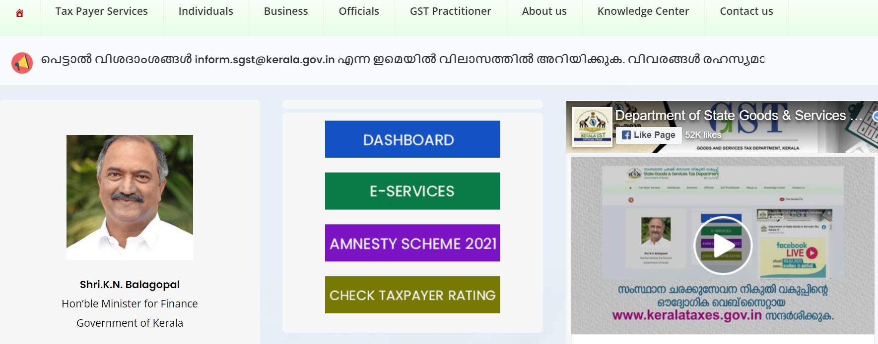

Slide 24
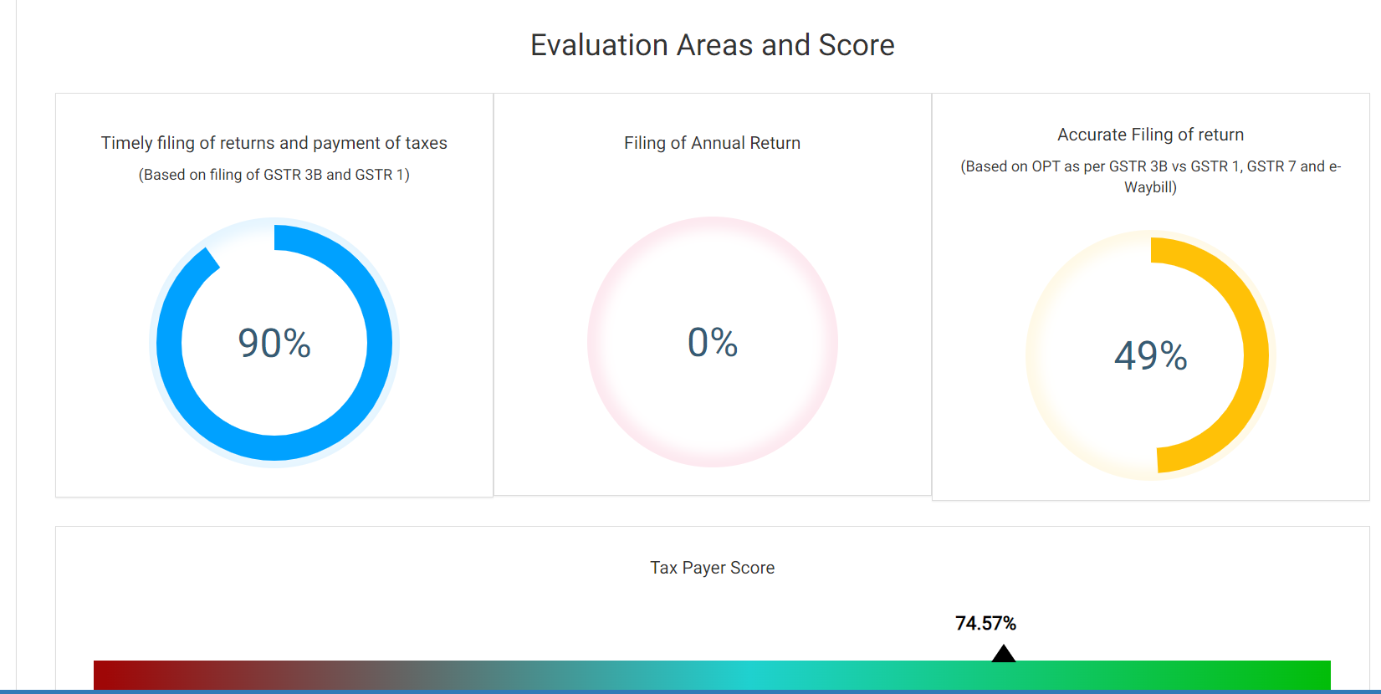

Slide 25
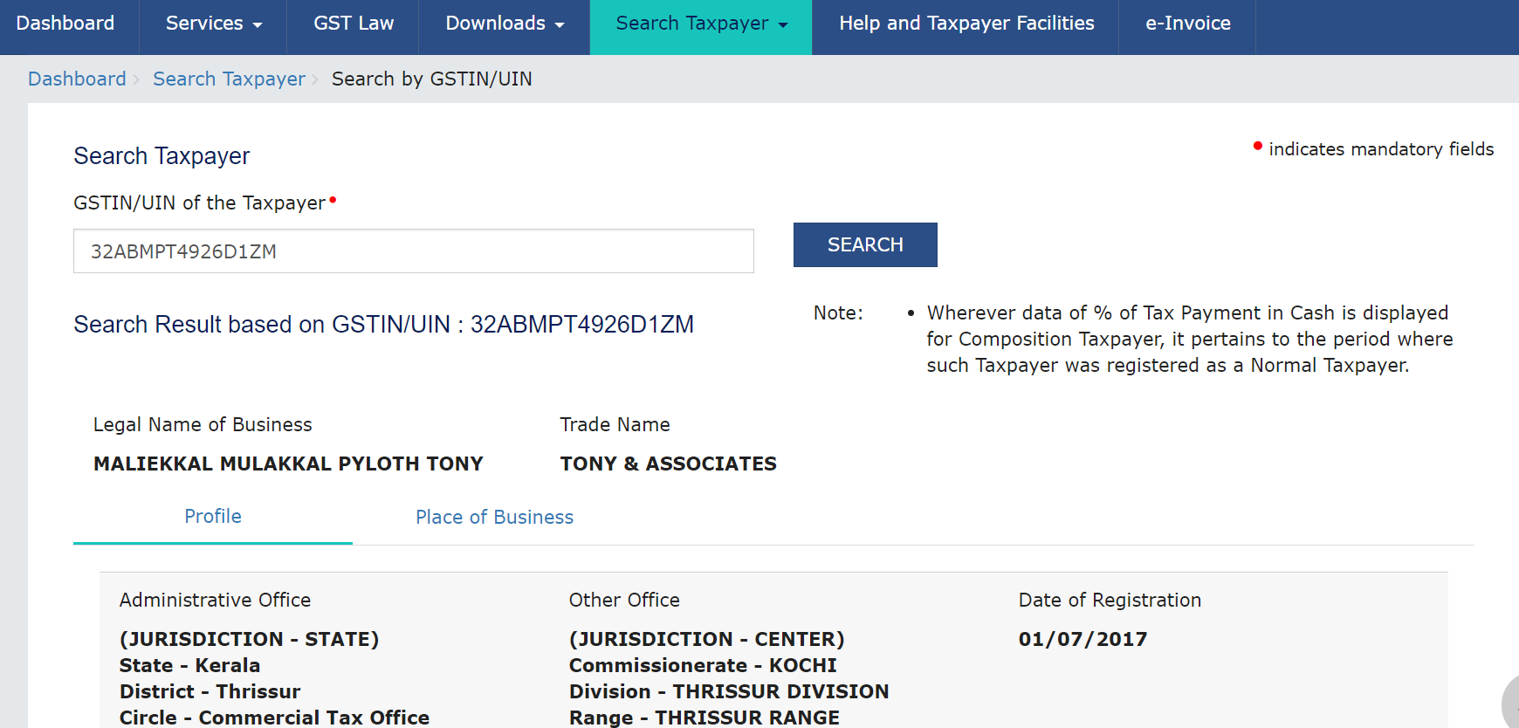

Slide 26
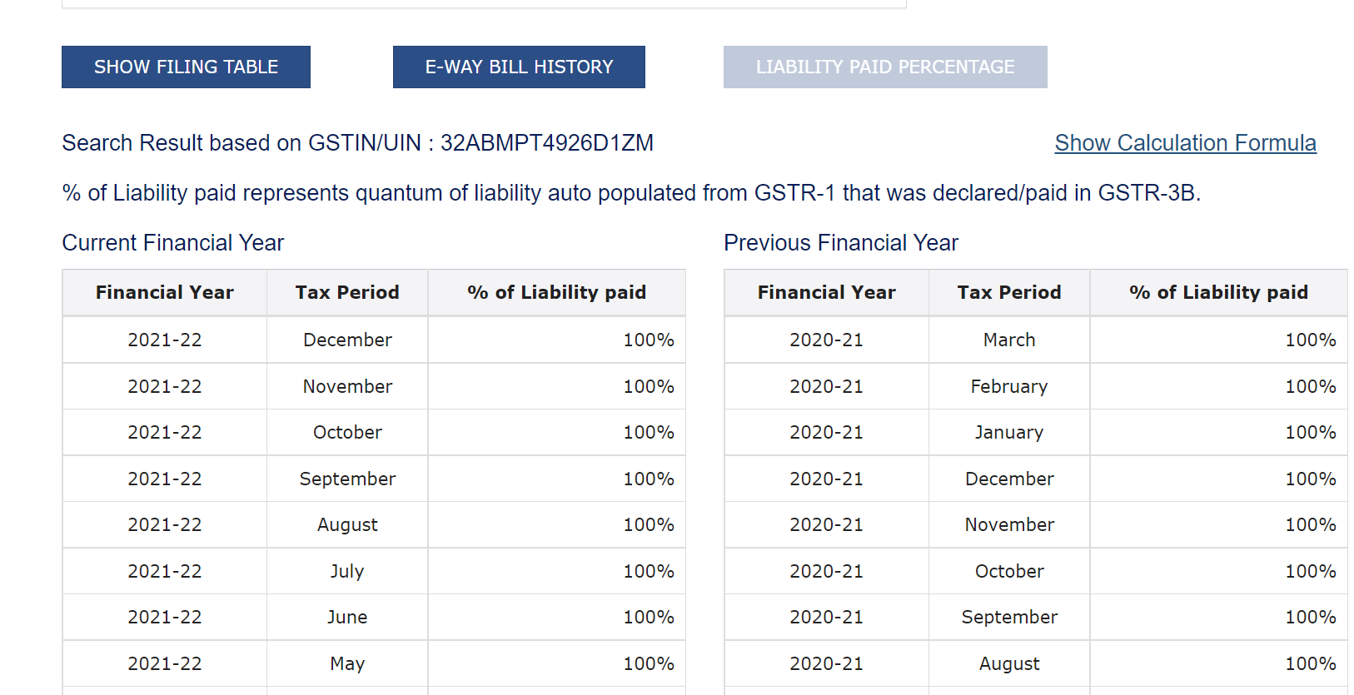

Slide 27
GST Changes in Budget 2022
Reorganisation of SGST Department…
Lucky Bill App will be launched…
Annual Return – KFC – Due date is 30.04.2022, but the form not yet introduced in the Portal.
Eway Bill for gold, within Kerala, is being explored…

Slide 28
Other Recent Changes

Slide 29
Other Changes
Restaurant services….included in Section 9(5)….wef 01.01.2022.
Adjudication of SCN issued by GST Audit Wing……..to Executive Commissionerate…..
Adjudication of SCN issued by DGGI related to Tax payers having Registration in multiple Commissionerates……moved ..to Centralised Commissionerates.
Applicability of E Invoice………….limit reduced to 20 Cr.

Slide 30
Thank You

