Slide 1
ANALYSIS OF CERTAIN RELEVANT CLAUSES OF FORM 3CD

Slide 2
CHANGES INTRODUCED IN FORM 3CD FROM AY 2021-22
CBDT has amended the Tax Audit Report (TAR) in Form 3CD vide Notification No. 28/2021 in G.S.R. 246(E) dated 1.4.2021 by Income-tax (eighth Amendment) Rules, 2021 in order to incorporate the changes brought in the Income Tax Act, 1961 (“Act”) by the Finance Act, 2021. These changes in Form 3CD shall be effective from the 1st day of April 2021 and shall apply for the assessment year 2021-22.
The notification of 1st April has brought in 6 (six) changes to Tax Audit Report which is applicable from AY 2021-22.

Slide 3
CHANGES INTRODUCED IN FORM 3CD FROM AY 2021-22
CLAUSE 8:
Changes in Clause 8a to report exercise of option under section 115BAC/115BAD :
Existing Clause 8a of Form 3CD requires reporting of exercise of an option by the assessee under section 115BA/115BAA/115BAB.
Finance Act, 2020 has introduced two new concessional tax rate regime under section 115BAC for Individuals and HUF and section 115BAD for cooperative societies. The two provisions are applicable from AY 2021-22.

Slide 4
CHANGES INTRODUCED IN FORM 3CD FROM AY 2021-22
In order to incorporate the same in the Tax Audit Report, Clause 8a of Form 3CD is changed to include these two sections - section 115BAC and section 115BAD also.
For this clause, clause 8a is amended as mentioned below-
“8A Whether the assessee has opted for taxation under section 115BA/115BAA/115BAB/ 115BAC/115BAD?”

Slide 5
CHANGES INTRODUCED IN FORM 3CD FROM AY 2021-22
CLAUSE 17:
Amendment in Clause 17 to report higher safe harbour rule of 20% between actual sales consideration and stamp duty value under section 43CA and section 56(2)(x).
Existing Clause 17 of Form 3CD requires to report the transfer of any land or building or both during the previous year for a consideration less than the value adopted or assessed or assessable by any authority of a State Government as per section 43CA or 50C.

Slide 6
CHANGES INTRODUCED IN FORM 3CD FROM AY 2021-22
Finance Act, 2021 has amended the provisions of section 43CA and section 56(2)(x). In order to boost demand in the real-estate sector and to enable the real-estate developers to liquidate their unsold inventory at a rate substantially lower than the circle rate and giving benefit to the home buyers, it is provided to increase the safe harbour from 10% to 20% under section 43CA for the period from 12th November 2020 to 30th June 2021 in respect of the only primary sale of residential units of value up to Rs. 2 crore.
Consequential relief by increasing the safe harbour from 10% to 20% was also allowed to buyers of these residential units under section 56(2)(x) for the said period. Therefore, for these transactions, the circle rate shall be deemed as a sale/purchase consideration only if the variation between the agreement value and the circle rate is more than 20%.

Slide 7
CHANGES INTRODUCED IN FORM 3CD FROM AY 2021-22
These changes are now incorporated in Form 3CD from AY 2021-22. For this purpose, existing clause 17 is substituted with the following new Clause 17-
“Where any land or building or both is transferred during the previous year for a consideration less than value adopted or assessed or assessable by any authority of a State Government referred to in section 43CAor 50C,please furnish:”
Details of property | Consideration received or accrued | Value adopted or assessed or assessable | Whether provisions of second proviso to sub- section (1) of section 43CA or fourth proviso to clause (x) of sub-section (2) of section 56 applicable? [Yes/No

Slide 8
CHANGES INTRODUCED IN FORM 3CD FROM AY 2021-22
CLAUSE 18:
Changes in Clause 18 related to Adjustment in WDV of Assets
For exercising option under sections 115BAC/115BAD :
Clause 18(ca) was introduced in the Form 3CD for the AY 2020-21 vide Notification No.82/2020 dated 01.10.2020 to report the adjustment in WDV of the block of assets if lower tax regime under Section 115BAA is exercised by the assessee.
This clause was valid for AY 2021-22 only. As stated earlier, Finance Act, 2020 introduced two new concessional tax rate regimes under Section 115BAC for Individuals and HUF and Section 115BAD for cooperative societies. The two provisions are applicable from AY 2021-22.

Slide 9
CHANGES INTRODUCED IN FORM 3CD FROM AY 2021-22
In these cases also additional depreciation is not allowed and hence requires adjustment in WDV of the block of assets. Hence Clause 18(ca) is substituted with the following new sub-clause (ca) which is applicable for AY 2021-22 only-
“(ca) Adjustment made to the written down value under section 115BAC/115BAD (for assessment year 2021-2022 only)……”

Slide 10
CHANGES INTRODUCED IN FORM 3CD FROM AY 2021-22
Changes in Clause 18 of Form 3CD related to Depreciation of Goodwill :
Finance Act, 2021has amended the provisions of section 32 to deny depreciation on goodwill. It is further provided that the block containing the goodwill as an asset shall be modified and depreciation on goodwill as appearing in that block at the WDV as of 1.4.2020 shall not be claimed from AY 2021-22 and such value of goodwill will be excluded from the block. The block needs to be modified to that extent. Form 3CD has made the necessary changes in clause 18.
For this purpose, a new sub-clause (cb) is inserted in Clause 18 of Form 3CD for reporting the adjustment in WDV of the block of assets in the following manner-
“(cb) Adjustment made to written down value of Intangible asset due to excluding value of goodwill of a business or profession…..”

Slide 11
CHANGES INTRODUCED IN FORM 3CD FROM AY 2021-22
CLAUSE 32:
Changes in Clause 32 to report adjustment in brought forward of losses if option u/s 115BAC/115BAD is exercised :
The new tax regime under section 115BAA, section 115BAC and section 115BAD do not allow certain deductions and if the option under these provisions is exercised then the brought forward losses need to be modified to the extent they are related to such restricted disallowed deductions.
Thus, similar to changes in clause 8a and clause 18, Clause 32 of the Form 3CD is also amended to include section 115BAC and section 115BAD in the reporting requirement.
For this purpose, Clause 32 of Form 3CD is substituted with the following new clause-

Slide 12
“(a)Details of brought forward loss or depreciation allowance, in the following manner, to the extent available:”
Serial Number | Assessment Year | Nature of loss/ allowance (in rupees) | Amount as returned* (in rupees) | All losses/allowances not allowed under section 115BAA/ 115BAC/115BAD | Amount as adjusted by withdrawal of additional depreciation on account of opting for taxation under section 115BAC/115BAD^ | Amounts as assessed (give reference to relevant order) | Remark
(1) | (2) | (3) | (4) | (5) | (6) | (7) | (8)

Slide 13
CHANGES INTRODUCED IN FORM 3CD FROM AY 2021-22
Omission of Clause 36 related to DDT
The amended Form 3CD has removed clause 36 from the reporting requirement from AY 2021-22.
Finance Act 2020 has abolished the Dividend Distribution Tax (DDT) and reverted the classic system of taxation of dividend income in the hands of the shareholders/recipients. Hence companies are not required to pay any dividend distribution tax from FY 2020-21.
These changes are now incorporated in Form 3CD. Clause 36 of the existing Form 3CD is omitted. Henceforth, no reporting is required in Form 3CD for DDT.

Slide 14
CLAUSE 13 – METHOD OF ACCOUNTING
REPORTING REQUIREMENTS:
(a) Method of Accounting employed in the previous year.
(b) Whether there has been any change in the method of accounting employed vis-à-vis the method employed in the immediately preceeding previous year.
(c) If answer to (b) above is in the affirmative, give details of such change, and the effect thereof on the Profit or Loss. [ in the specified reporting format ].
(d) Adjustments on account of ICDS I to ICDS X with details of impact on profit.
(e) Disclosure as per ICDS except ICDS VI and VIII.

Slide 15

CLAUSE 13 – METHOD OF ACCOUNTING
Whether any adjustment is required to be made to the profits or loss for complying with the provisions of ICDS notified u/s 145(2). If yes, details are to be given in the specified format below:
ICDS notified u/s 145(2) warrants various disclosures to be made. Such disclosures are to be made in the reporting format:

Slide 16
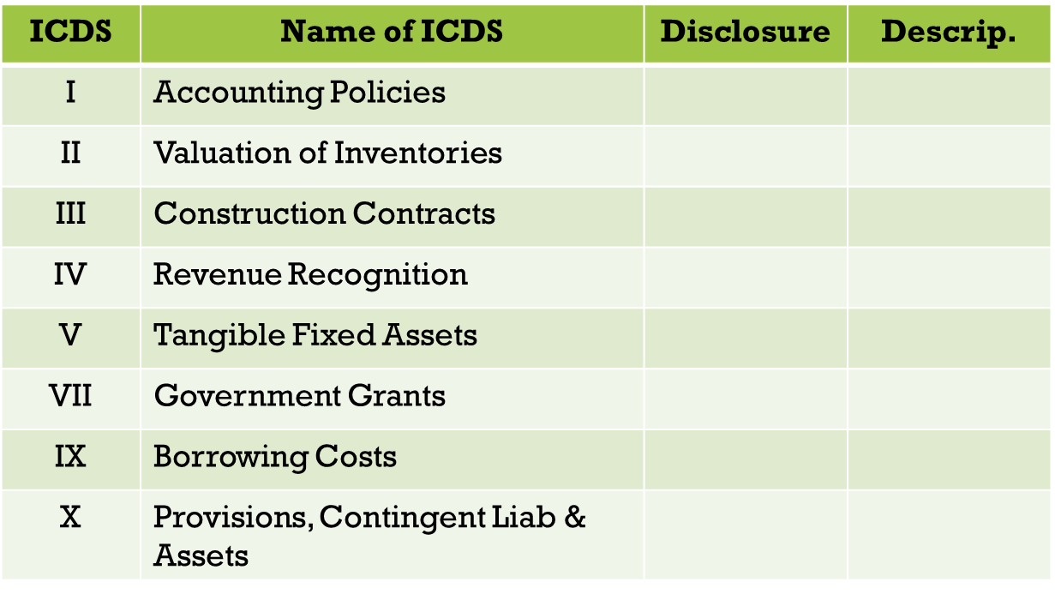
Disclosure as per ICDS:

Slide 17
CLAUSE 14 – METHOD OF VALUATION OF CLOSING STOCK
Valuation to be done as per Sec 145A which mandates ICDS II on valuation of inventories.
In case of deviation from the method of valuation prescribed u/s 145A, the effect of deviation on profit or loss should provided.
Audit Checklist includes:
Study the procedure and method of valuation adopted by the assessee.
Examine whether the method of stock valuation is followed consistently from year to year.
Peruse the stock valuation statement.
Examine compliance with applicable ICDS II or AS – 2.
Ensure whether proper adjustments are made in total income computation for differences arising out of GST, cess etc depending on the method of accounting followed.

Slide 18
CLAUSE 16 : AMOUNTS NOT CREDITED TO P&L ACCOUNT
Verify the reserves account, or any other account to identify I any item is directly credited to the same.
Verify credits in capital accounts of the proprietor/partner, credits in the other balance sheet items.
Only the claims lodged and admitted by authorities be reported. If such claims are not admitted, the same need not be reported.
General disclaimer may be given that the auditor has not gone beyond the books of accounts produced to him during audit and has not conducted an investigation to find out if the assessee has not credited any amounts in the book.

Slide 19
CLAUSE 22: INTEREST INADMISSIBLE U/S 23 OF MSME ACT, 2006
Section 23 of the Micro Small and Medium Enterprises Development Act, 2006 (MSMEDA) overrides the provisions of the Income Tax Act, 1961.
Section 23 of the MSMEDA provides that if a buyer pays interest to a supplier being, a micro or small enterprise, such interest, for the purposes of computation of Income – Tax Act, not allowed as a deduction.
Obtain a full list of suppliers, who fall within the purview of the definition of MSME Act.

Slide 20
CLAUSE 26 – PAYMENTS U/S 43B
Sec 43B commences with the non-obstante clause, ie “Not withstanding anything contained in any other provisions of the Act”, the following amounts shall be allowed as deduction.
In respect of any sum referred to in clause (a),(b),(c), (d),(e ), (f) or (g) of Section 43B, the liability for which –
pre-existed on the 1st day of the previous year but was not allowed in the assessment of any preceding previous year and was –
(a) paid during the previous year
(b) not paid during the previous year
was incurred in the previous year and was –
(a) paid on or before the due date for furnishing the ROI of the PY u/s 139(1)
(b) not paid on or before the aforesaid date.

Slide 21
CLAUSE 26 – PAYMENTS U/S 43B
Amendment to Sec 43B(da) with effect from 01.04.2020
A deduction of any sum, being interest payable under clause (da) (with regard to deposit taking NBFCs and systematically important Non – deposit taking NBFCs), shall be allowed if such interest has been actually paid and any interest referred to in that clause which has been converted into a loan or borrowing shall not be deemed to have been actually paid.

Slide 22
CLAUSE 31- 269SS/269T/269ST
PROVISIONS OF SEC 269SS
No person can accept or take any Loan or Deposit or specified sum from any other person otherwise than by an account payee cheque or DD, use of ECS through a bank account, or such other electronic mode as may be prescribed if –
The amount of the Loan or deposit or specified sum the aggregate of such sum is Rs 20,000 or more, or
On the date of taking or accepting such loan or deposit, any loan or deposit taken or accepted by such person from the depositor is remaining unpaid and the amount or aggregate amount remaining unpaid is Rs 20,000 or more or,
The amount of the aggregate amount referred to in (a) along with the amount or the aggregate amount referred to in (b) is Rs 20,000 or more.

Slide 23
Penalty u/s 271D is attracted for contravention of sec 269SS:
If payment of amount is made by a partner to the firm, the provision of section 269SS is not applicable. [ Sreepack Enterprises 64 ITD 300 (Ahd) ].
Transactions between Family Members – The provisions of this section is applicable even for transactions between husband and wife or parents and children or relatives.
Share Application Money – the amount paid in support of an application for shares must be considered to be a deposit u/s 269SS till the allotment of shares or refund of the money on rejection of the application.

Slide 24
PROVISIONS OF SECTION 269T
No person shall repay any loan or deposit made with it or any specified advance received by it otherwise than by an account payee cheque or account payee bank draft drawn in the name of the person who has made the loan or deposit or paid the specified advance, or by use of electronic clearing system through a bank account if –
the amount of the loan or deposit or specified advance together with the interest, if any, payable thereon is Rs 20,000 or more, or
the aggregate amount of the loans or deposits held by such person with the branch of the banking company or co-operative bank or, as the case may be, the other company or co-operative society or the firm, or other person either in his own name or jointly with any other person on the date of such repayment together with the interest, if any, payable on such loans or deposits is Rs.20,000 or more,, or
the aggregate amount of the specified advances received by such person either in his own name or jointly with any other person on the date of such repayment together with the interest, if any, payable on such specified advances is Rs.20,000 or more.

Slide 25
PROVISIONS OF SEC 269ST
No person shall receive an amount greater than or equal to Rs 2 lakhs, otherwise than by an account payee cheque or an account payee bank draft or use of ECS, such other electronic mode as may be prescribed –
In aggregate from a person in a day, or
In respect of a single transaction, or
In respect of transactions relating to one event or occasion from a person
Penalty u/s 271DA is leviable for contravention of sec 269ST.

Slide 26
CLAUSE 34 – TDS/TCS SUMMARY
Details of all expenses on which TDS / TCS is required to be deducted/collected and details of whether TDS/TCS is deducted/collected at specified rates.
Reporting Requirements:
Whether the assessee is required to deduct or collect tax as per the provisions of Chapter XVII-B or chapter XVII-BB, if yes, furnish the details in the reporting format specified.
Whether the assessee is required to furnish the statement of TDS or TCS. If yes, please furnish the details in the reporting format specified.
Whether the assessee is liable to pay interest u/s 201(1A) or sec 206C(7). If yes, please furnish the details in the reporting format specified.

Slide 27
CLAUSE 35 : QUANTITATIVE DETAILS
Following quantitative details of principle items traded are to be disclosed in case of both trading and manufacturing concern :
Opening Stock
Purchases during the year
Sales during the year
Closing Stock
Shortage / excess if any, etc.
Issues with respect to valuation –
Whether value should be as per ICDS or as per books?
Mismatch of opening and closing stock as reported in financials, TAR and ITR.

Slide 28
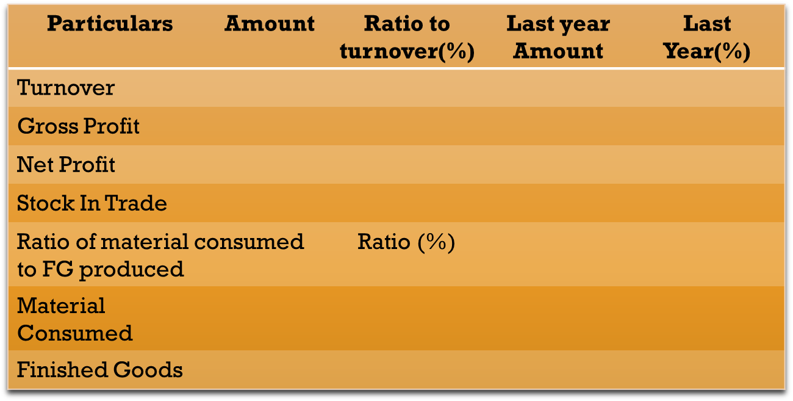
CLAUSE NO: 40 – ACCOUNTING RATIOS
Determine the different ratios by culling out relevant information from the Manufacturing/Trading and Profit and Loss account.

Slide 29
CLAUSE 42: ASSESSEE REQUIRED TO FURNISH STATEMENT IN FORM 61 / 61A/ 61B
Verify whether auditee is one of the reporting entities u/s 285BA for reporting specified financial transactions (SFT)
If yes furnish:
i. Identification number
ii. Type
iii. Due date for furnishing statement
iv. Date of furnishing statement
v. Whether form contains all details
If no furnish details of transactions not reported

Slide 30


Slide 31


