Slide 1
Income Tax Return Forms for AY 2021-22 Important Changes
CA. P. SATHEESAN FCA
THRISSUR

Slide 2
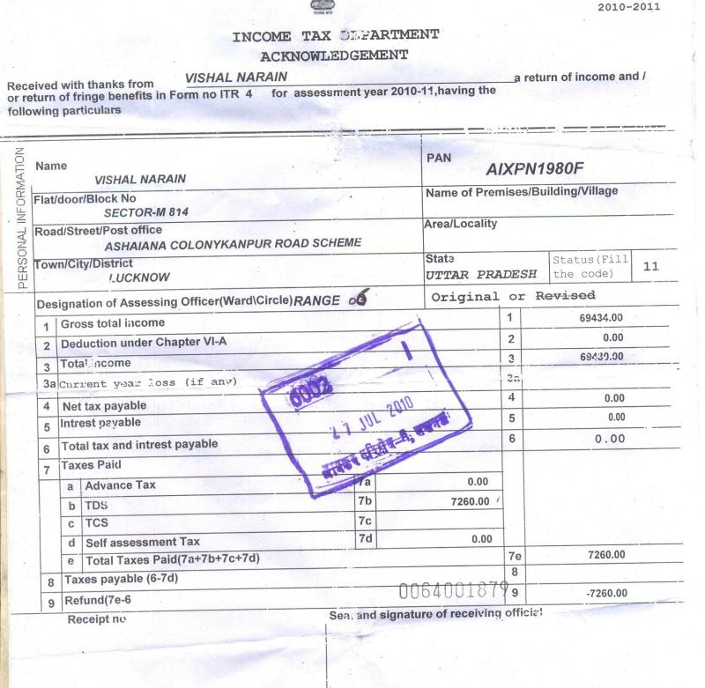
CBDT has vide Notification dated 31st March, 2021 notified 7 ITR Forms and ITR V for AY 2021-22.
As of now only Form ITR-1,2 & 4 is available for e-filing on website for AY 2021-22.
The other ITR Utilities will be available in due course.
Don’t know what are the issues will arise due to the new site.

Slide 3
New section in the Finance Act, 2020 Section 115BAC & 115BAD
New Section 115BAC and 115BAD:
Individuals and HEF can opt for new rate of tax for their computation of income under section 115BAC with out considering the Chapter VIA deductions ( except Sections 80CCD –Pension and 80JJAA-New employee cost) and subject to some other restrictions.
Co-operative Societies can opt for a tax rate of 22% under section 115BAD with some restrictions.

Slide 4
Belated Return u/s 139(4)
Belated (Revised) Return can now be filed 3 Months before the end of the Relevant AY (ie on or before December) (extended to January now)
Revised Return u/s 139(5)
Revised Return can now be filed 3 months before the end of the Relevant AY.
Return can be revised any no. of times.

Slide 5
VARIOUS ITR FORMS
Form No. | Purpose
ITR-1 : SAHAJ | For resident Individuals having Income from Salaries, one house property, other sources (Interest etc.) and having total income unto Rs.50 lakh
ITR-2 | For Individuals and HUFs not carrying out business or profession under any proprietorship, Director of the Company, Payment of tax on ESOP of startup deferred and any TDS deducted under section 194N
ITR-3 | For individuals and HUFs having income from a proprietary business or profession and Payment of tax on ESOP of start-up deferred and any TDS deducted u/s 194N

Slide 6
VARIOUS ITR FORMS
Form No. | Purpose
ITR-4 : SUGAM | For Presumptive Income from Business & Profession and TDS u/s 194 N (For resident individuals and firms other than LLPs)
ITR-5 | For persons other than,- (i) individual (ii) HUF (iii) Companies and (iv) person filing Form ITR-7
ITR-6 | For Companies other than companies claiming exemption under section 11
ITR-7 | For persons including companies required to furnish return under sections 139(4A) or 139(4B) or 139(4C) or 139(4D) or 139(4E) or 139(4F)

Slide 7
Common Changes applicable to all ITR Forms
Due to change in taxability of dividend income Schedule OS (other Sources )changed to incorporate the income. Also added columns under this for the deductions under section 57 subject to maximum of 20% of dividend.
All form except in ITR -1 the dividend received details for the quarter wise details are asked in the schedule OS to calculate the interest under section 234C

Slide 8
Common Changes applicable to all ITR Forms
New raw inserted “any other income chargeable at special rate” for non-resident unit holders of business trust.
SPV Distributes Dividends -> To Business Trusts -> Exemption for BT u/s 10(23FC) -> BT further distributes the dividend to unit holder -> No Tax
If Business Trust exercised option of special tax rate u/s 115BAA, the dividend income is taxable for unit holders
Consequential changes in Schedule SI (Special Income) Removed option to show dividend income taxable u/s 115BBDA (Dividend Exceeds 10Lacs.) and in Schedule EI ( Exempted Income) Dividend income from domestic company (amount not exceeding Rs. 10 lakh)’ has been removed from Schedule EI.

Slide 9
Common Changes applicable to all ITR Forms
Section 194M provides that every Individual or HUF (who is not required to deduct tax under Section 194C, Section 194H and Section 194J) shall deduct tax at source under this provision at the rate of 5% from the payment made to a contractor or commission agent or broker or professional, if the payment exceeds more than 50 lakhs in a FY. The CBDT has amended Rule 31 to provide that certificate of tax deducted under Section 194M shall be issued in Form No. 16D.
ITR forms require details of tax deducted at source as per the certificate issued by the Deductor. The ITR Forms for Assessment Year 2021-2022 have included a reference of Form 16D.(Applicable to ITR 3 to 7)
No option to carry forward TDS deducted under Section 194N (ITR 2 to 7)
Section 199 read with Rule 37BA provides that credit for tax deducted at source shall be given in the assessment year in which such income is assessable.
However as TDS under section 194N is deducted on cash withdrawal and it can’t be directly linked to relevant income of the assesse, hence carried forward not allowed

Slide 10
Common Changes applicable to all ITR Forms
Increase in safe harbour limit prescribed under Section 50C [ITR 2, 3, 5 & 6]
Section 50C lays down the special provision for determination of full value of consideration over and above the fair value in case of transfer of land or building or both, the Finance Act, 2020, has increased such tolerable limit from 105% to 110% from Assessment Year 2021-2022.
Date of cash donation in case of deduction under Section 80GGA [ITR 2, 5 & 6]
Section 80GGA provides deduction for the donations made by an assesse, who is not earning income under the head ‘profits and gains of business or profession’-Scientific research associations /Universities . No deduction is allowed for the cash donation in excess of Rs.2,000.

Slide 11
Common Changes applicable to all ITR Forms
Computing cost of acquisition u/s 112A and 115AD:
In the case of sale of Equity shares/Units of Equity Oriented Mutual Fund/Units of Business Trust, which were acquired before 31.01.2018, the cost of acquisition is computed after considering the Fair Market Value as on 31.01.2018.
The ITR has been amended with new columns to allow tax payer to insert Sale Price, FMV and Cost of Acquisition in order to effectively calculate the capital gain.

Slide 12
Common Changes applicable to all ITR Forms
Clause-wise disclosure in respect of interest taxable under Section 115A read with Section 194LC (Except in ITR1) (Schedule OS income from other sources)
The Finance Act, 2020 has amended Section 194LC to provide for deduction of tax shall be done at 5% except in case the interest is payable in respect of monies borrowed from a source outside India by way of issue of any long-term bond or rupee denominated bond, TDS is required to be deducted at the rate of 4%, subject to fulfilment of certain conditions. Prior to such amendment tax was required to be deducted under Section 194LC at the flat rate of 5%. Previously in ITR a single disclosure was required in respect of the income which is taxable under Section 115A read with Section 194LC.

Slide 13
Form No.: ITR-1 Sahaj
Very simple, single page ITR Form
Not applicable in the following cases:
House Property income having brought forward or carry forward of losses.
But, it can be used for set off of House Property Loss of current AY against income under any head for current year.
Income From Other Sources with Lottery / Race Horse Income and set off of losses
If any TDS deducted under section 194N

Slide 14
Form No.: ITR-1 Sahaj
Not applicable in the following cases: (contd…)
Has income from any source outside India.
Has any financial asset or signing authority in any account outside India
Sec 5A (i.e. Portuguese Civil Code) is applicable
Has agricultural income exceeding Rs. 5,000/-
Claiming Relief of tax u/s 90/90A/91

Slide 15
Form No.: ITR-1 Sahaj
Not applicable in the following cases: (contd…)
Has income of the nature referred to in Section 115BBE (Ie income under the heads 68 & 69)
Other changes
Those who opting the new tax rate under 115BAC has to file a Form 10 IE before filing the return and to be select whether they are opting this section in general information.
Additional column in Schedule DI had been deleted for the deductions made for the extended investments (investments from 01/04/2020 to 30/06/2020)

Slide 16
Form No.: ITR-2 – “Non-Business Assesses Form”
Given that ITR-1 is not applicable for the RBNORs and non-residents, they have to necessarily go with ITR-2 for filing their return of income.
Directors of the company has to file ITR 2

Slide 17
Form No.: ITR-2
If an employee has received ESOPs from an eligible start-up referred to in Section 80-IAC in respect of which the tax has been deferred, the Part B of Schedule TTI (Computation of tax liability on total income) seeks the disclosure of the tax amount which has been deferred in this respect

Slide 18
Form No.: ITR-2
The Finance Act, 2020, has allowed to defer the payment or deduction of tax on ESOPs allotted by an eligible start-up referred under Section 80-IAC. The tax is required to be paid or deducted in respect of such ESOPs within 14 days from the earliest of the following period:
After expiry of 48 months from the end of Assessment year relevant to the financial year in which ESOPs are allotted;
From the date the assesse ceases to be an employee of the organization; or
From the date of sale of shares allotted under ESOP
ESOP.xlsx

Slide 19
Form No.: ITR-2
Date of cash donation in case of deduction under Section 80GGA
Section 80GGA provides deduction for the donations made by an assesse who is not earning income under the head ‘profits and gains of business or profession’. No deduction is allowed for the cash donation in excess of Rs. 2,000.
The ITR forms notified for Assessment year 2021-2022 requires additional disclosures of the date on which such cash donation has been made.
Applicable to ITR 5 & 6 also

Slide 20
Form No.: ITR-3
A very elaborate 45 page ITR Form for AY 2020-21
If an employee has received ESOPs from an eligible start-up referred to in Section 80-IAC in respect of which the tax has been deferred, the Part B of Schedule TTI (Computation of tax liability on total income) seeks the disclosure of the tax amount which has been deferred in this respect

Slide 21
Form No.: ITR-3
Section 44AB was amended by the Finance Act, 2021, to increase the threshold limit, for a person carrying on business, from Rs. 5 crore to Rs. 10 crore. if the following conditions are satisfied:
Cash receipts, including amount received for sales, turnover or gross receipts, does not exceeds 5% of the aggregate amount received during the previous year; and
Cash payments, including amount incurred for expenditure, does not exceed 5% of the aggregate amount paid during the previous year.
Applicable for ITR-5, 6 also

Slide 22
Form No.: ITR-3

Slide 23
Form No.: ITR-3
Additional question for ensuring the compliance under Section 92E
Earlier the assesse was only required to answer as to whether he is required to obtain a Transfer Pricing report under section 92E and if yes, then he had to furnish the date of filing such report.
Now, the ITR forms for Assessment year 2021-22 has inserted a new question as to if the assesse was liable to obtain a Transfer Pricing report under section 92E, then whether he has actually complied with such requirement or not. And after clicking yes, the assesse is required to furnish the date of filing of report.
Applicable for ITR-5, 6 also

Slide 24
Form No.: ITR-3
Adjustment of unabsorbed depreciation if assesse has opted for Section 115BAC or 115BAD Schedule DPM (Depreciation on Plant and Machinery) amended to make one-time adjustment to the WDV of the respective block of asset.
Assesse cannot claim additional depreciation on addition of plant and machinery @ 20 as per Section 32(1)(iia). Further, any unabsorbed depreciation relating to such additional depreciation shall be deemed to have been given full effect to and no further deduction for such depreciation shall be allowed for any subsequent year. However, as a one-time relief, the proviso to sub-section (3) of Section 115BAC and Section 115BAD allow the assessee to increase the WDV of the block of asset by the amount of the unabsorbed depreciation which has not been given full effect up to the beginning of AY 2021-22, provided he opts for the alternative tax regime in the assessment year 2021-22
Applicable to ITR 5 also

Slide 25
Form No.: ITR-3

Slide 26
Form No.: ITR-3
Schedule UD [Unabsorbed Depreciation and allowance ] has also been amended to make the corresponding adjustment to the unabsorbed depreciation for the amount of depreciation already adjusted with the WDV of the respective block of asset.

Slide 27
Form No.: ITR-3
Further, carried forward losses attributable to such exemptions and deduction are not allowed to be set off. These losses are deemed to have been given full effect to and no further deduction for such loss shall be allowed for any subsequent year.

Slide 28
Form No.: ITR-4 Sugam
More elaborate disclosures in respect of incomes from Salary and Income from House Property as in Form No: ITR-1.
ITR – 4 cannot be filed in case of deferment of tax on ESOPs
Can exercise of option prescribed under section 115BAC(New option for special rate)

Slide 29
Form No.: ITR-5 (Residuary Form)
Exercise of option prescribed under section 115BAD
The Finance Act, 2020, has inserted a new Section 115BAD which provides for special tax regime (also known as ‘alternate tax regime’) for co-operative societies. This provision provides an option to pay taxes at concessional rates subject to fulfilment of certain conditions. The Co-operative society has to exercise this option on or before the due date for furnishing the returns of income by filing Form 10-IF.
In Part-A (General Information) a co-operative society is required to choose if it is opting for the alternative tax regime of Sections 115BAD. Further, it is required to mention the date of filing of Form 10-IF and Acknowledgement number if it is exercising the option of Section 115BAD
As like other forms the ITR-5 for the Assessment year 2021-22 also provides that deduction under section 54EC shall not exceed Rs. 50 lakhs.

Slide 30
Form No.: ITR-5 (Residuary Form)
Nature of business code to be mentioned if assesses is claiming deduction under Section 80P
As per Section 80P a co-operative society engaged in specified business is allowed to claim the deduction in respect of the profit and gains arising from such business along with interest and dividend subject to certain conditions.
ITR form for the assessment year 2021-22 has inserted one more column in the Schedule 80P. This column requires the assesses to provide the nature of business code in front of various types of income of such person

Slide 31
Form No.: ITR-6
A Very Lengthy 56 Page Income Tax Return Form.. The most lengthiest of all..
Introduction of Section 80M
Section 80M was introduced by the Finance Act, 2020 to provide a deduction to a domestic company for the amount received as dividend from another domestic company, a foreign company or a business trust. The is allowed to the extend when the company further distributes the dividend to the shareholders

Slide 32
Form No.: ITR-7
Trust/ Association covered by Form ITR-7
Charitable/ Religious Trusts u/s 11 & 12
Political Parties -Sec 13A
Research Association -Sec 10(21)
News Agency – Sec 10(22B)
Association/ Institution- Sec 10(23A)/ 10(23B)/ 10(23C)
Mutual Fund- Sec 10(23D) and Securitization Trust 10(23DA)

Slide 33
Form No.: ITR-7
Trust/ Association covered by Form ITR-7 (contd…)
Person Referred to in Sec 10(23AAA)
Investor protection fund- Sec 10(23EC)
Core Settlement Guarantee Fund - Sec 10(23EE)
Venture Capital Company - Sec 10(23EE)
Trade Union - Sec 10(24)(a)/(b)
Board/ Authority- Sec 10(29A)
Infrastructure Debt Fund- Sec 10(47)

Slide 34
Thanks P. SATHEESAN FCA V K KRISHNAKUMAR & Co. CHARTERED ACCOUNTANTS Thirssur, Kaloor & Ernakulam

