Slide 1

RECENT CHANGES IN INCOME TAX RETURN
R Krishan FCA, DISA

Slide 2
INTRODUCTION
New ITRs notified on April 5 , 2018
Applicable for AY 2018 -19
Changes are made more in line with and to accommodate the various amendments brought about in Finance Act 2017

Slide 3
Contd..
Numerous reporting requirements made mandatory in ITR forms for AY 2018-19
Department now seeks more and more information from assessees, as it moves towards e-assessment.
GST brings in new reporting requirements in ITR.

Slide 4
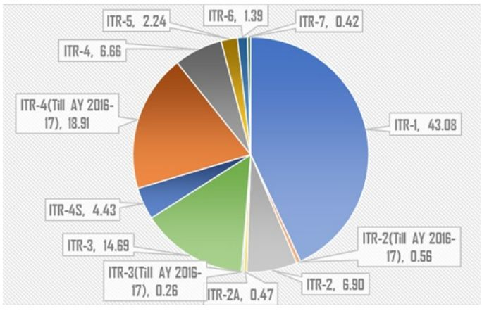
% of ITR Wise receipts of e-return in FY 2017-18
Total 6.74 crores e-return filed during the FY 2017-18 (3.79 crores -4 years ago)
Rs,10 trillion (Rs.10 lakhs crores ) collected as direct taxes last year.

Slide 5
ITR to be filed Online except in certain cases
All the tax returns have to be filed online as was the case last year. However , there are certain exceptions where the return can be filed in paper /physical form
If the individual is of age 80 years or more and
The tax return is furnished using ITR Form-1 (Sahaj) or
ITR Form-4 (Sugam)

Slide 6
NOTIFIED ITR FORMS FOR THE AY 2018-19
ITR 1 SAHAJ
Applicable to | Not applicable to
A resident individual whose total income is less than Rs. 50 lakhs for the assessment year 2018- 19 and includes:- (a) Income from Salary/ Pension (b) Income from One House Property (excluding cases where loss is brought forward) (c) Income from Other Sources (excluding winning from lottery and income from Race Horses, Income taxable under section 115BBDA or Income of the nature referred to in section 115BBE) | 1. Non residents 2.Any Individual who has any of the following : (a) Income from more than 1 house property (b) Income from winnings from lottery or income from Race horses (c) Income taxable u/s 115BBDA (d) Income of the nature referred to in section 115BBE (e) Income under the head “Capital Gains”
Notes:
111BBDA
115BBE

Slide 7
Contd..
Applicable to | Not applicable to
 | (f) Agricultural income in excess of Rs. 5,000 (g) Income from Business or Profession (h) Loss under the head ‘Income from other sources’ (i) Person claiming relief u/s 90 and/or 91 (j) Any resident having any asset (including financial interest in any entity) located outside India or signing authority in any account located outside India (k) Any resident having income from any source outside India

Slide 8
ITR 2
Applicable to | Not applicable to
This Return Form is to be used by an individual or an HUF who is not eligible to file Sahaj ITR-1 and whose income chargeable to income-tax under the head “Profits or gains of business or profession” is in the nature of interest, salary, bonus, commission or remuneration, by whatever name called, due to, or received by him from a partnership firm. | This Return Form should not be used by an individual whose total income for the AY 2017- 18 includes Income from Business or Profession under any proprietorship.

Slide 9
ITR 3
Applicable to | Not Applicable to
This Return Form is to be used by an individual or a HUF who is carrying out a proprietory business or profession. | Other than individual or HUF carrying out business or profession.

Slide 10
ITR 4
Applicable to | Not Applicable to
Individual/ HUF/ Partnership Firm who has:- (a) Business income u/s 44AD and 44AE of the Act (b) Income from Profession taxable u/s 44ADA (c) Salary/ Pension (d) Income from One House Property (excluding cases where loss is brought forward) (e) Income from Other Sources (excluding Winning from Lottery and Income from Race Horses). | Any individual/ HUF/Partnership Firm who has:- (a) Income from more than one house property; or (b) Income from Winnings from lottery or income from Race horses; or (c) Income under the head “Capital Gains”, or (d) Income taxable u/s 115BBDA; or (e) Income of the nature referred to in section 115BBE; or (f) Agricultural income in excess of Rs.5,000; or

Slide 11
Contd..
 | Not Applicable to
 | (g) Income from Speculative Business and other special incomes; or (h) Income from an agency business or income in the nature of commission or brokerage; or (i) Person claiming relief of foreign tax paid u/ss 90, 90A or 91; or (j) Any resident having any asset (including financial interest in any entity) located outside India or signing authority in any account located outside India; or (k) Any resident having income from any source outside India.

Slide 12
Contd..
Note 1: The income computed shall be presumed to have been computed after giving full effect to every loss, allowance, depreciation or deduction under the Income Tax Act.
Note 2: Further, in a case where the income of another person like spouse, minor child, etc. is to be clubbed with the income of the assessee, this Return Form can be used only if the income being clubbed falls into the above income categories.

Slide 13
ITR 5
Applicable to | Not Applicable to
This Form can be used by a person being a firm, LLP, AOP, BOI, artificial juridical person referred to in section 2(31)(vii), persons referred to in section 160(1)(iii) or (iv), cooperative society, registered societies and local authority. | A Person who is required to file the return of income u/s 139(4A) or 139(4B) or 139(4C) or 139(4D) or 139(4F).

Slide 14
ITR 6
Applicable to | Not Applicabl e to
ITR for Companies | Other than a company claiming exemption under section 11
Note: Section 11 – Income from property held for charitable or religious purposes as specified in the Income Tax Act, 1961.

Slide 15
ITR 7
Applicable to | Not Applicabl e to
This Form can be used by persons including companies who are required to furnish return under section 139(4A) or 139(4B) or 139(4C) or 139(4D) or 139(4E) or 139(4F) | Persons required to furnish return under sections other than 139(4A) or 139(4B) or 139(4C) or 139(4D) or 139(4E) or 139(4F).

Slide 16
CHANGES RELATING TO SALARY AND HOUSE PROPERTY INCOME
Applicable to ITRs 1 to 4
Earlier only taxable amount was to be reported, now detailed calculation is required.

Slide 17

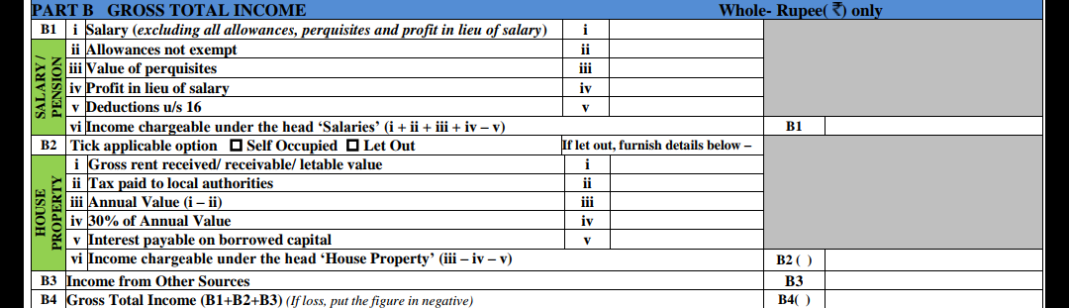
EARLIER
NOW

Slide 18
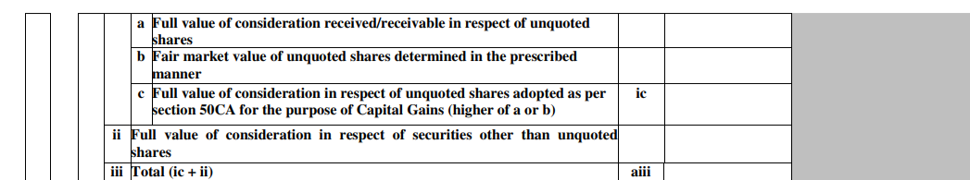
CAPITAL GAINS ON TRANSFER OF UNQUOTED SHARES AND SUMS TAXABLE AS GIFTS
Applicable to ITRs 2,3,5,6 and 7
Capital Gains in case of transfer of unquoted shares-for providing consequential reporting as per amended new section 50CA inserted by Finance Act,2017 new column inserted

Slide 19

Contd..
Reporting of sums taxable as gift-new clause 56(2)(x) as inserted by the Finance Act 2017 is applicable to all assessees
However no separate reporting requirement in ITR 1 and ITR -4

Slide 20
REVISED DEPRECIATION SCHEDULE
Applicable to ITRs 3,5 and 6
Revised depreciation schedule –CBDT vide Income Tax (29th Amendment) Rules,2016, dated 07-11-2016 had restricted the highest rate of depreciation for any block of assets to 40% .i.e. all block of assets which were eligible for depreciation at the rate of 50%,60%,80% or 100% would be eligible for depreciation at the rate of 40%.
Inserted a field for proportionate depreciation in the event of business reorganisation, i.e demerger, amalgamation etc.

Slide 21
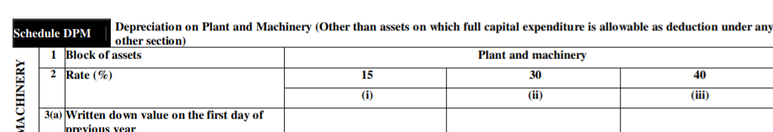
Contd..

Slide 22
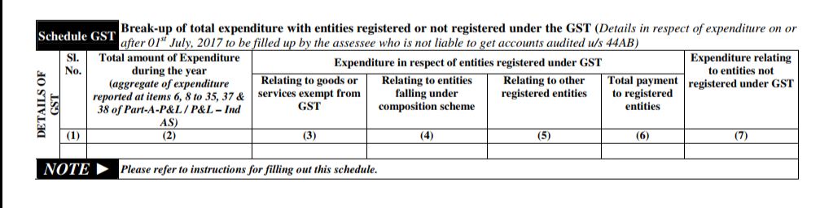
GST IN ITR FORMS
Applicable for ITR Form 6
Detailed analysis to be provided with respect to business transactions with registered and unregistered suppliers under GST

Slide 23
Contd..
Applicable for ITR Forms 3,5,& 6
Schedule PL have been modified to include GST related details;
  Income: GST received or receivable in respect of Goods Sold or supplied (Part A P&L. Point 1C)
  Expenses: GST paid or payable in respect of Goods and services purchased (Part A P&L , Point 7)
  Expenses: GST paid or payable to Government (excluding taxes on income)(Part A P&L ,Point 36)
  Refund of GST not credited to P&L account (Part A-OI, 5)
  Amount of credit outstanding in account in respect of GST (Part A-OI,12)

Slide 24
Contd..
Applicable for ITR Form-4
  Now there is an additional requirement to quote GSTR No. and turnover /gross receipts as per GST return filed. Under schedule BP vide point E9 and E10, GST No. in respect of details of business and profession computed under presumptive basis u/s 44AD(or) 44AE (or) 44 DA-if applicable
  Amount of Turnover/Gross Receipts as per the GST return filed if applicable.
  Turnover includes Taxable, exempted, Zero rated ,Nil rated and Non GST supplies.
  The turnover as mentioned above should match with Gross Receipt to be shown in Schedule BP point no.E1

Slide 25
Contd..
Relevant extract of ITR

Slide 26
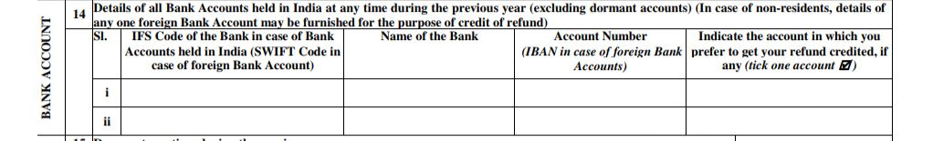
NON RESIDENT AND NEW ITR FORMS
Applicable to ITRs 2 to 7
NRs can now claim refund in a foreign bank account by providing details of foreign bank.
Non-Residents can no more file the simple ITR-1

Slide 27
TRANSFER OF TDS CREDIT
Applicable to ITR Forms 2 to 7
Where an income, which is added to the common pool, has been subjected to TDS, assessee face difficulties in proving their claim for TDS Credit.
There are similar situations, where a person is entitled to claim the credit for tax deducted in the name of another person , i.e ., inheritance, Partners’ TDS deducted in Firm’s PAN and vice versa ., deposits held in Join names and TDS deducted only in First name, etc.

Slide 28
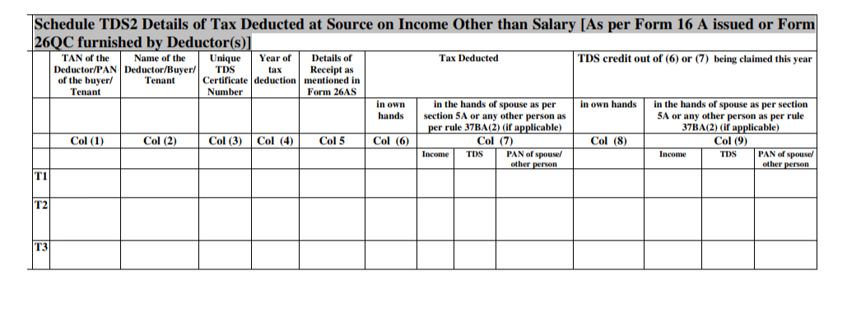
Contd..
Relevant extract of ITR

Slide 29

TDS DEFAULT AND DISALLOWANCE
ITRs 2 , 3 , 5 , 6 and 7
Section 40(a)(ia) disallows 30% of certain expenditure if tax is not deducted in respect of those expenditure in accordance with Chapter XVII-B or if tax is deducted but not deposited on or before the due date for filing of return of income
New column has been inserted in ITR to report such expenses on which TDS deducted but not deposited on or before due date of filing.

Slide 30
FOREIGN CURRENCY DETAILS IN NEW ITR
Applicable only to ITR Form 6
Applicable only to assessee who is not liable to audit u/s 44AB
Details of payment made and sum received in foreign currency towards capital and revenue account.

Slide 31
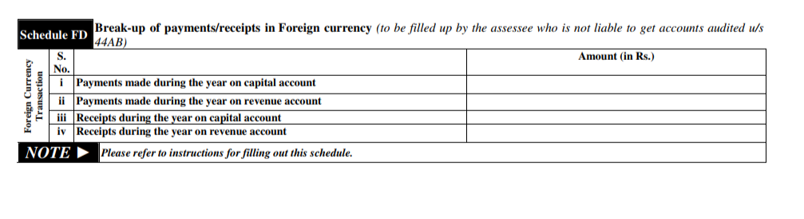
Contd..
Relevant extract of ITR

Slide 32
SPECIAL CHANGES IN ITR 4
Earlier only 4 financial particulars of the business (creditors, debtors ,stock and cash balance) needed to be disclosed
Now whole balance Sheet in condensed form is also required to be furnished.

Slide 33
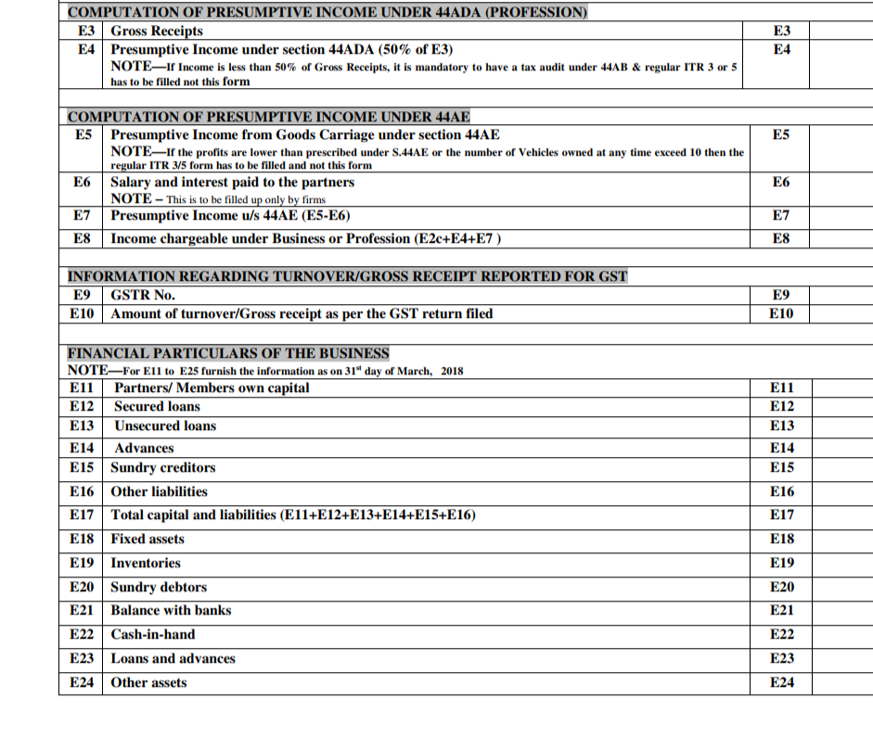
Contd..
Relevant extract of ITR

Slide 34
MISCELLANEOUS CHANGES
Partners cannot use ITR 2, for the AY 2018-19 they shall be required to file in Form ITR 3 only.
Assessee claiming DTAA relief is required to report more details like rate as per treaty, rate and section as per IT Act etc.
Capital gain exemption to be furnished in detail-exemption u/s 54,54B.54EC,54EE,54F,54GB and 115F shall be reported in detail and separately.
Taxability on remission of trading liability in case of ‘Income from other source’ –new ITR forms require separate reporting of such remission or cessation, which is taxable as per Section 59, in Schedule OS
Notes:
54ee

Slide 35
Misc. changes contd..
Details of GST paid and refunded – new ITR forms have introduced new columns to report CGST, SGST, IGST and UTGST paid by, or refunded to, assessee.
Removal of ‘Gender’ from personal information in the ITR 2, 3 and 4.
Declaration required by Political Parties to confirm if cash donations are received[Section 13A] – new ITR 7 requires the political parties to provide a declaration by selecting the ‘Yes’ or ‘No’ check-box to confirm whether it has received any cash donation in excess of Rs. 2,000.
Reporting of CSR appropriations – new column has been inserted in ITR Form 6 to provide details of appropriations made by the companies from the net profit for the CSR activities.

Slide 36
Misc. changes contd..
Details of fresh registration upon change of objects [Section 12A]
A trust will be required to furnish the following details if there is any change in its stated objects
  Date of change in objects
  Whether application for fresh registration has been made within stipulated time period?
  Whether fresh registration has been granted?
  Date of such fresh registration.
A field to claim credit of TDS on rent paid in excess of Rs.50,000 has been inserted in ITR-1

Slide 37
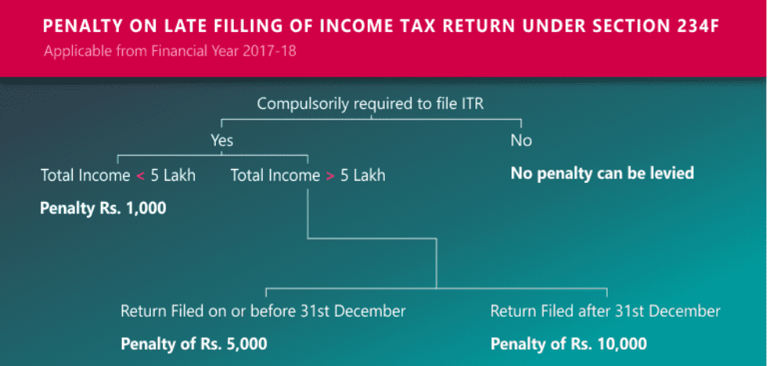
PENALTY U/S 234F
As amended by the Finance Act 2017
Penalty for not filing ITR on or before due date.

Slide 38
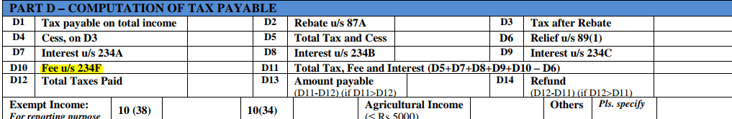
Contd..
Relevant extract of ITR

Slide 39
Contd..
Consequently penalty u/s 271F pertaining to delay in filing the return removed from statute w.e.f AY 2018-19
Penalty for non compliance with the provision of section 44AB remains in the statute.
Details of tax auditor etc. to be furnished in the ROI, wherever applicable.
Delayed filing of ITR in cases where audit report is not filed on time, may entail penalty u/s 271B of the IT Act

Slide 40
CONCLUSION
Return filing exercise is becoming more strenuous and probably now requires the attention of the professional himself or his senior versatile staff. With department slowly doing away with all manual procedures, it is important that the returns are filed with accurate information and correctly. The consequences of a wrong filing may prove to be very heavy. The Department calls it simplification. Is it really so? It leads to a situation where the CA is going to be burdened further. The professionals need to gear up to the ever so many changes. One has to bear in mind that the returns have to be filed with 100% precision. We are reminded of the slogan relating to computers- “GARBAGE IN, GARBAGE OUT”. Technology drives the world and ITD, though late has embraced technology. Lets move forward together.

Slide 41


Slide 42


